Slide 1












Successful K-12 STEM Education
Barbara M. Olds
Directorate for Education and Human Resources
STEM Smart, February 28, 2012, Seattle, WA
Inspiring STEM Learning
Through Discovery and Innovation
Notes:
Good morning and many thanks to the Math and Science Partnership for the kind invitation to be a part of this Learning Network Conference. I commend you for your theme and I cannot overemphasize the importance of effective teaching in STEM.

Slide 2
Workforce Concerns
Many jobs require STEM expertise
U.S. will not have enough qualified STEM-trained workers to fill available jobs
America will not be able to successfully innovate and compete in the global marketplace
Lack of technical expertise jeopardizes national security and national defense
Populace will not have the educational base needed for good decision-making
Successful K-12 STEM Education
2 February 2012

Slide 3
K-12 STEM Concerns
Roughly 65% of U.S. 8th graders are not proficient in mathematics when they complete 8th grade; in science 70% of students are not proficient when they complete 8th grade
U.S. students lag behind the highest performing nations on international assessments
Engineering and Technology (the “E” and “T” in “STEM”) are seldom taught in K-12
There’s been a decreasing emphasis on and time for science education in the elementary years
Successful K-12 STEM Education
3 February 2012

Slide 4
K-12 STEM Concerns
Pre-service and in-service experiences for teachers are seldom coherent and linked to each other
State assessments largely ignore science, and as a result, it is not significantly taught in the elementary years
Many teachers in middle and high schools are teaching “out of field”
Poor mathematics preparation of K-12 students leads to too many students in remedial programs in the first year of college
Incoherent system across the nation’s 14,000 school districts
Successful K-12 STEM Education
4 February 2012

Slide 5
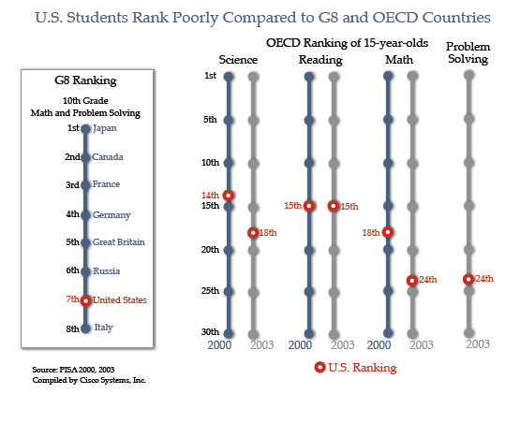
High School Student Rankings
Successful K-12 STEM Education
5 February 2012

Slide 6
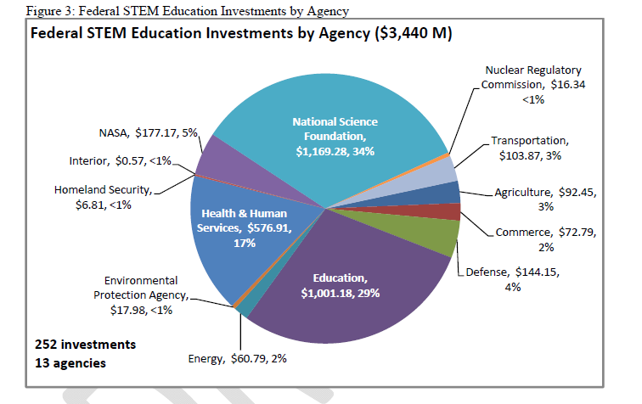
Federal Investment in STEM Education
Successful K-12 STEM Education
6 February 2012

Slide 7
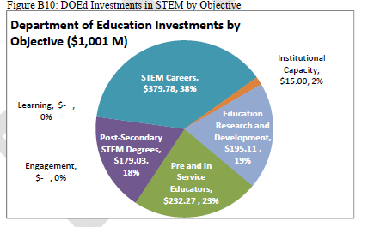
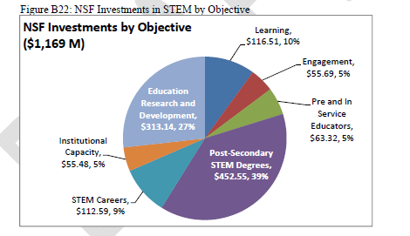
NSF’s STEM Investments Complement the DoEd’s
Successful K-12 STEM Education
7 February 2012

Slide 8
Why NSF as a Leader for K-12 STEM Education?
There is a long history of and a substantial investment on learning in K-12 education
  In addition to EHR projects, there are significant investments in ENG, MPS, CISE and GEO
NSF has close connections with scientists, mathematicians, and engineers
Students need to be engaged and motivated to pursue STEM in the early years—waiting until high school is too late
Successful K-12 STEM Education
8 February 2012

Slide 9
Why NSF?
NSF brings strong connections to higher education (including teacher preparation)
NSF has experience and expertise in diversifying the STEM workforce
NSF has linkages to the informal science education sector, linkages which need to be strengthened to ensure more seamless experiences for students

Slide 10
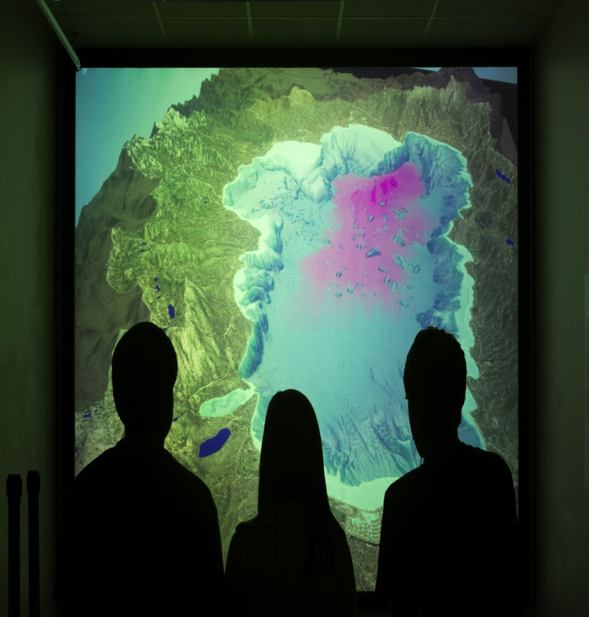

EHR FY 2013
Congressional Budget Request
Total FY 2013: $875.61 million
Change Over FY 2012 Estimate: +5.6% +$46.61 million

Slide 11
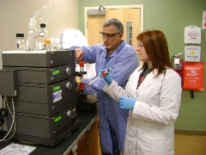
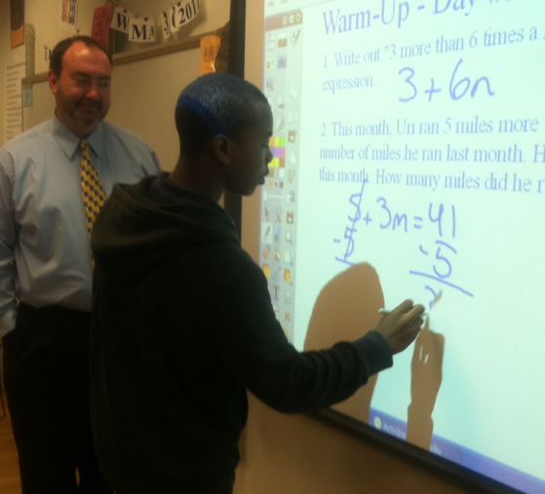
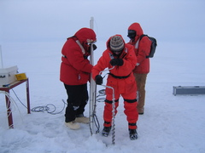
EHR 2013
Research & Development Core
Leadership
Expeditions

Slide 12
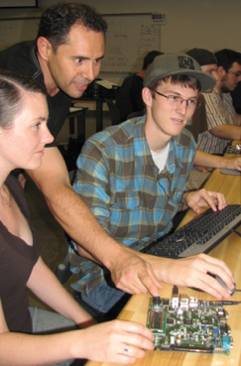
Core Launch
Research & Development Core
STEM Learning
STEM Learning Environments
Broadening Participation and Institutional Capacity in STEM
STEM Professional Workforce Preparation

Slide 13
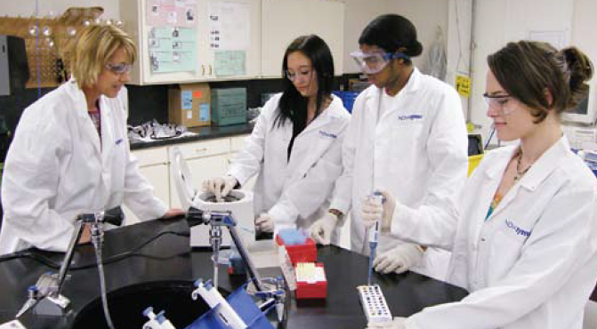
Leadership
Accelerating the development of the next generation of diverse well qualified STEM researchers and educators

Slide 14
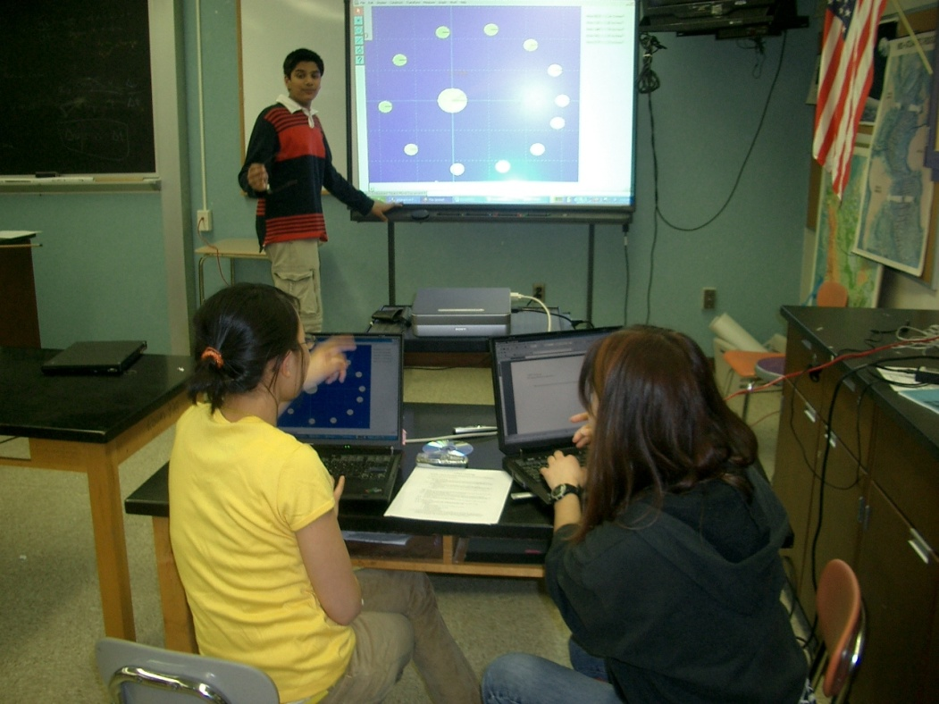
Expeditions
Catalytic and high-return activities that have the potential to transform science and engineering education and create the world-class workforce needed to compete in the twenty-first century: done in partnership, internally and externally.

Slide 15
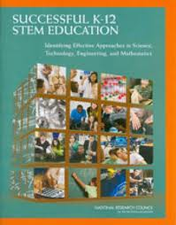
Follow-Up to Successful K-12 STEM Education Report
Regional meetings (here, Reno, Chicago, Baltimore)
NSF-wide “think tank” and GPRA goal
K-16 math initiative and other coordination between NSF and Department of Ed
NRC evaluation plan for measuring report’s recommendations(under discussion)
Successful K-12 STEM Education
15 February 2012

Slide 16
Where We Need Additional Research
Learning progressions
Influence of common core state standards in math and (later) science
Transition points
Role of districts in implementing reforms
Creation of research agenda WITH practitioners (Bryk)
Implementation of reforms
?

Slide 17
Conclusion
"Over the next 10 years, nearly half of all new jobs will require education that goes beyond a high school education. And yet, as many as a quarter of our students aren't even finishing high school. The quality of our math and science education lags behind many other nations. America has fallen to ninth in the proportion of young people with a college degree. And so the question is whether all of us—as citizens, and as parents—are willing to do what's necessary to give every child a chance to succeed."
Source: 2012 State of the Union Address by President Barack Obama
Successful K-12 STEM Education
17 February 2012

