Slide 1











Successful K-12 STEM Education
Joan Ferrini-Mundy
Assistant Director, National Science Foundation
Education and Human Resources
April 10, 2012 Chicago, Illinois

Slide 2
What you already know

Slide 3
About current conditions:
Data on student achievement and teaching capacity is complex and nuanced with some gains in some places for some populations.
Time devoted to teaching science during the elementary and middle school day is falling and lags behind time devoted to language arts and mathematics.
24 x 7 learning (in school and out) is not well understood.

Slide 4
And about achievements.
8th graders continued to show gains in mathematics scores in 2011.
12th graders continued to show gains in mathematics scores between 2007 and 2009.
Most high school teachers in mathematics and science taught in field (2007).
Very young children are capable of learning abstract concepts earlier than we had believed. And our brains remain “plastic” longer, so it is never too early or too late to learn. The question is how?
Notes:
First bullet: Grade 8 in 2011 was up significantly for math between 2003 and 2011 but gains between 2009 and 2011 are very modest (+1) Source: National Center for Education Statistics, The Nation’s Report Card; Mathematics 2011; Trial Urban District Assessment; Results at Grades 4 and 8 December 2011 (http://nces.ed.gov/nationsreportcard/pubs/dst2011/2012452.asp). [NAEP hasn’t released equivalent 2011 data on 12th graders.]
Second bullet: Science and Engineering Indicators: 2012, Chapter 1. Elementary and Secondary Mathematics and Science Education. http://www.nsf.gov/statistics/seind12/c1/c1h.htm
3rd bullet: Science and Engineering Indicators: 2012, Chapter 1. Elementary and Secondary Mathematics and Science Education. http://www.nsf.gov/statistics/seind12/c1/c1h.htm#s3
Note: Students did not show equivalent gains in science.
Sources for data on scores:
Science and Engineering Indicators: 2012, Chapter 1. Elementary and Secondary Mathematics and Science Education. http://www.nsf.gov/statistics/seind12/c1/c1h.htm
Science and Engineering Indicators: 2012, Chapter 1. Elementary and Secondary Mathematics and Science Education. http://www.nsf.gov/statistics/seind12/c1/c1h.htm#s3

Slide 5
What can nsf do?

Slide 6
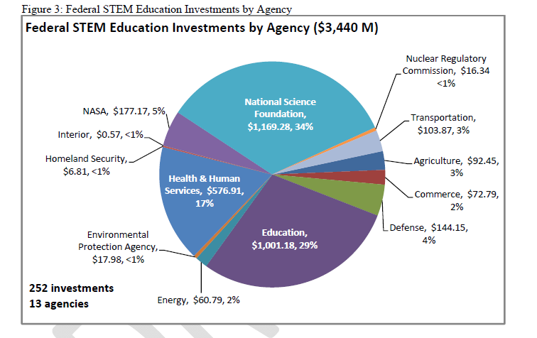
Federal Investment in STEM Education
The Federal Science, Technology, Engineering, and Mathematics (STEM) Education Portfolio, December 2011, p. 10

Slide 7
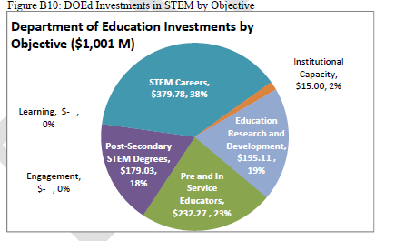
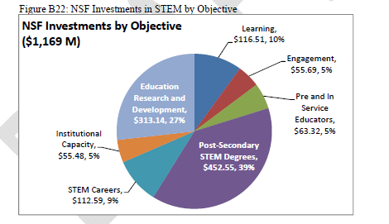
NSF’s STEM Investments Complement the Department of Education’s
The Federal Science, Technology, Engineering, and Mathematics (STEM) Education Portfolio, December 2011, pp. 62, 68.

Slide 8
NSF can:
Call attention to emerging and important areas of research, e.g.:
  Pre-K – 5 year olds
  Learning opportunities outside the classroom
Leverage investments in educational research and learning and development with exciting science investments.
Build partnerships across agencies, sectors, and jurisdictions.
Facilitate sharing and building knowledge with practitioners.

Slide 9
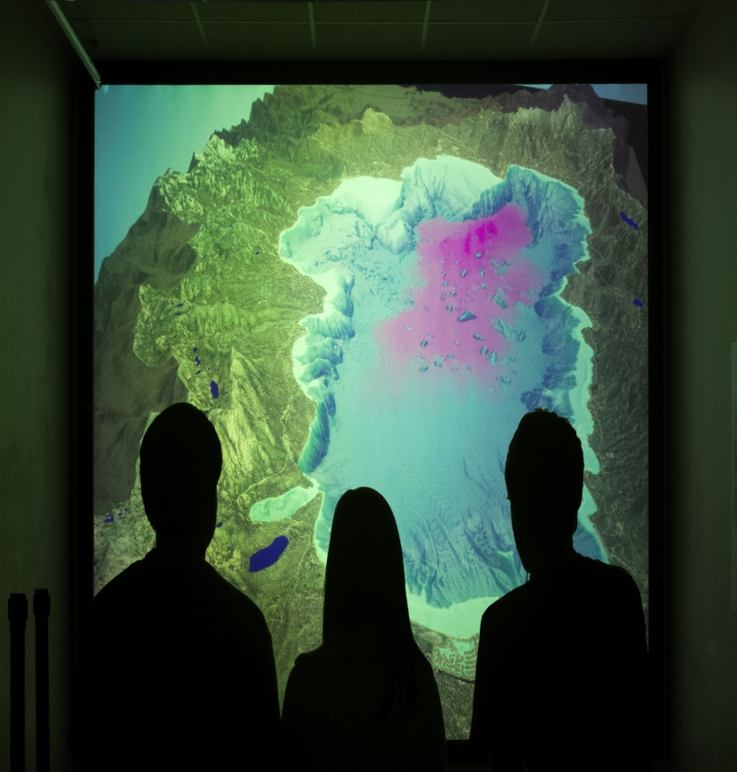
EHR FY 2013
Congressional Budget Request
Total FY 2013: $875.61 million
Change Over FY 2012 Estimate: +5.6% +$46.61 million

Slide 10

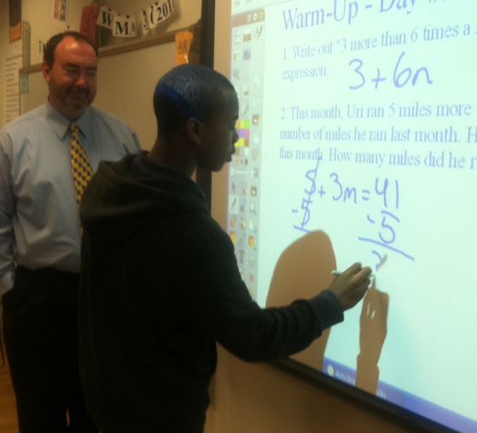
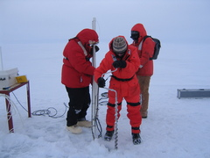
EHR 2013
Research & Development Core
Leadership
Expeditions

Slide 11
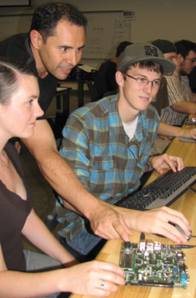
Core Launch
Research & Development Core
STEM Learning
STEM Learning Environments
Broadening Participation and Institutional Capacity in STEM
STEM Professional Workforce Preparation

Slide 12
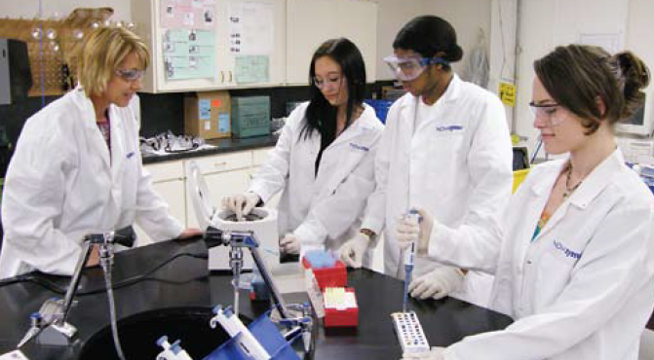
Leadership
Accelerating the development of the next generation of diverse well qualified STEM researchers and educators

Slide 13
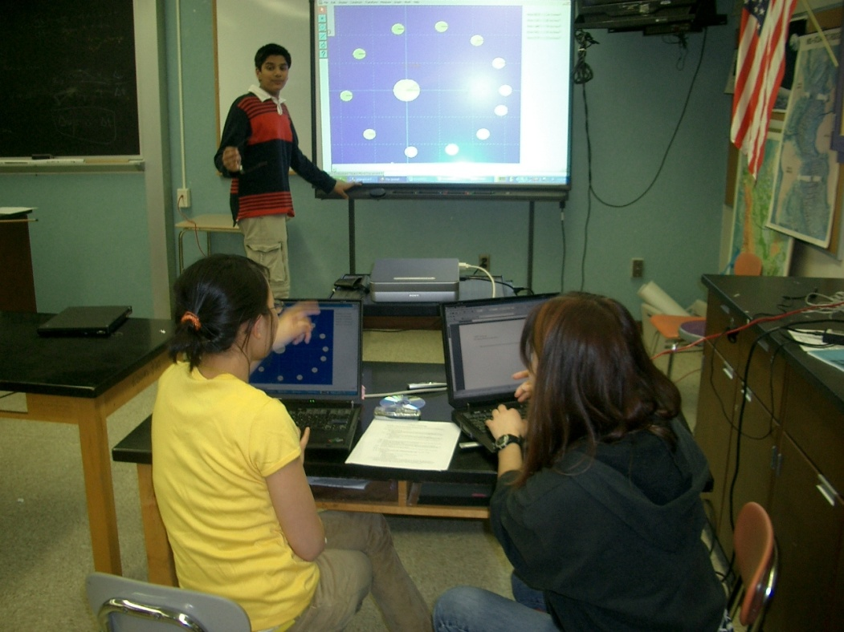
Expeditions
Catalytic and high-return activities that have the potential to transform science and engineering education and create the world-class workforce needed to compete in the twenty-first century: done in partnership, internally and externally.

Slide 14
What are we doing today?

Slide 15
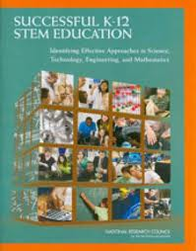
Follow-Up to Successful K-12 STEM Education Report
Organize regional meetings (Seattle, Reno, Chicago, Baltimore)
Establish NSF-wide “think tank” to examine K-12
Launch K-16 math initiative and other coordination between NSF and Department of Ed
Create evaluation framework for measuring report’s recommendations through award to NRC.

Slide 16
Where We Need Additional Research
Learning progressions in science and mathematics
Implementation of common core state standards in mathematics and (later) science
Transition points, Pre-K, elementary-middle, in/outside of school.
Role of districts in implementing improved STEM education
Creation of research and implementation agenda WITH practitioners (Bryk)
?

Slide 17
Many people put this event together.
EDC
  Wayne Harvey, Vice President and Director of Mathematics and Science Programs
  Barbara Berns
  Catherine McCulloch
  Brenda Sanya
University of Chicago
  Jeanne Century
  Marty Gartzman
NSF/EHR
  Janice Earle
  Jim Hamos
  Dennis Schatz
  Darryl Williams
NSF/OLPA
  Bobbie Mixon
  Karen Pierce

Slide 18





Thank You!
Contact Information
Joan Ferrini-Mundy
jferrini@nsf.gov
www.nsf.gov
Keyword: EHR
MSP Learning Network Conference
18 January 24, 2012
Notes:
This is an exciting time in STEM education and I wish you much success and challenge you to help recruit future scientific talent that will help our nation maintain its leadership role in science and engineering.

Slide 19
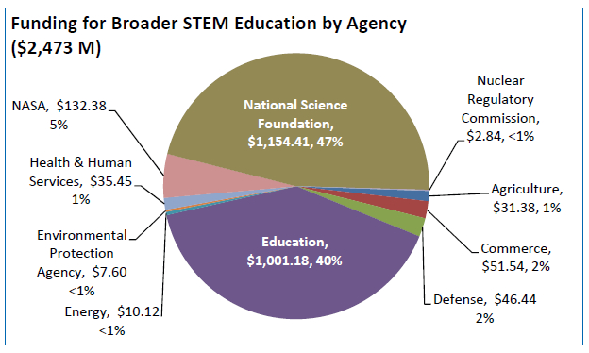
Co-STEM major findings
The Federal Science, Technology, Engineering, and Mathematics (STEM) Education Portfolio, December 2011, p. 12

Slide 20
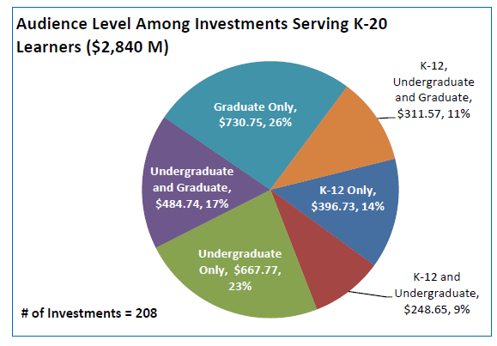
Co-STEM Major Findings
The Federal Science, Technology, Engineering, and Mathematics (STEM) Education Portfolio, December 2011, p. 21

Slide 21
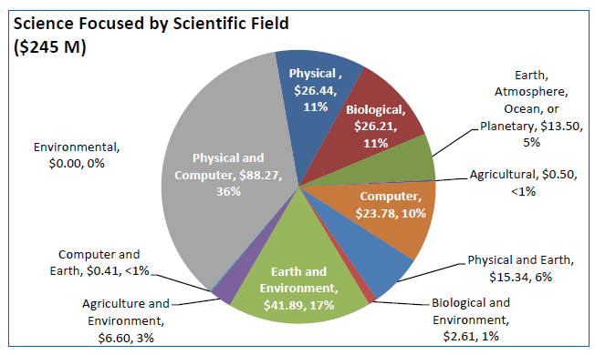
Co-STEM Major Findings
The Federal Science, Technology, Engineering, and Mathematics (STEM) Education Portfolio, December 2011, p. 22

