Slide 1
Engaging STEM Partnerships:
Reinforcing a Foundation for Student Success
Presented by:
Traci J. Buckner, Instructional Leader, National Inventors Hall of Fame School ... Center for Science, Technology, Engineering and Mathematics (STEM) Learning and
Alison L. White, Grant Communications Coordinator, Ohio STEM Learning Network (OSLN) Akron Hub and The University of Akron

Slide 2

School Design Qualities
Family, community
& school partners serve as advocates

Slide 3
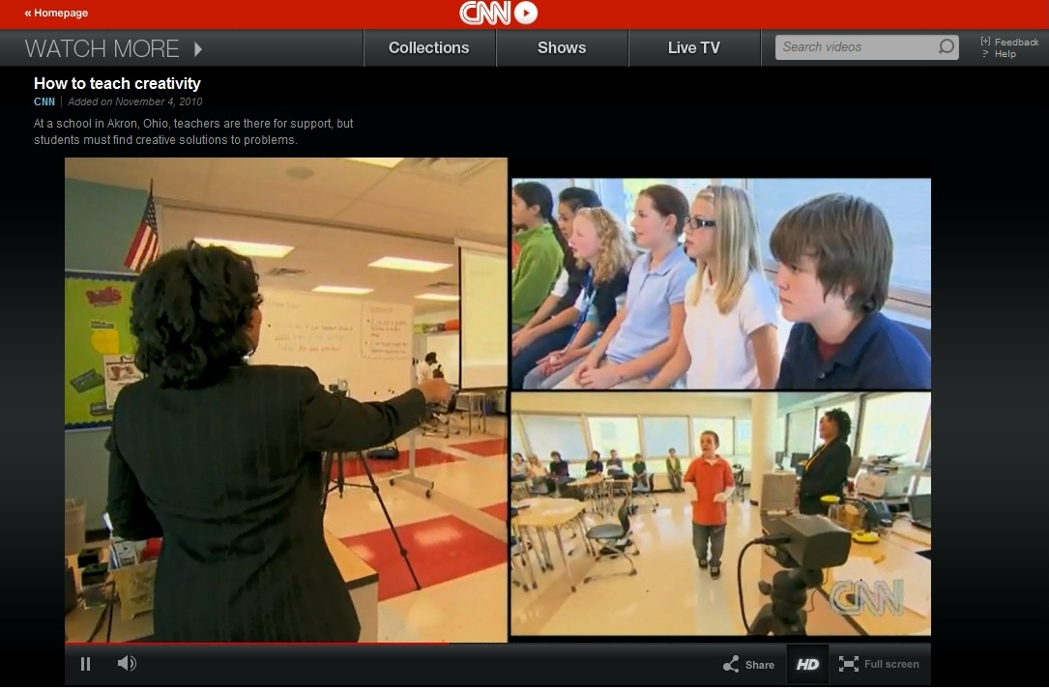
CNN and Problem-Based Learning
Learners worked with Cuyahoga Valley National Park rangers to solve an invasive species problem
The project was featured on Perry’s Principles, an education segment on CNN’s Anderson Cooper 360

Slide 4
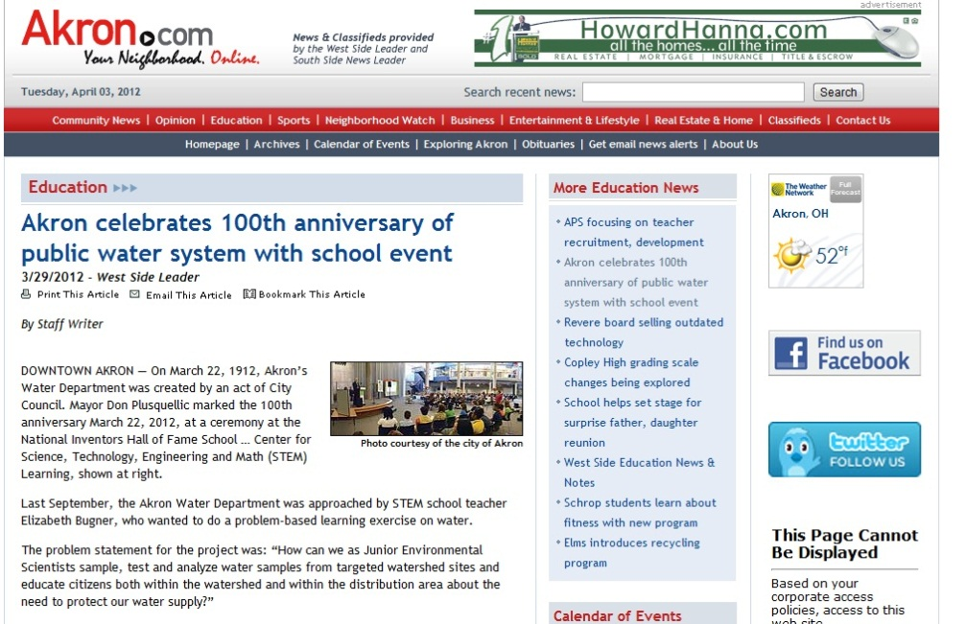
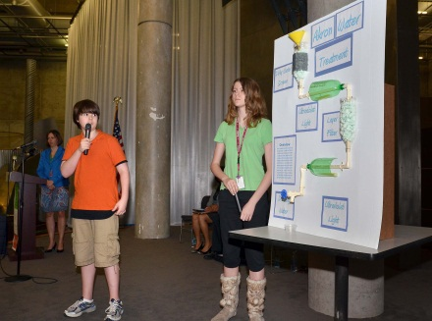
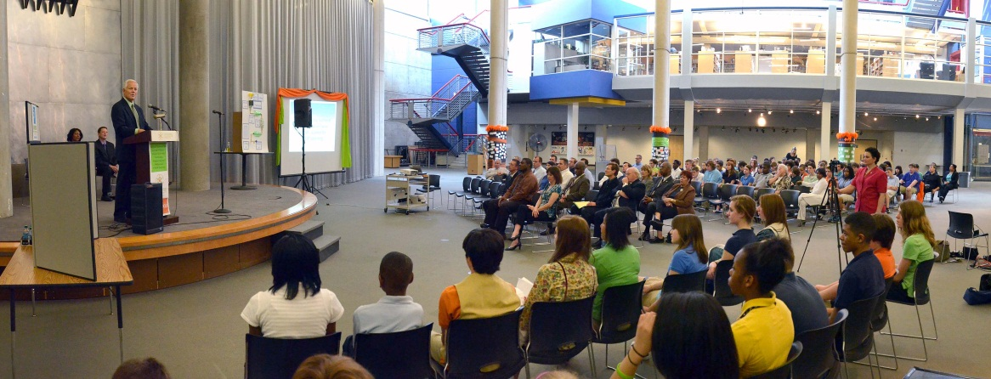
City of Akron Press Conference
Highlighted a water PBL and celebrated the 100th birthday of the water department

Slide 5
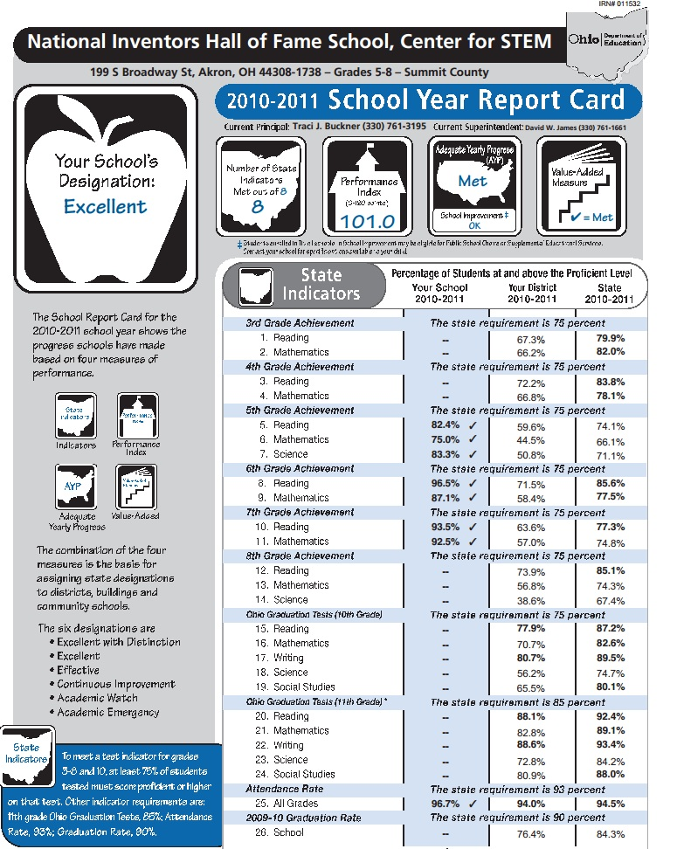
School Report Card
Student success leads to ongoing research studies

Slide 6

The Metiri Group
21st Century Skills

Slide 7
The University of Akron
The University of Akron Evaluation Reports
Ohio Achievement Assessment (OAA) and Student Grade Performance

Slide 8
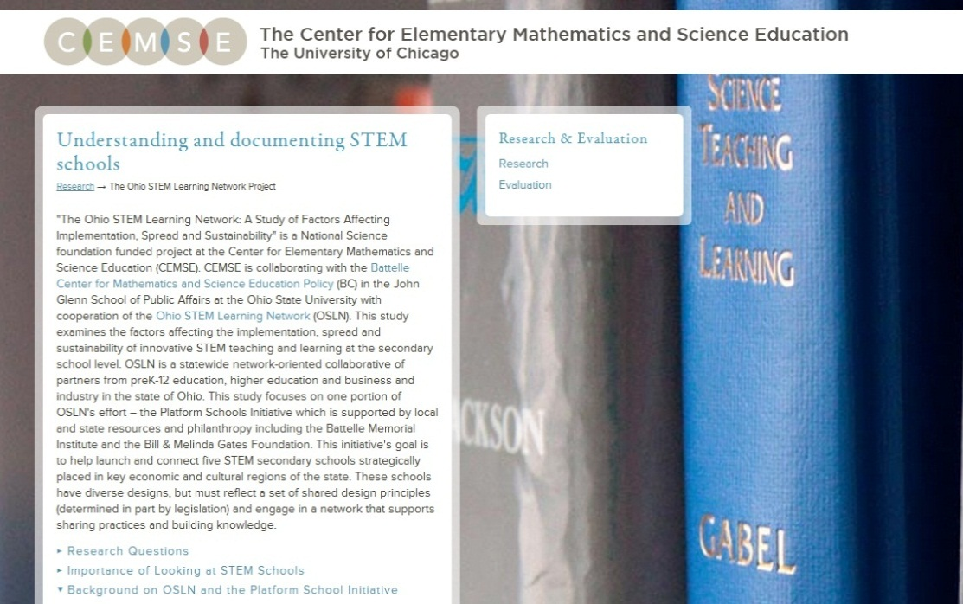
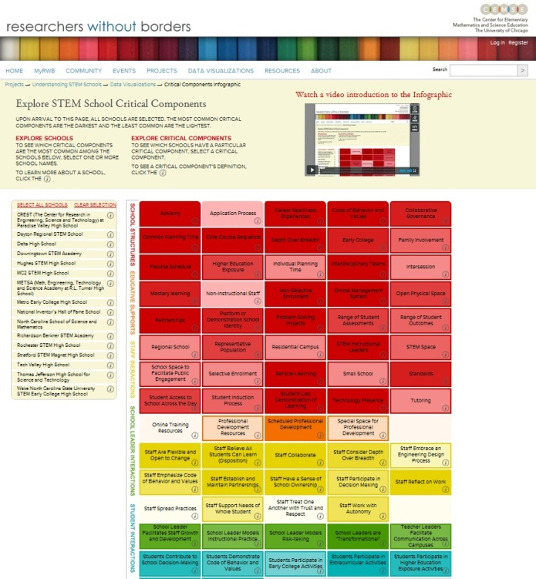
The University of Chicago/CEMSE
Understanding and documenting STEM Schools

Slide 9

Professional Development School
The University of Akron PDS model is implemented at NIHF-STEM School
School staff receives ongoing professional development

Slide 10


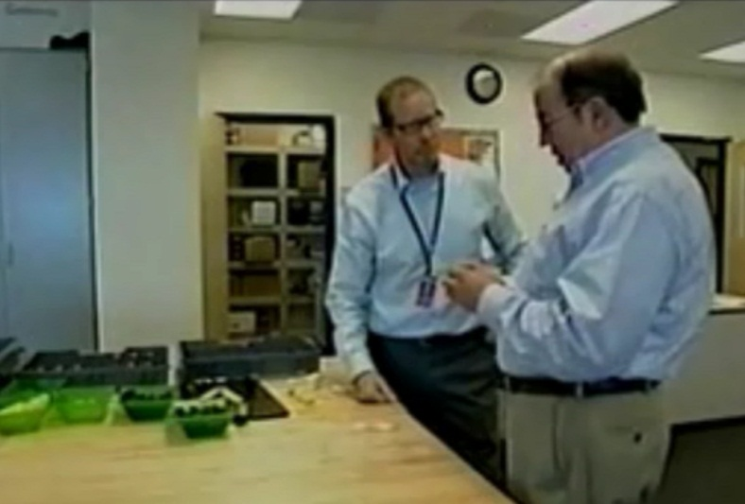
Goodyear Engineer-in-Residence
Supports engineering courses and soap box derby club at NIHF-STEM School
Serves as an advisor and mentor to students

Slide 11

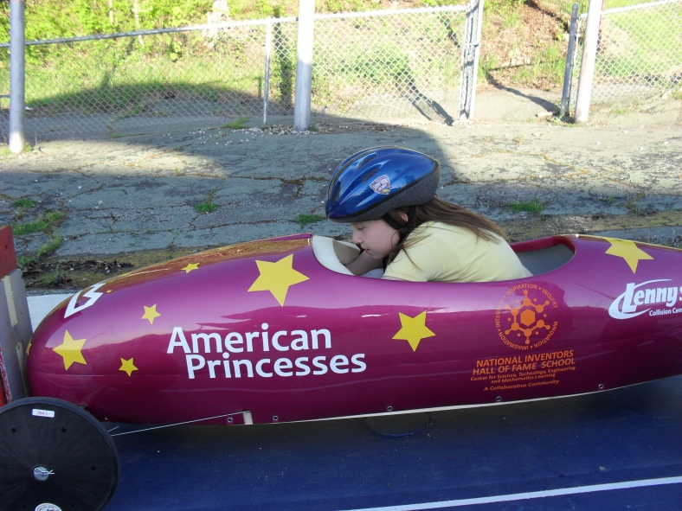
All-American Soap Box Derby

Slide 12
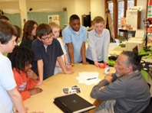
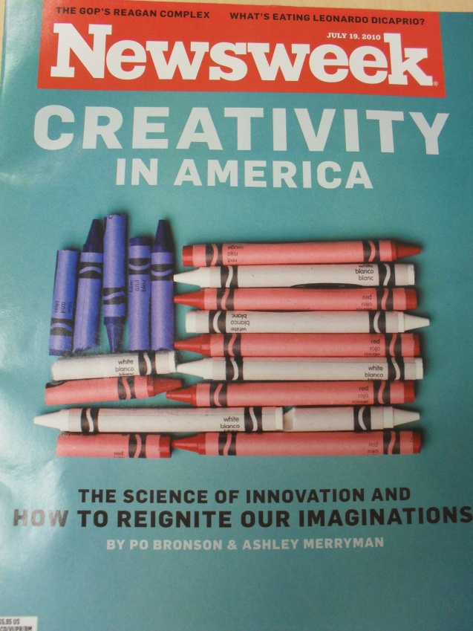
Invent Now – Visiting Inductee Program (VIP)
A problem based learning unit with Inventor Jim West was featured in Newsweek

Slide 13
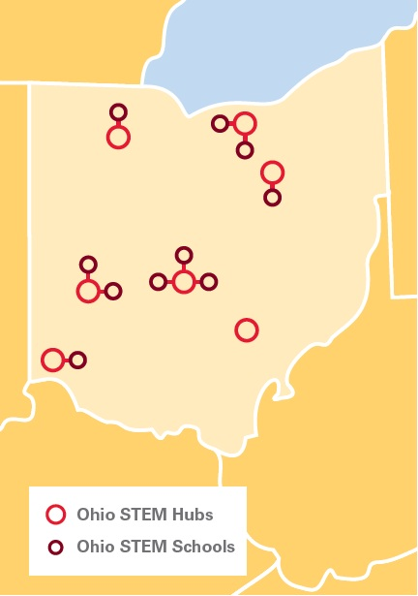
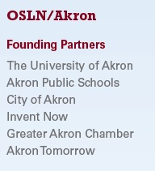
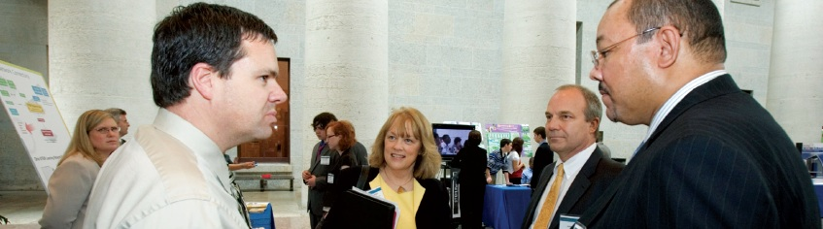
Ohio STEM Learning Network – Akron Hub
Serves a 13-county region by facilitating STEM sharing and networking

Slide 14
Questions or comments?
For more information, visit
http://akronschools.com/scienceschool/ or
http://osln.org/state-stem-landscape/akron-hub/index.php

