Slide 1

Synthesis: How to Promote Coherence and
Equity in STEM Education
Philip Bell
Learning Sciences - College of Education - University of Washington

Slide 2
Grand Challenge
  How can we improve educational outcomes for all youth through STEM? (Janice & Bryce)
Strategy
  Take advantage of the ‘perfect storm’ of STEM
  Leverage our best consensus research accounts of learning throughout our work
  Build capacity for improvement in relation to a coherent implementation of standards
  And attending to persistent educational inequalities in opportunities to learn in STEM

Slide 3
Big Ideas & Opportunities
  Promote learner agency in extended investigations of personal relevance through curriculum and supports for educators (e.g., Promoting Student Voice)
  Leverage the broad interest in and growing maturity of educational technology—to integrate learning technologies with curriculum, assessment, and PD (e.g., SimCalc)
  Include engineering in the science curriculum in more significant ways (Engr is Elem; Framework & NGSS)—interdisciplinary contemporary STEM
    “Science is about knowing. Engineering is about doing” (Petroski)

Slide 4
Thorny Problems & Possibilities
  Lack of instructional time in elementary science
    Seek out efficiencies of coordinating CCSS ELA and Math with Framework / NGSS
    Two Ways Forward: Dial Back Accountability OR Include Science in Accountability
  Equal access to high-quality learning opportunities
  (e.g., learning through disciplinary practices, supporting active knowledge construction, building on prior interest/identities, developmental supports)
    More modest PD supports can lead to impressive learning gains (e.g., SimCalc)
    We need to understand why different schools (or school models) are demonstrating success in broadening participation (culture, organization, development).

Slide 5


National Policy Documents from mid-1990s
1993
1996
Notes:
I’ll emphasize that each of these principles are linked to bodies of research on learning and teaching.

Slide 6

Online: tinyurl.com/ScienceFramework
Notes:
Introduce self
Important things to note:
National Academies
Framework
Guide standards

Slide 7


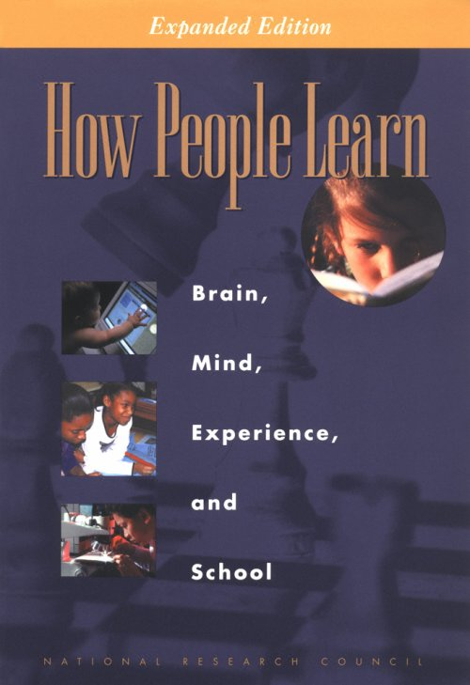


Available:
nap.edu
Notes:
7

Slide 8

Promoting Coherence in a Complex System
Assessments
We need to study the details of implementation through an interventionist mode.
— Design-Based Implementation Research (Penuel, Fishman, Cheng & Sabelli, 2011)
Curricula
Framework
Standards
Instruction
Teacher development
July 2011
December 2012
(anticipated)
Start Working
Now!

Slide 9
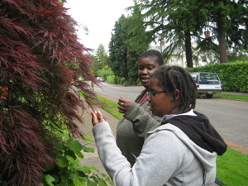
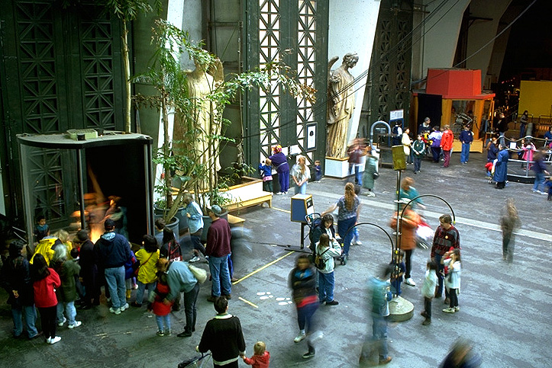
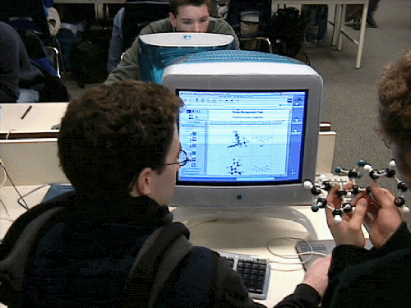
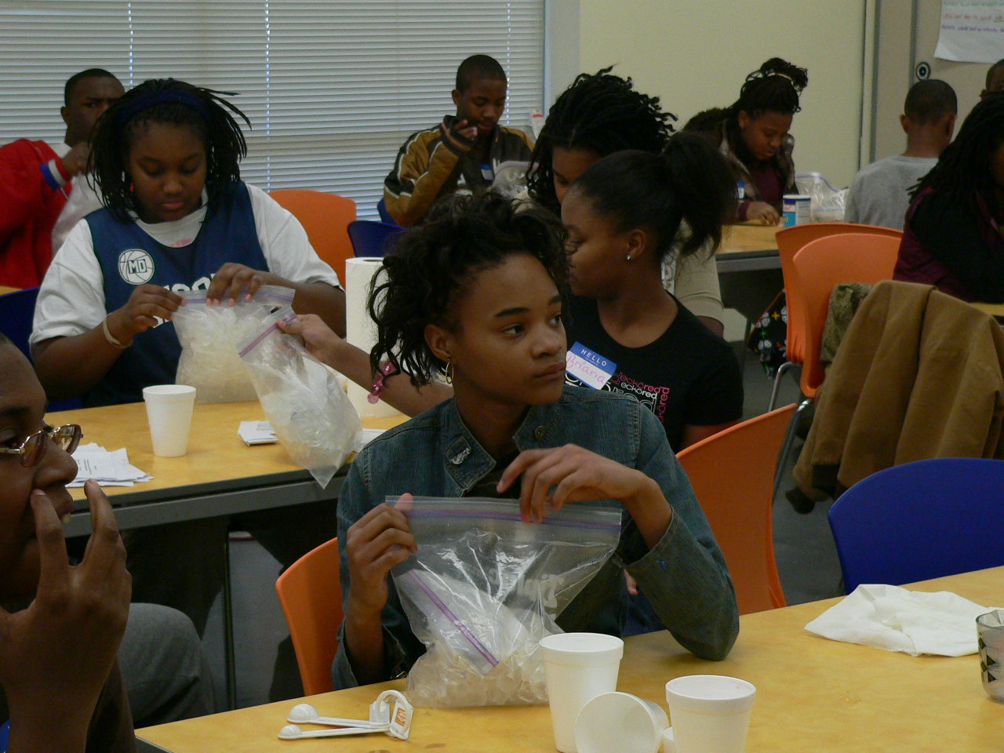
STEM Learning Occurs Across Settings Over Time
R&D Idea: Explore models of cross-setting coordination of learning—to leverage the affordances of environments and explore the potential of seamless learning.
Everyday Settings &
Family Activities
(e.g., Callanan & Oakes, 1992; Crowley &
Galco, 2001; Goodwin, 2007; Bell et al., 2006)
Designed Informal Settings
(e.g., Allen & Gutwill, 2004; Callanan &
Jipson, 2001; Rennie & McLafferty, 2002)
Classroom Instruction
(e.g., Barton, et al., 2003; Davis, 2003; Linn, 2006;
Newton, Driver & Osborne, 1999; Reiser et al., 2004)
Programs for Young & Old
(e.g., Halpern, 2002; Noam, et al., 2003;
Gibson & Chase, 2002)
Notes:
“The committee found abundant evidence that across all venues—everyday experiences, designed settings, and programs—individuals of all ages learn science.” (NRC, 2009)
We organize the discussion into “venues” – these are the places where non-school science learning happens.
What they have in common:
people typically participate of their own volition
the experience itself is highly participant-governed
variably structured, but often group-oriented: can be peers, families, parent/child groups, sometimes school groups
materials – they are rich with natural phenomena and educational materials that facilitate interactivity and engagement
How they differ:
Everyday/family – are not necessarily structured with an explicit educational goal – these are the places in life that occur naturally and vary tremendously in terms of culture/home community and peculiarities of families.
Designed settings – navigated variably/freely and episodically but they are intentionally designed for educational engagement. Not always conceptual – in fact often promoting engagemetn at an emotional/physical/ even visceral level
Programs – these are the most like school. Typically structured with facilitator, curriculum, recurring engagements at regular intervals.

Slide 10
Free PDF of A Framework for K-12 Science Education is available at: http://tinyurl.com/ScienceFramework http://tinyurl.com/ScienceBrief (executive summary)
For Updates on Next Gen Science Standards: http://www.nextgenscience.org/ http://nas.edu/BOSE
Get Involved! Download the Framework.
Review the NGSS in April.

