Slide 1



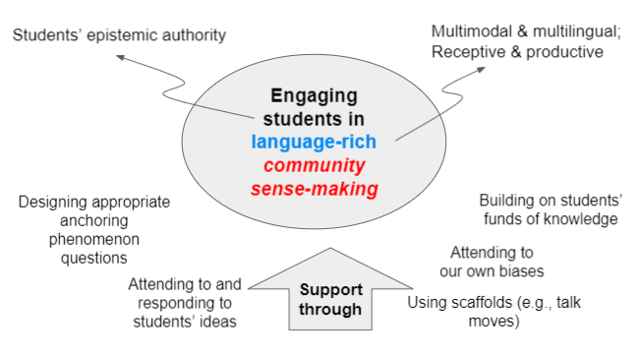
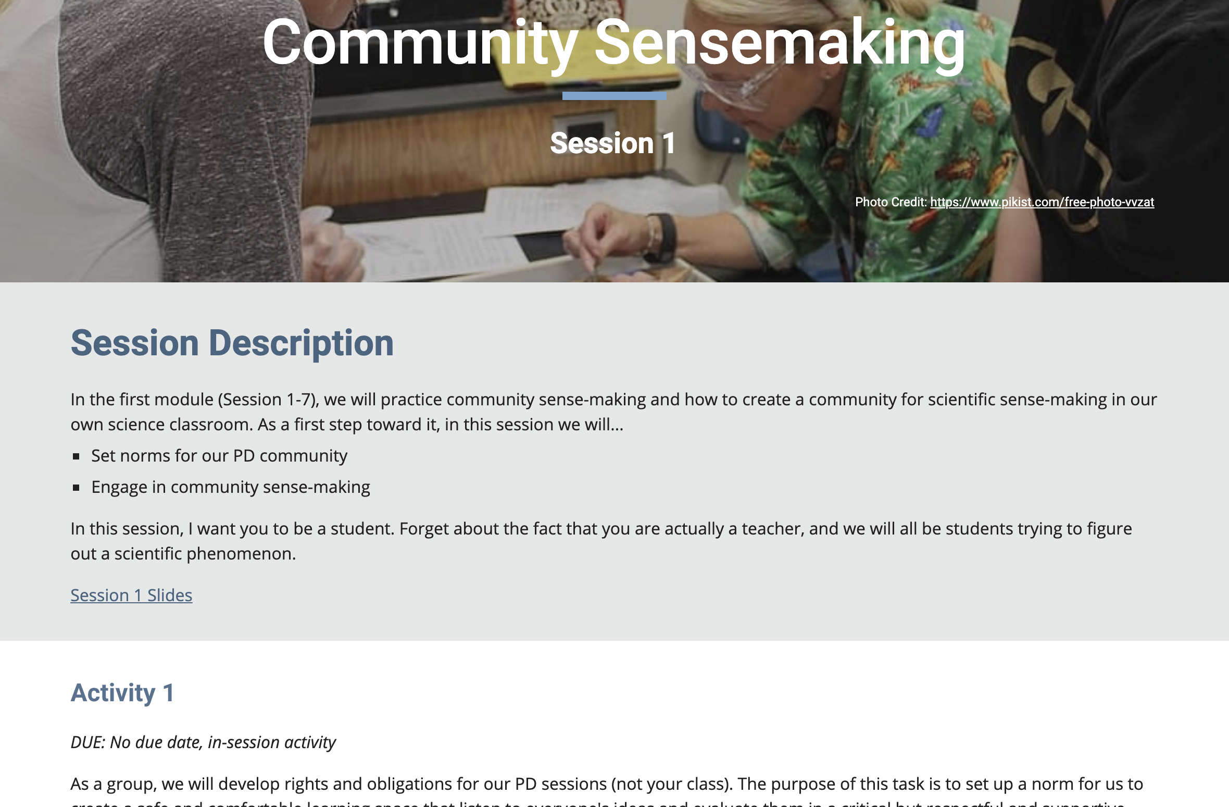
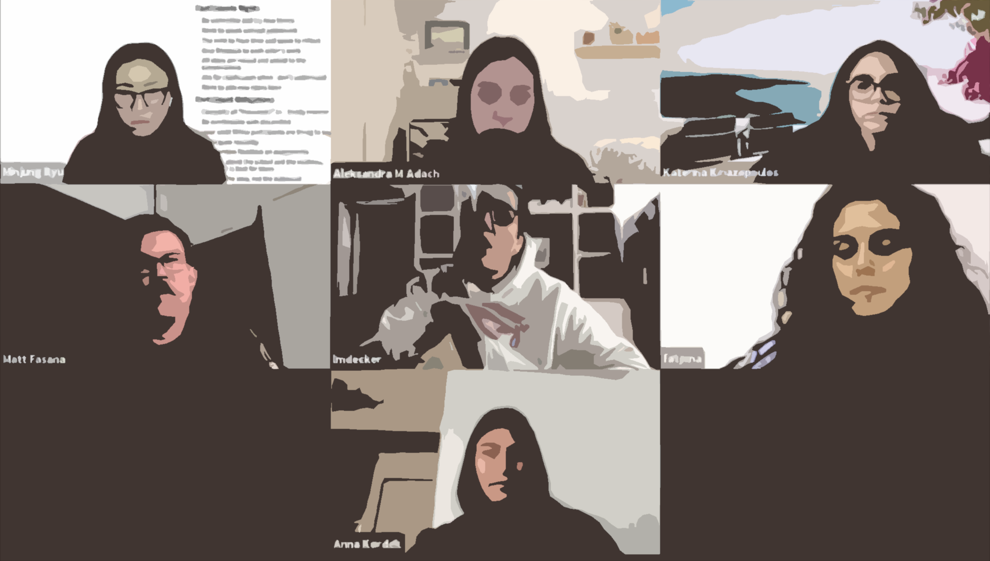
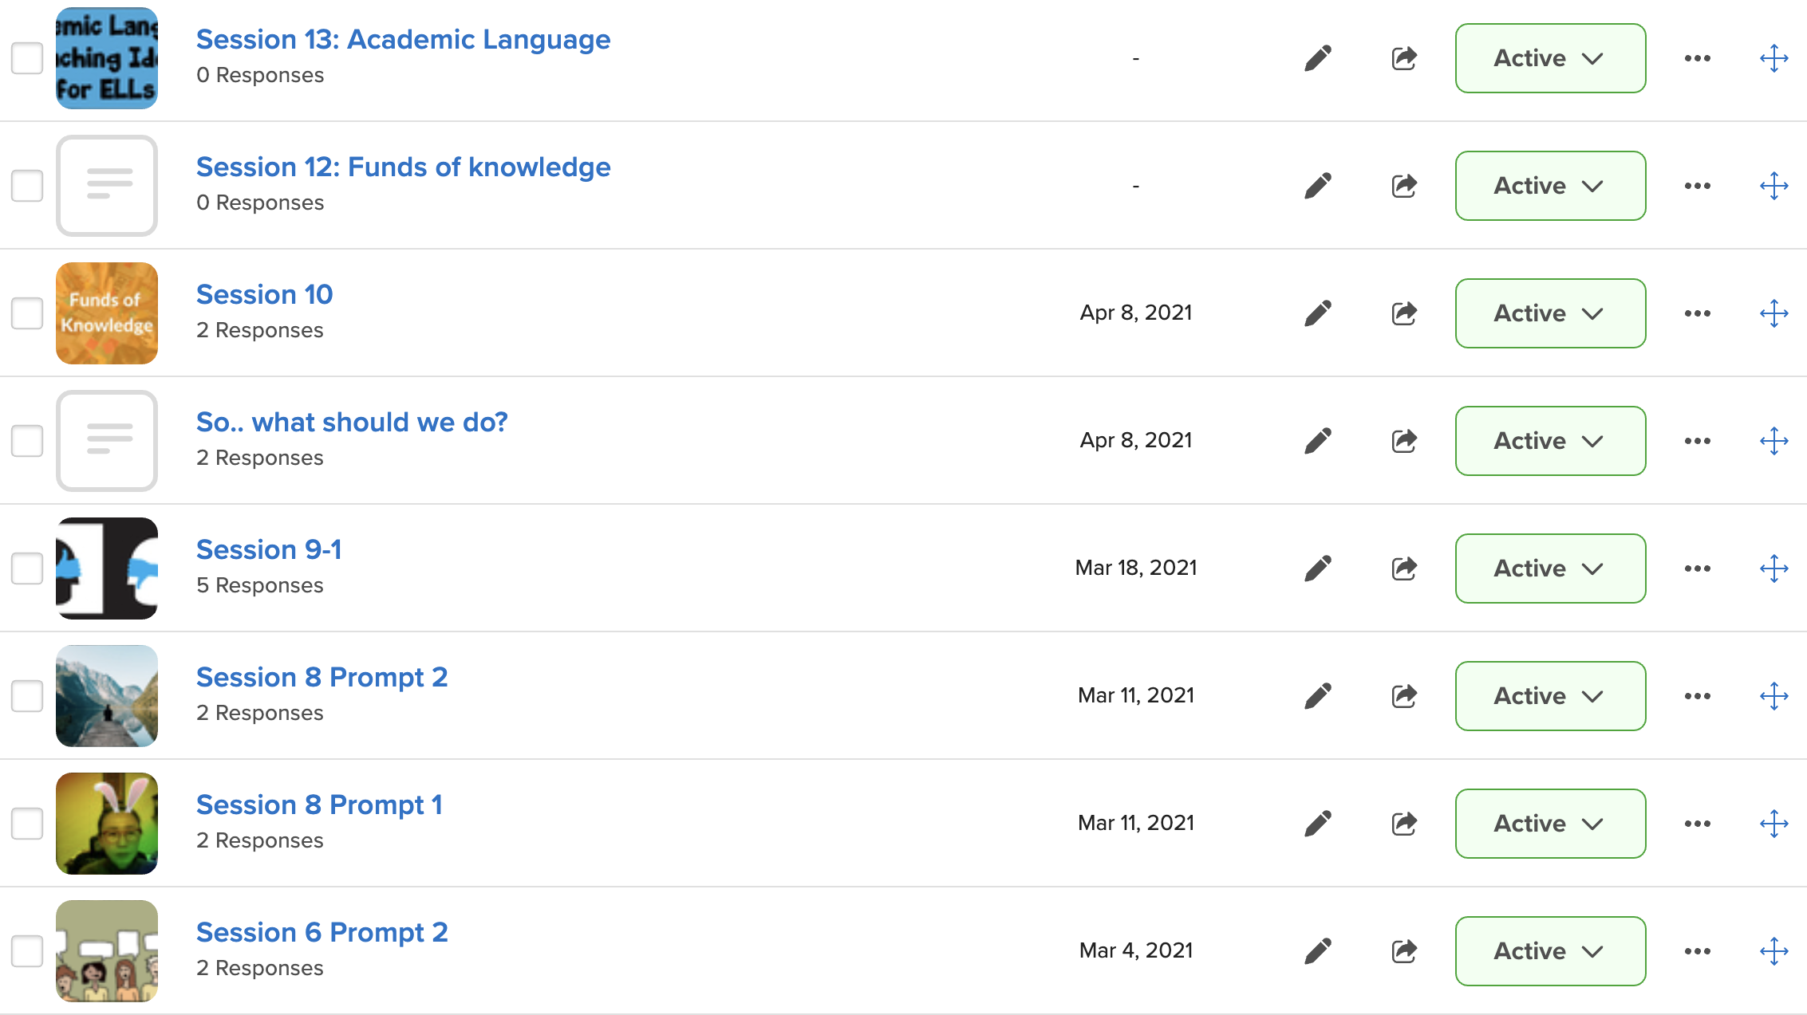
Professional development (PD) for K-12 science teachers in linguistically diverse classrooms LETS Science: Language-Enhanced Teaching in Superdiverse High School Science Classrooms Minjung Ryu, Aleksandra Adach, Roshni Bano (University of Illinois at Chicago) Laura Decker (Chicago Public Schools)
Grant No. 1813937
Context Science PD work in two linguistically superdiverse (~20 different languages) high schools
Research Questions
What are needs of ELLs and science teachers who teach in superdiverse classrooms to ensure all students’ learning? What are resources that ELLs and science teachers can utilize to improve ELLs’ learning in superdiverse contexts? What are key elements of science teaching materials and practices that enhance learning experiences of ELs in superdiverse science classroom settings?
PD Framework
Riverview High School | Hillside High School
Small district; historically White neighborhood | Large urban district; racially and socioeconomically diverse neighborhood
Mostly White teachers; Most with many years of experience | Multilingual teachers; Mostly shorter years of experiences
Stand-alone ESL Dept; SIOP training | No stand-alone ESL Dept.; connections to refugee agencies, adopted NGSS
COVID-19 Modification
Tools for Online PD
    Google Sites (https://sites.google.com/view/lets-science)
    Zoom for synchronous sessions
    Flipgrid for asynchronous sessions
    Qualtrics for informed consent
    Box for teacher journal reflection
Emerging Findings
Complexity of teaching science in superdiverse contexts Accommodation for ELLs may unintentionally single them out, which then discourage them from participation (Manuscript in press) Teachers’ actively draw on their multilingual/multicultural identities in unique ways during teaching and interaction with ELLs. Future Directions Examine how teachers’ multilingual/multicultural identities shape their teaching Design a ”hybrid” Lesson Study model with limited school access (Re COVID-19) Examine students’ experiences and voices
Original Study Design | Modified Study Design
Ethnography to understand current practices | No ethnography
One week summer PD workshop | 16-week hybrid online PD
Lesson Study | ? (TBD)
Google Sites
To communicate weekly plans and share materials and resources
Bi-weekly Zoom Meetings
To synchronously meet and collect meeting video-recordings
Flipgrid
To asynchronously share ideas and reflections and provide an accountability measure for asynchronous sessions
This project is funded by the National Science Foundation, grant # 1813937. Any opinions, findings, and conclusions or recommendations expressed in these materials are those of the author(s) and do not necessarily reflect the views of the National Science Foundation.

