Slide 1

Tool systems for supporting ambitious science teaching
• Tools for diagnostic assessment
• Tools
for classroom discourse
• Tools for construction
of big ideas
Mark Windschitl & Jessica Thompson
Teachers’ Learning Trajectories Initiative
University of Washington
Stamatis Vokos
Diagnoser Tools
Seattle Pacific University

Slide 2
Our purpose today
To start a conversation about the role of tools in supporting ambitious teaching– a conversation that can have a life beyond our session
To explore and critique specific tools developed by our two projects

Slide 3
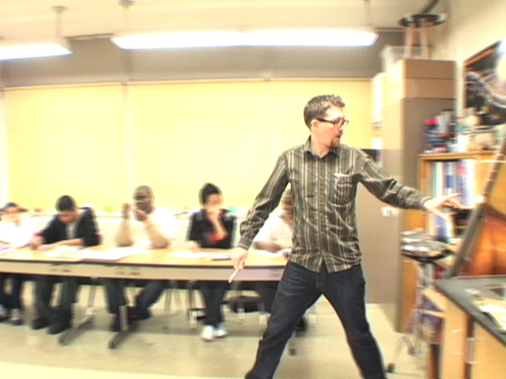
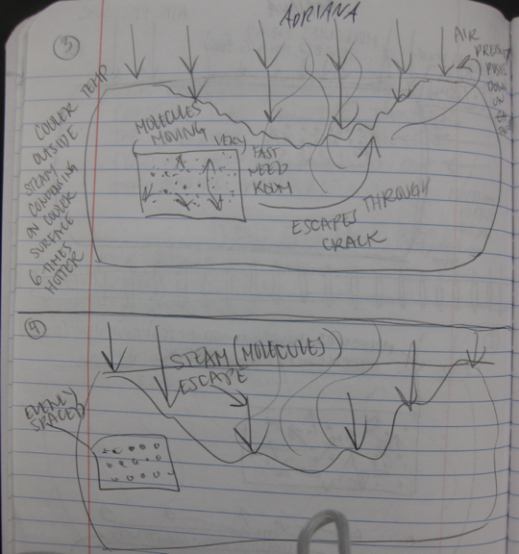
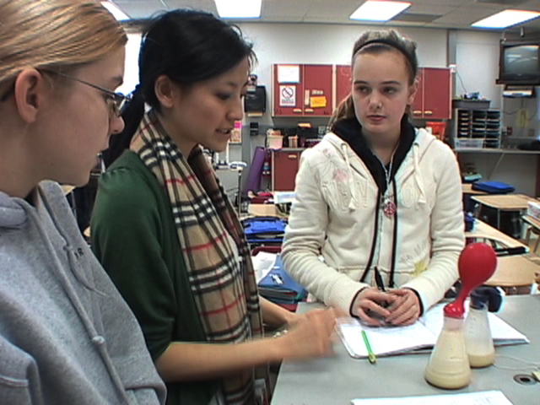
Describing “Ambitious practice”
Aim of instruction:
• Students develop evidence-based causal explanations for puzzling, complex cases involving natural phenomena.
Primacy of building on students’ ideas:
• Teacher elicits and then adapts instruction based on students’ initial conceptions of scientific ideas and their use of everyday language and experiences to reason about these ideas.
Epistemic aims:
• Teacher provides students with readings and activity to support links between observable natural phenomena and unobservable processes, events, or entities.
• Teacher unpacks the nature of good scientific explanations with students, and “what counts” as evidence.
Rich discourse
Teacher scaffolds sense-making discourse among all students in the classroom as a regular feature of instruction. Students build on and critique one another’s ideas.
Role of model-based reasoning:
Teacher asks students to make visible and use tentative models as references before, during and after each inquiry. Students reason about these models using ideas from multiple investigations, readings.

Slide 4
Helping us define categories of tools
What tools are you familiar with for supporting ambitious teacher practice?
What would you like to unpack in this session?
  How tools can influence practices?
  The context of their use?
  Theories that underlie their development?
  Obstacles preventing teachers from using or benefitting from tools
Notes:
If no one contributes ideas about tools we can offer 1) Miriam Sherin’s work on “Noticing”, 2) RTOP 3) Charlotte Danielsen, 4) Instructional rounds 5) Atlas of Scientific Literacy

Slide 5

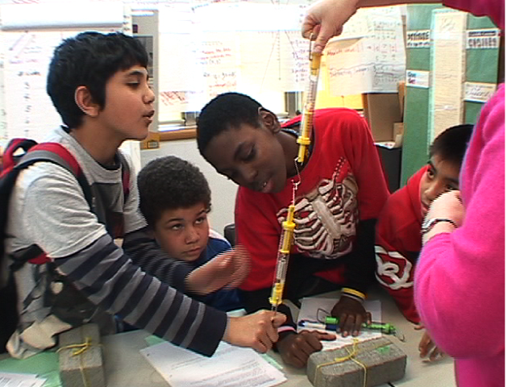
What are we trying to accomplish?
Make elements of expert practice visible¹
Reframe teachers’ visions about important classroom interactions²
Influence student and teacher learning
Tools for
teachers
Support more generative tensions, failures, innovation⁴
Support valued but unfamiliar forms of planning and classroom discourse³
¹ Grossman et al. 2009; Sherin, 2007; Lynch, 1990; Goodwin & Goodwin, 1996.
² Argyris, 1992; Bereiter & Scardemalia, 1993
³ Mercer, 2002; Resnick, Michaels, O’Connor, 2010; Vygotsky & Luria, 1993
Engestrom, 2004
Black, P., & Wiliam, D. (1998a, b).

Slide 6
Discourse tools (UW project)
Back-pocket questions: Observations and patterns
When students break into small groups, circulate among them and consider these questions. Write them on an index card.
“What are you seeing here?” (or similar broad observational question)
Electronic document
Designed to scaffold 3 forms of classroom discourse
Structures their pre-planning, helps them anticipate likely trajectories of dialogue
Students cite relevant features
Students focused on extraneous features of activity
“But what do you notice about ____?” [Direct their attention to salient features of activity]
“Are there some patterns here or differences between groups? What might these patterns tell you?” (Try and hear from everybody in group)
Students mention patterns,
but do not explain the significance
Student about to describe patterns, significance of patterns as “meaning something.”
“So what have we been studying the past few days? What do we already know about ____?, or how ___ happens? How do you think this is related to____?”
So what can we infer from this? Can you hypothesize what might be going on here based on our background reading?

Slide 7



Big Idea tool (UW project)
Electronic sharable, revisable document
Designed to unpack and then focus curriculum “topics”
Big idea= puzzling phenomenon and its underlying explanatory model
Sustains kids’ intellectual effort, raises expectations for their thinking
Puzzling Phenomena
Explanatory model
  There are air molecules inside and outside of the oil tanker. Steam cleaning adds water molecules that move at a high speed and collide with the interior wall. Prior to being sealed, high-energy air molecules are driven out of the tanker. After sealing the tanker, there is no gain or loss of molecules on the inside. The steam and air molecules on the inside lose energy as it cools and there are fewer, less energetic collisions in the interior. Pressure decreases on the inside but pressure on the outside remains the same (14lbs/in²). With less pressure, the tanker collapses until equilibrium is reached.

Slide 8
Sample results from use of our tool system: Comparing two cohorts of beginning teachers
Total # of classroom observations at this level
Big Ideas
Focus on topics or “things” vs. explanatory models
Pressing for explanation
No press for explanation vs. pressing for causal story

Slide 9
Tools to Support an Assessment/Learning Environment
www.diagnoser.com

Slide 10
Web Based Diagnoser Tools
Elicitation Questions
Developmental Lessons
Web Based Questions Sets
Prescriptive Lessons
Facet Cluster

Slide 11
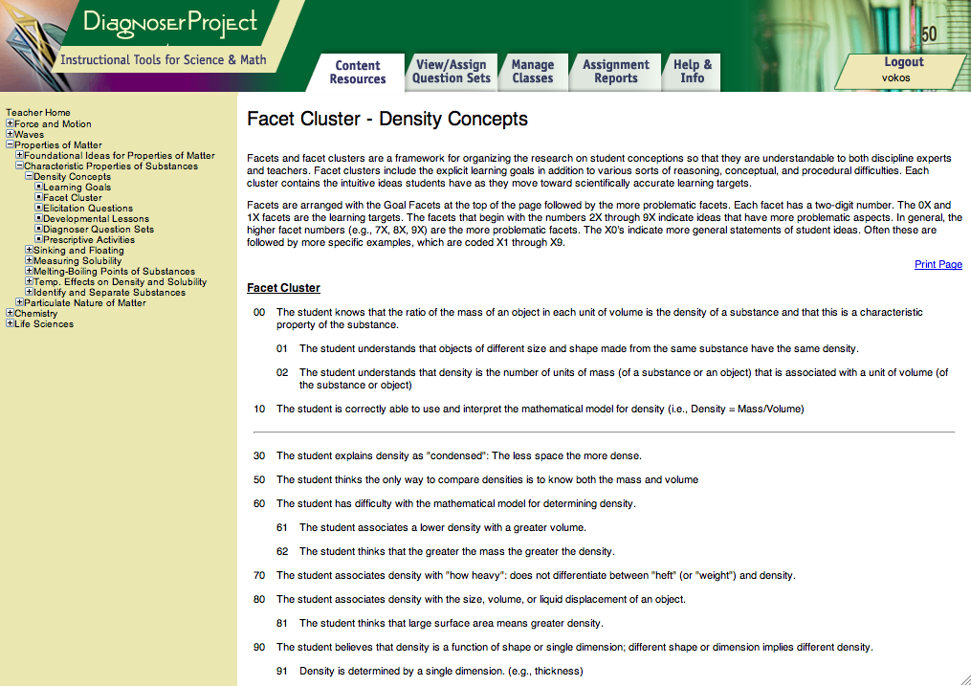

Slide 12
How we’ll proceed
Three stations to visit – can hear more details, context, see them “in action”
Goal is to ask better questions about the development of these tools and any tools designed to support ambitious teaching
Which of the questions from our group conversation do you want to address?

Slide 13
Your thoughts?
Make elements of expert practice visible
Reframe teachers’ visions about important classroom interactions
Influence student and teacher learning
Tools for
teachers
Support more generative tensions, failures, innovation
Support valued but unfamiliar forms of planning and classroom discourse

Slide 14
Back to large group (write on poster paper)
Do these tools connect with other tools you’ve seen?
Do we need tools for certain kinds of teaching that don’t yet exist?
Are there other research agendas in the room that might benefit from these tools?

