Slide 1
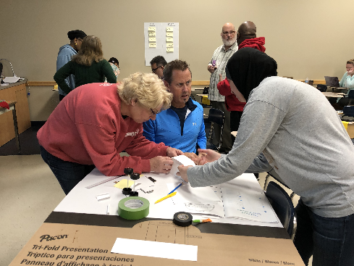
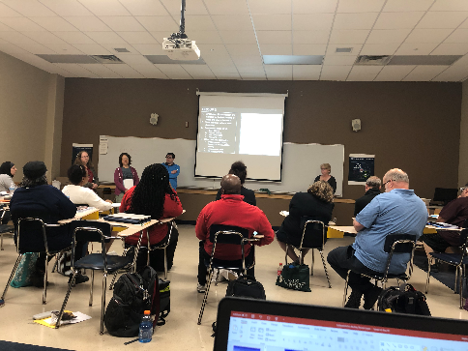
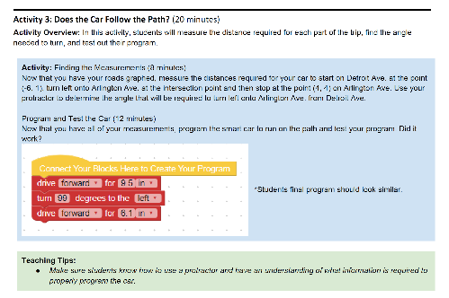
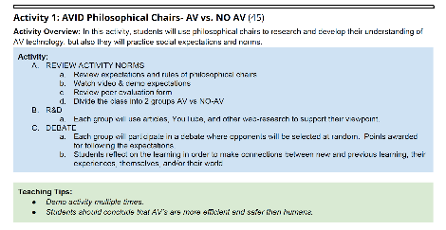
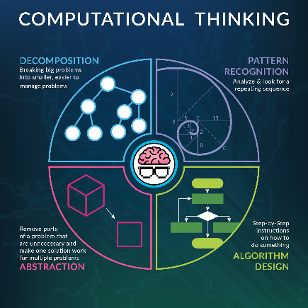
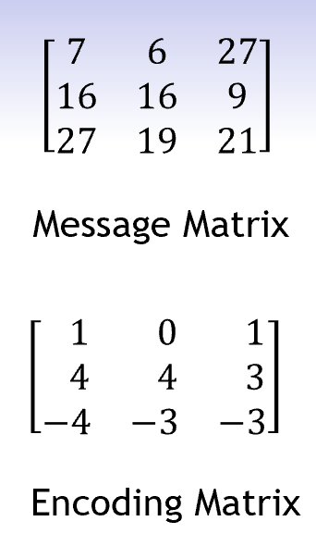
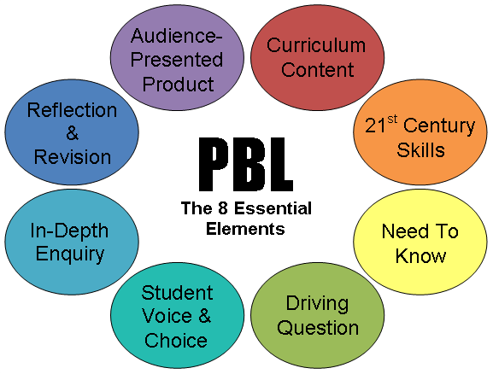
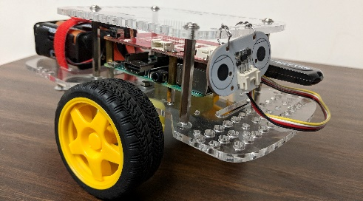
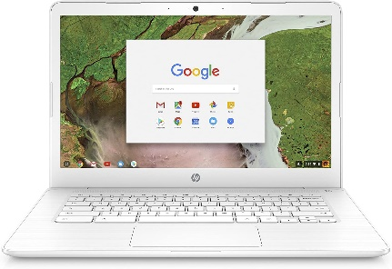
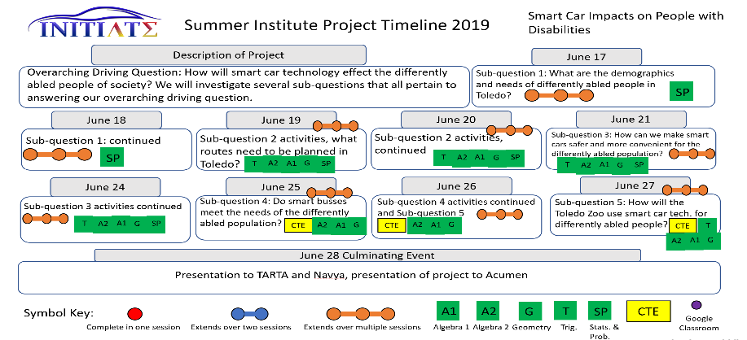
Overview of the INITIATE Project – PBL and GoPiGo
Akshay Mathur, Dr T. Ponnaiyan, Dr T Shockey, Dr J Oluoch, Dr A Javaid, Dr C Czerniak
INTRODUCTION
ACTIVITIES DESIGNED
INSIGHTS
Self-driving cars are powered by computers through artificial intelligence, powerful processors, sensors, and cameras.
However, one of the greatest challenges is preventing them from being hacked and making them accident free.
Addressing the issue by encouraging teaching and learning STEM disciplines along with Computational Thinking (CT) using smart cars, especially Mathematics.
INITIATE’s goal is to improve academic achievement and improve mathematical and CT skills among high school students through Project-Based Learning (PBL) and a programmable smart car prototype (GoPiGo).
In-Person Session Activities:
Activity designed to find the quickest route and program GoPiGo to traverse the routes R1 and R2.
Impact on Teachers:
During the Summer Institute teachers seemed engaged and brainstormed during the activities.
Lesson Plans created by teachers had all essentials of PBL and CT.
Online Session Activities:
Activity designed to encrypt and decrypt a keyword using matrices.
Teachers Engagement during Summer Institute
Mathematics and CTE Teachers’ Lesson Plans
Impact on Students:
Teacher’s lesson plan observations suggested that students were more engaged and learnt the concepts better.
Essentials of PBL
Teachers implemented their lesson plans during the academic year in a planned timeline.
Components of Computational Thinking
FUTURE WORK
Collect students progress over the years to track progress.
Utilize newer smart car prototypes and formulate new solutions to existing problems.
GoPiGo Smart Car Prototype
Chromebook for GoPiGo

