Slide 1
Calipers II: Using Simulations to Assess Complex Science Learning
Diagnostic Assessments Panel
DRK-12 PI Meeting - Dec 1–3, 2010
Mike Timms, WestEd
This material is based upon work supported in part by the National Science Foundation (DRL 0733345)
Any opinions, findings, and conclusions or recommendations expressed in this material
are those of the author(s) and do not necessarily reflect the views of the National Science Foundation
Notes:
**Have assessment demos open and ready to use**
Welcome,
Introductions
Agenda,
Goals:
Inferences from results
Input on analysis
input on future directions based on results and state perspectives
Input on report designs, formative uses of assessment, and quality of new development
Additional ideas, directions for future work
Tufte, E. (2003) Power Point is Evil. Wired Magazine Online,
http://www.wired.com/wired/archive/11.09/ppt2_pr.html

Slide 2
Calipers II Research
Builds on research base, current and prior work
  Model-based learning and assessment
  Evidence-centered design
  Cognitive science
  Part of the SimScientists portfolio of projects
Investigating feasibility, utility, and technical quality
  Formative uses of assessment
  Simulations for assessment
  Technology-based assessments in classrooms

Slide 3
Development
Simulation-based assessments for middle and high school
  Life science: Ecosystems, Climate, Human body systems
  Physical science: Force & Motion, Atoms & Molecules
  Earth science: Climate, Plate tectonics
  Formative and summative uses of assessments
  Integrated understanding of complex systems
  Investigation, communication, and collaboration
Learning management system
  Assigning assessments, scoring, and reporting

Slide 4
Curriculum-embedded Assessment
Formative Features
During instruction
Process used by teachers and students
Provides immediate, individualized feedback
Adjusts ongoing teaching
  Graduated coaching during simulations
  Grouping recommendations for reflection activities
  Differentiated reflection activity tasks and teacher guidance for them

Slide 5
Target Model for Ecosystems
Model Level | Descriptions | Content Targets | Inquiry Targets
Component | What are the components of the system and their rules of behavior? | Every ecosystem has a similar pattern of organization with respect to the roles (producers, consumers, and decomposers) that organisms play in the movement of energy and matter through the system. | Identify and use scientific principles to distinguish among components.
Interaction | How do the the individual components interact? | Matter and energy flow through the ecosystem as individual organisms participate in feeding relationships within an ecosystem. | Predict, observe, and describe interactions among components.
Emergent | What is the overall behavior or property of the system that results from many interactions following specific rules? | Interactions among organisms and among organisms and the ecosystem’s nonliving features cause the populations of the different organisms to change over time. | Predict, observe, and investigate changes to a system. Explain changes using knowledge about the interactions among components.
Notes:
Combining model-based learning and evidence-centered design

Slide 6
Assessment Suite
Embedded in Classroom Instruction
Embedded Formative Assessments and Reflection Activities (2 or 3)
Online module with feedback and coaching
Progress Report
Follow up Classroom Reflection Activity
Benchmark Summative Unit Assessments
Online assessment without feedback
Teacher scores constructed responses
Bayes Net
Proficiency Report

Slide 7
Assessment Demonstrations

Slide 8
Assessment Suite
Embedded in Classroom Instruction
Embedded Formative Assessments and Reflection Activities (2 or 3)
1
Online module with feedback and coaching
Progress Report
Follow up Classroom Reflection Activity
Benchmark Summative Unit Assessments
Online assessment without feedback
Teacher scores constructed responses
Bayes Net
Proficiency Report
Notes:
There is diagnostic assessment going on in three parts of the assessment suite:
1. In the coaching during the formative assessment

Slide 9
Example of a Rule-based Method - A Decision Tree for Diagnosing Student Misconceptions in the SimScientists Ecosystems Embedded Assessment
Error class represents common misconception

Slide 10
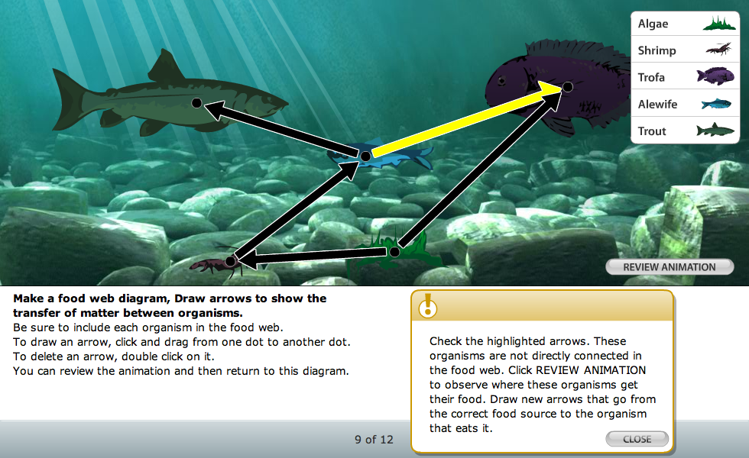
Example of Coaching
Notes:
Play animation:
Students should have been introduced to producers and consumers.
We ask them to observe feeding interactions among organisms, identify the producers and consumers, then draw food web and describe energy flow through ecosystem.
Three levels of feedback and coaching, including worked examples as recommended in the NRC report, Taking Science to School (Duschl et al.)

Slide 11
Assessment Suite
Embedded in Classroom Instruction
Embedded Formative Assessments and Reflection Activities (2 or 3)
1
2
Online module with feedback and coaching
Progress Report
Follow up Classroom Reflection Activity
Benchmark Summative Unit Assessments
Online assessment without feedback
Teacher scores constructed responses
Bayes Net
Proficiency Report
Notes:
There is diagnostic assessment going on in three parts of the assessment suite:
In the coaching during the formative assessment
In selecting students for follow up differentiated activities

Slide 12
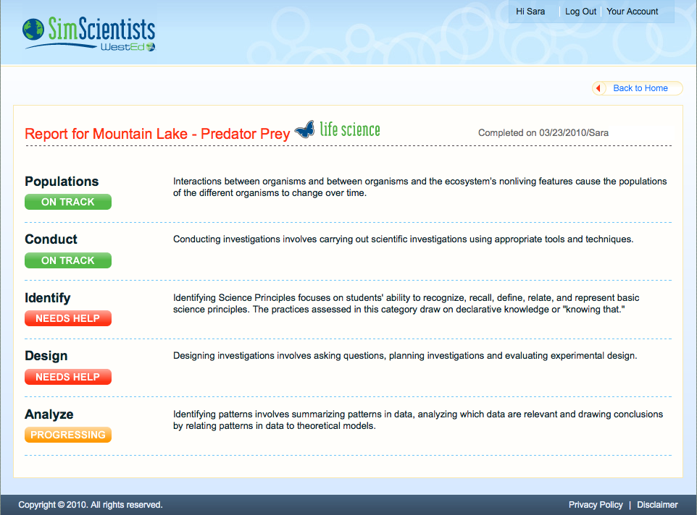
Embedded Report to Student

Slide 13
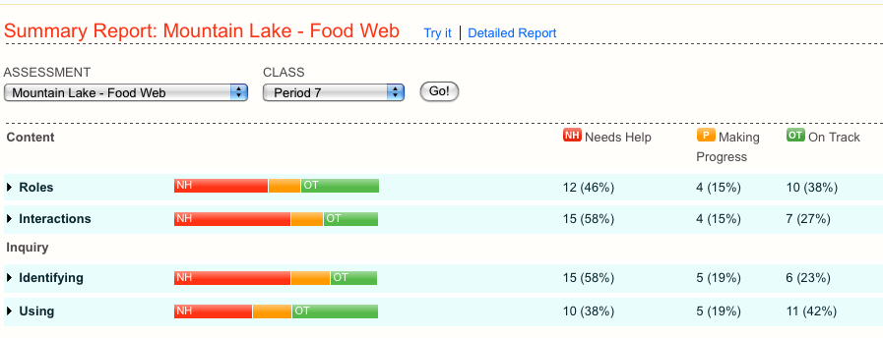
Embedded Report: Class Summary
NH = needs help P = making progress OT = on track
Notes:
After students complete the embedded assessment, teacher retrieves a summary report that provides a snapshot of the state of the class on the various content and inquiry targets.

Slide 14
Calculations
All based on average of tries variable across items.
Calculate Averages separately for Roles and Interactions first, then apply rule:
if Roles <2 AND Interactions <2, then Group A
Else if Roles <2 then Group B
Else C.

Slide 15
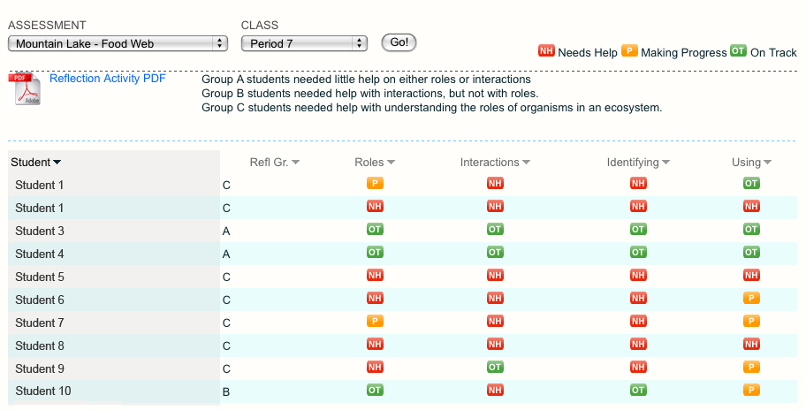
Embedded Report: Student Details
Notes:
The detailed report provides a progress report for individual students or teams of students, and recommendations for placing them into one of three teams for the classroom reflection activity. Teachers should use their own judgment in the actual grouping based upon their knowledge of classroom dynamics and personality interactions.

Slide 16
Classroom Reflection Activity
Formative use of assessment results
  Students assigned to teams based on embedded results
Transfer to different, more complex system
Jigsaw structure
  Allows differentiated instruction via tasks of varying difficulty
  Promotes small and large group discourse and collaboration
Guidance to teacher
  Teacher review of key points in simulation
  What to look for during group work and questions to pose in response
  Presentations
  Evaluation of presentations

Slide 17
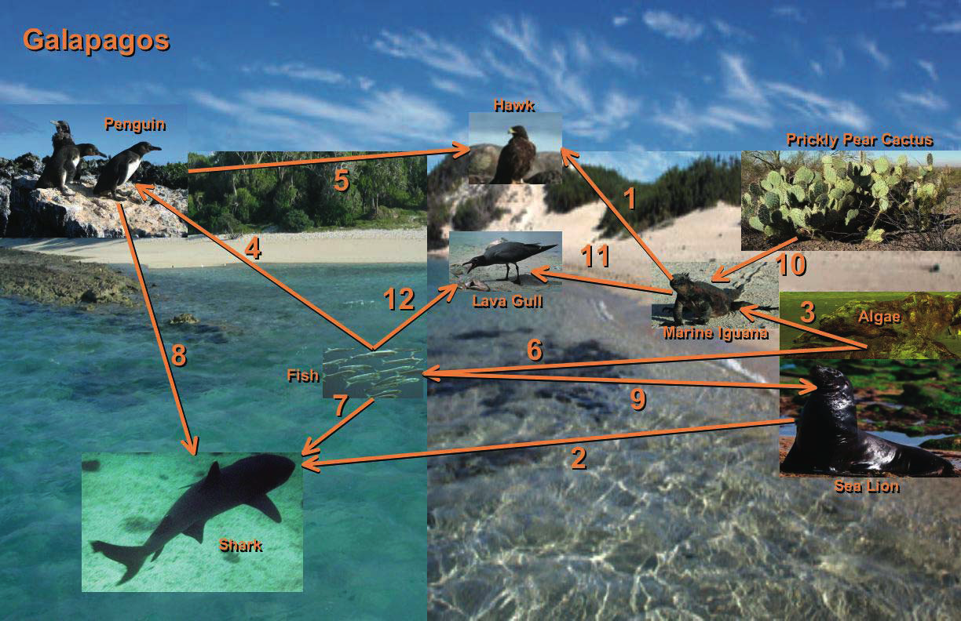
Example Reflection Activity
Add image of galapagos

Slide 18
Assessment Suite
Embedded in Classroom Instruction
Embedded Formative Assessments and Reflection Activities (2 or 3)
1
2
Online module with feedback and coaching
Progress Report
Follow up Classroom Reflection Activity
Benchmark Summative Unit Assessments
3
Online assessment without feedback
Teacher scores constructed responses
Bayes Net
Proficiency Report
Notes:
There is diagnostic assessment going on in three parts of the assessment suite:
In the coaching during the formative assessment
In selecting students for follow up differentiated activities
In classifying students into the four NCLB categories

Slide 19
End of Unit:
Scoring and Reporting
Teacher scores constructed responses in benchmark.
Bayes Net estimates proficiency by target.
Report generated for teacher.
Benchmark Summative Unit Assessments
Benchmark Summative Unit Assessments
Online assessment without feedback
Online assessment without feedback
Teacher scores constructed responses
Teacher scores constructed responses
Bayes Net
Bayes Net
Proficiency report
Proficiency report

Slide 20
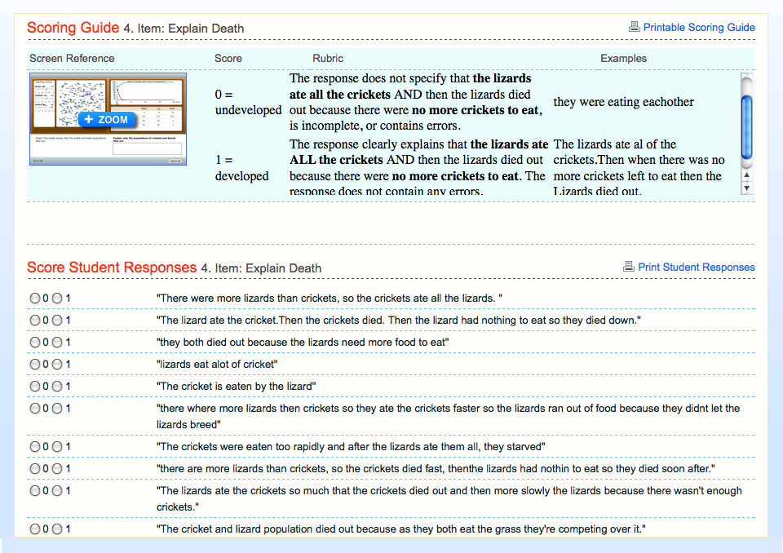
Scoring Open-Response Items
Notes:
Teacher training
Reliability
Scoring procedures

Slide 21
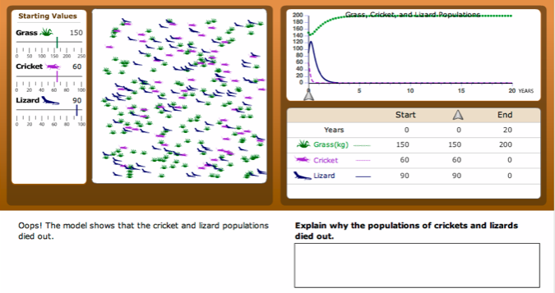
Zoomed in view of item being scored

Slide 22
Scoring Design for SimScientists Projects
Main KSA
MAIN
KNOWLEDGE/SKILL/ABILITY (KSA)
(Main content/inquiry targets)
COMPONENT
KNOWLEDGE/SKILL/ABILITY
(content specific and inquiry targets)
Component KSA
Component KSA
Component KSA
Diagnostic variable
Diagnostic variable
Diagnostic variable
Diagnostic variable
Diagnostic variable
DIAGNOSTIC VARIABLES
(D)
(Evaluation Procedures)
OBSERVABLE EVENTS
(O)
observable event
observable event
observable event
observable event
observable event
observable event
observable event
observable event

Slide 23
Fragment of a Bayes Net From the Calipers II Ecosystems Benchmark Assessment
Nodes
Edges
Note: the conditional probabilities associated with the edges are not visible in this view
Notes:
Bayes Net is a directed acyclical graph.
A network of nodes and lines specifiying the connections and relationships between them.

Slide 24
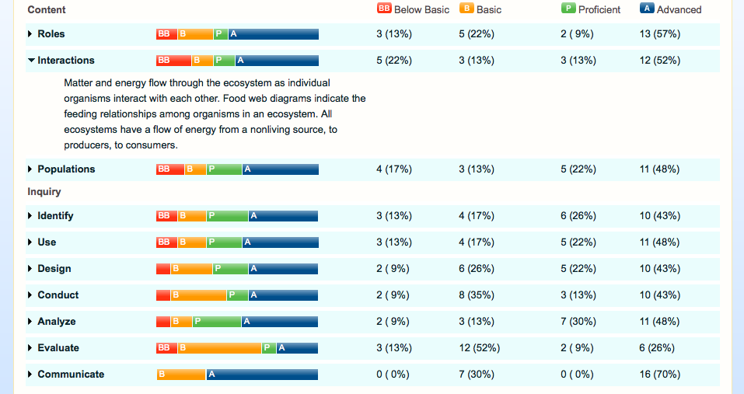
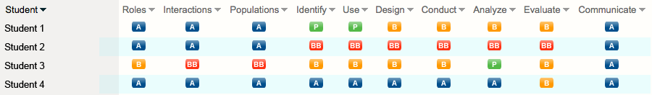
Summary Benchmark report
Detailed Report by Student and Target

Slide 25
Analysis of the
Benchmark Assessments

Slide 26
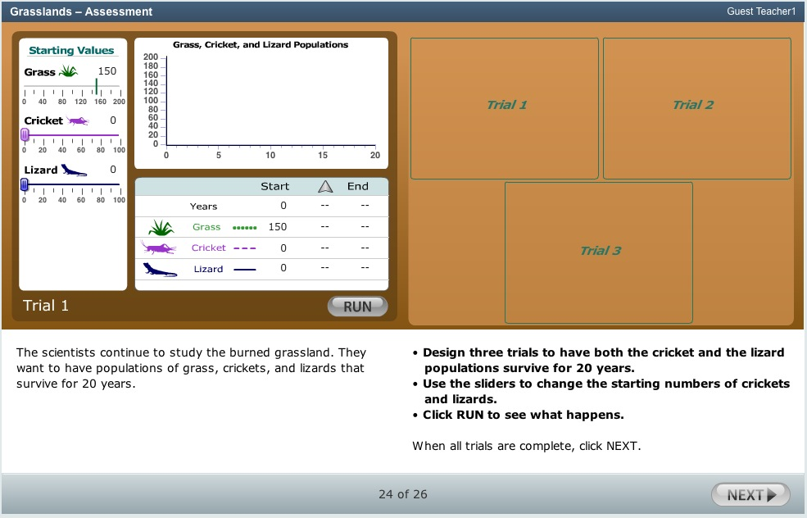
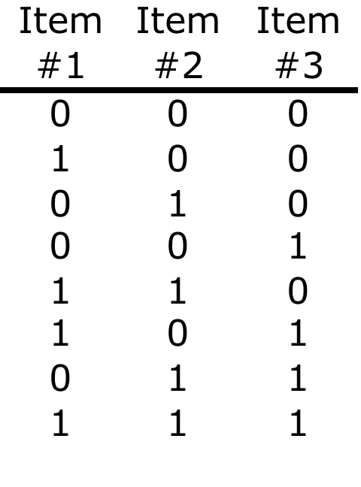
Created Items ‘Bundles’
Notes:
Makes sense both from a content perspective and psychometric perspective to bundle these three items

Slide 27
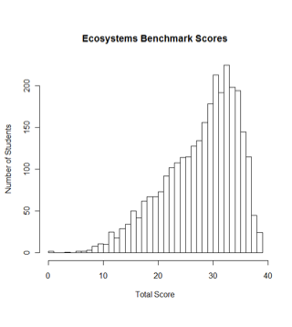
Ecosystems Benchmark Assessment is Reliable
n = 2984 complete responses
Max possible raw score was 39
Mean score was 28.14 (sd 6.64)
All bundles of items fitted well to the IRT measurement model. This means that the items all were contributing information relevant to the overall measure.
Coefficient Alpha measure of reliability was 0.85, which is very good
Notes:
A total of 3,824 students took the Ecosystems Benchmark assessment, of which, 2,984 were complete responses and used in these analyses (i.e. 840 were incomplete for various reasons). The mean score was 28.24 (s.d. 6.64) from a maximum total score of 39. The Coefficient Alpha measure of reliability was 0.85, which is very good. Figure XX below shows the score distribution, which is skewed to the upper scores.

Slide 28
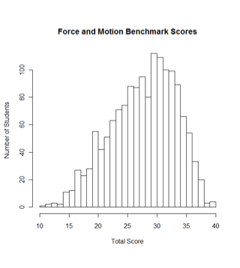
Force & Motion Benchmark Assessment is Reliable
n = 1504 complete responses
Max possible raw score was 40
Mean score was 28.15 (sd 5.51)
All bundles of items fitted well to the IRT measurement model. This means that the items all were contributing information relevant to the overall measure.
Coefficient Alpha measure of reliability was 0.79, which is good
Notes:
Force and Motion Benchmark Test
A total of 2,208 students took the Ecosystems Benchmark assessment, of which, 1,504 were complete responses and used in these analyses (i.e. 704 were incomplete for various reasons). The mean score was 28.15 (s.d. 5.51) from a maximum total score of 40. The Coefficient Alpha measure of reliability was 0.79, which is good. Figure XX shows a graph of the score distribution.

Slide 29
Validity Evidence

Slide 30
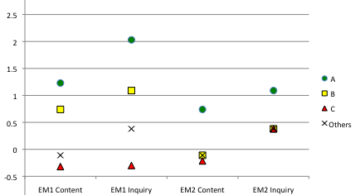
How did the Ecosystems Reflection Groups perform on the posttest? (Medians)
Notes:
Analyses of Variance showed a statistically significant differences among each groups’ performances on the summative benchmark assessments, for both science content knowledge and for inquiry skills
Analyses of Variance showed a statistically significant differences among each groups’ performances on the summative benchmark assessments, for both science content knowledge and for inquiry skills

Slide 31
Correlation of Benchmark to Posttest
 | Ecosystems (n=2924) |  | Force and Motion (n=1496)
 | Content Ability estimate | Inquiry Ability estimate | Content Ability estimate | Inquiry Ability estimate
Correlation with ability estimates on posttest | .51** | .24** | .40** | .45**
** Correlation is significant at the 0.01 level (2-tailed)
Notes:
Interpretations
NOTE: Both the posttest and the benchmark assessments were designed to test the same constructs and were reviewed by experts to show that they were aligned.
Ecosystems Content: The positive correlation indicates that the posttest and benchmark are sorting performances of students in similar ways, but the correlation is not strong.
Ecosystems Inquiry: The positive, but weak correlation indicates that the posttest and benchmark are sorting performances of students in somewhat similar ways. It may be low because the inquiry skills being assessed in the simulation based assessment is different from that in the posttest.
Force & Motion Content: The positive correlation indicates that the posttest and benchmark are sorting performances of students in similar ways, but the correlation is not strong.
Force & Motion Inquiry: The positive correlation indicates that the posttest and benchmark are sorting performances of students in similar ways, but the correlation is not strong.

