Slide 1
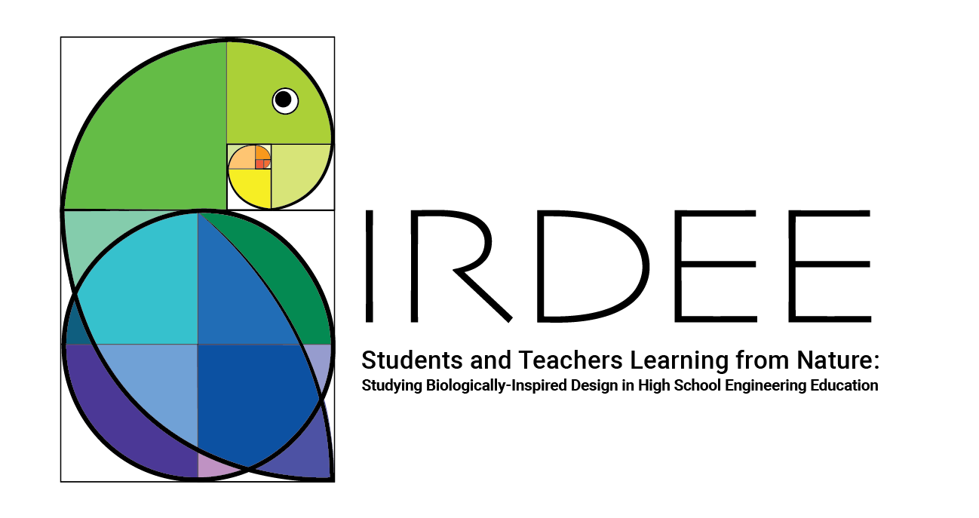


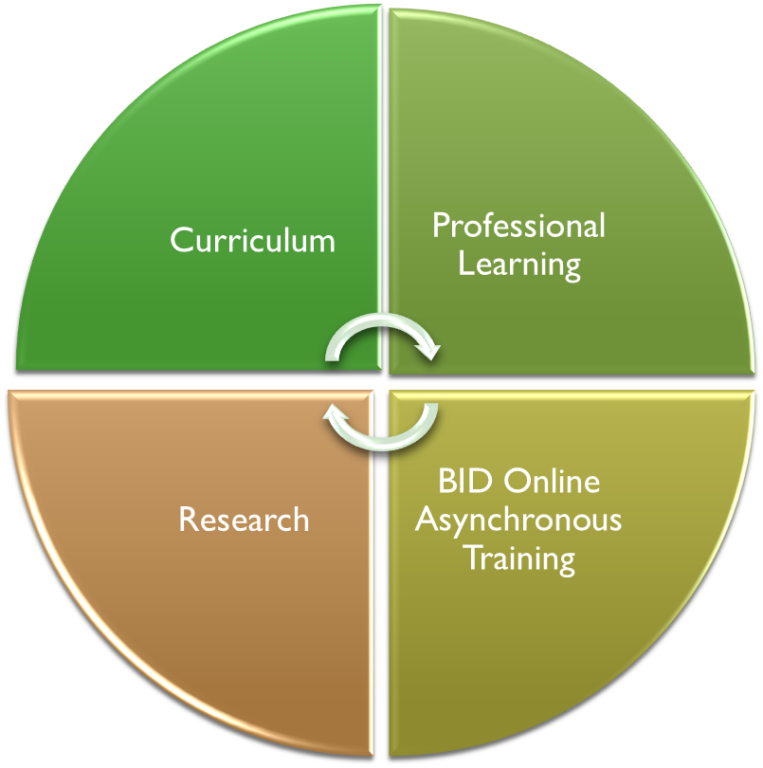
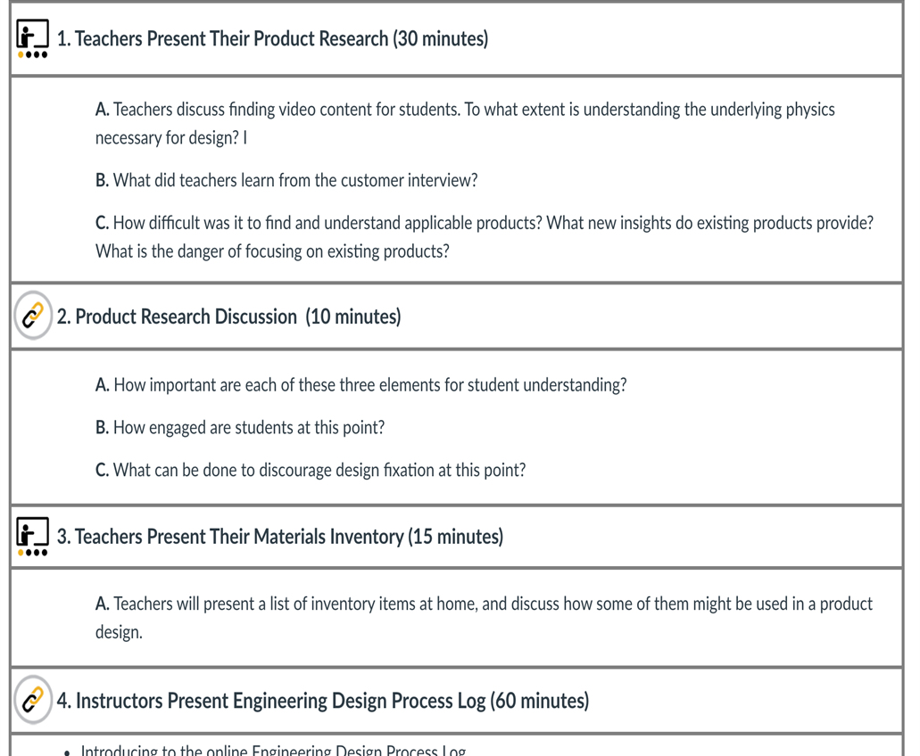
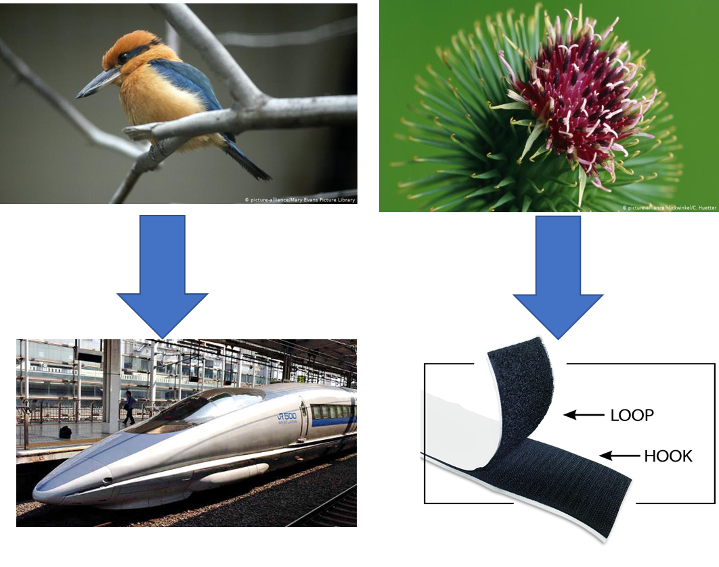
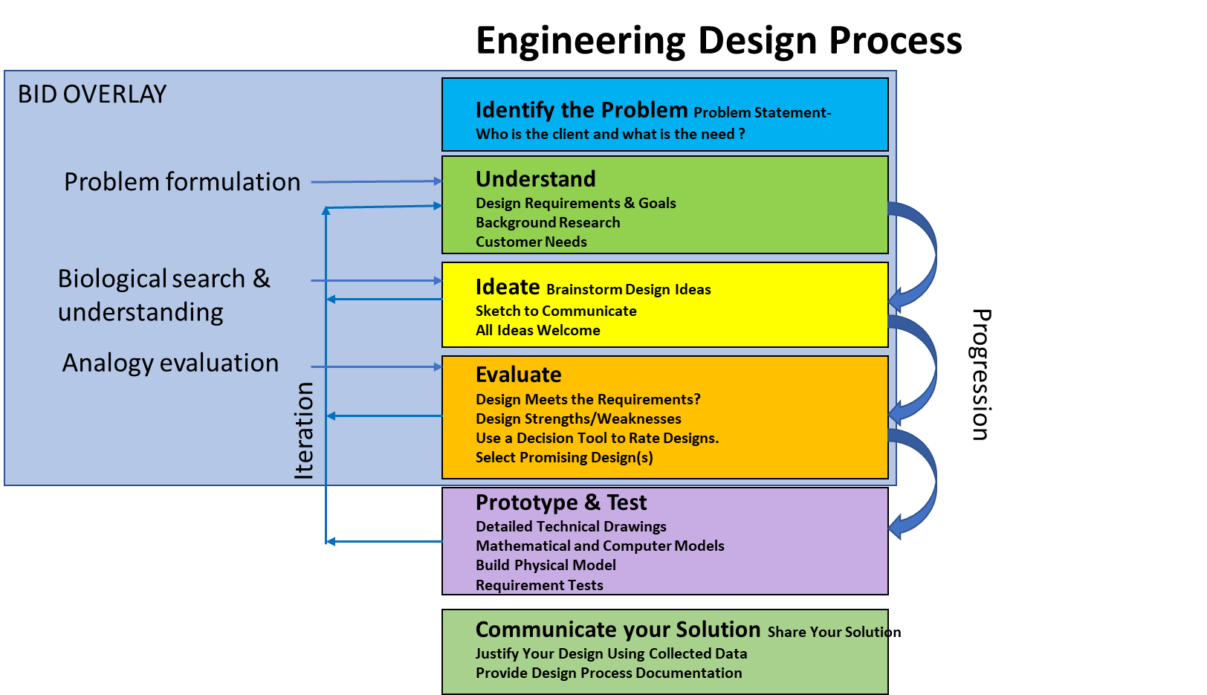
Bringing Biologically Inspired Design into High School Engineering Curricula
BIRDREE components:
Biologically Inspired Design for Engineering Education, (BIRDEE), is a DRK-12 project that partners GT’s Centers for Education Integrating Science, Mathematics, & Computing and Biologically Inspired Design with two school districts.
Components combine curriculum development, and professional learning (PL) to support instruction with research to evaluate curricular impact and required elements of professional learning
Professional learning leverages on-line platform for scale up for asynchronous delivery
Research questions:
What extent and what type of professional development is required to support teachers to teach BID curriculum?
How does PL affect teachers’:
  Understanding of EDP?
  Engineering self-efficacy?
  Perspective toward nature
How does BID affect students':
Understanding of Engineering design process (EDP)?
Ability to generate well formulated design
problem formulation?
Engineering self-efficacy?
Intention to persist in engineering?
Shikansen bullet train
Velcro
Biologically Inspired Design (BID) is the process of identifying mechanisms from organisms that can aid the design of human systems and translating them into products or processes. It depends on making analogies, based on function, between human problems and natural “solutions.
The curriculum adds BID to the engineering design process through making and
evaluating analogies between human problems
This project is funded by the National Science Foundation, grant #1907906 . Any opinions, findings, and conclusions or recommendations expressed in these materials are those of the author(s) and do not necessarily reflect the views of the National Science Foundation.
and natural “solutions”

