Slide 1
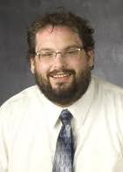
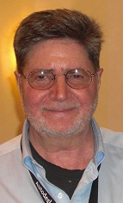
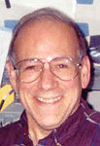
A Panel Discussion of Issues and Challenges Related to Development and Implementation of School-Based Engineering and Technology Education Programs.
DR K-12 PI Meeting - December 2, 2010
K-12 Engineering
Johannes Strobel
Purdue
Michael Hacker
Hofstra
Kurt Becker USU
Julie Ross
UMBC
Cary Sneider
Portland
State Univ.

Slide 2
Each Panelist will Introduce themselves and speak for about 15 minutes (1 hour and 15 minutes) Invite Audience Participation – Ideas and Questions (15 minutes) Small group reactions and frame a recommendation (15 minutes) Sharing with large group (Until the End of the Session)
K-12 ENGINEERING EDUCATION
PANEL PROGRAM
In a panel discussion with participant involvement, leaders of K-12 engineering and technology education initiatives will discuss conceptual frameworks, curricular initiatives, implementation strategies and attendant challenges related to institutionalizing K-12 engineering and technology education programs in the nation’s schools.

Slide 3
Johannes Strobel, Director School of Engineering Education, Learning Design & Technology, and Division of Environmental and Ecological Engineering

Slide 4
What is INSPIRE?
Mission: To study engineering thought and learning at the P-12 level and to inspire diverse students to pursue engineering and science for the benefit of humanity and the advancement of society.
Conducts basic and applied multidisciplinary research focusing on–teacher professional development, assessment, student learning, and informal learning.
Composed of 11 faculty, three (3) staff, and four (4) postdoctoral researchers, 14 graduate and 11 undergraduate research assistants
Has impacted 600+ teachers and 17,000+ students

Slide 5
Funded INSPIRE Research
Private and Corporate Foundations
NSF DRK-12: R&D (2008 – 2013): Quality Cyber-Enabled, Engineering Education Professional Development to Support Teacher Change and Student Achievement (E2PD)
NSF GSE/RES (2007 – 2011): Examining Engineering Perceptions, Aspirations and Identity among P-6 Girls
NSF MSP (2010-2015): Engineering design principles to effect how science/math are taught: 200 teachers and 5,000 students across four Indiana school districts. Collaboration between faculty of engineering, technology, science, education, INSPIRE.
NSF IEECI (2009 – 2011): Environmental awareness of high school and first-year students
NSF VOSS (2009 – 2011): Bibliometric & social network analysis and Oral History of the development of Engineering Education Research including P-12.
NSF CI-TEAM (2010 – 2012): Collaborative Research: CI-TEAM Demonstration Project: WaterHUB for Cyber Enabled Training, Education and Research in Water Resources

Slide 6
Highlights
New Journal: Journal of Pre-College Engineering Education Research (J-PEER) – first issue 2011
PBS Teacherline – Online Certificate in integrating Engineering into elementary classrooms
AssessmentHub: online repository for P-12 research and evaluation instruments
Engineering Teacher-in-Residence program: unique on-location, in-time teacher professional development model
Online support community for P-12 teachers

Slide 7
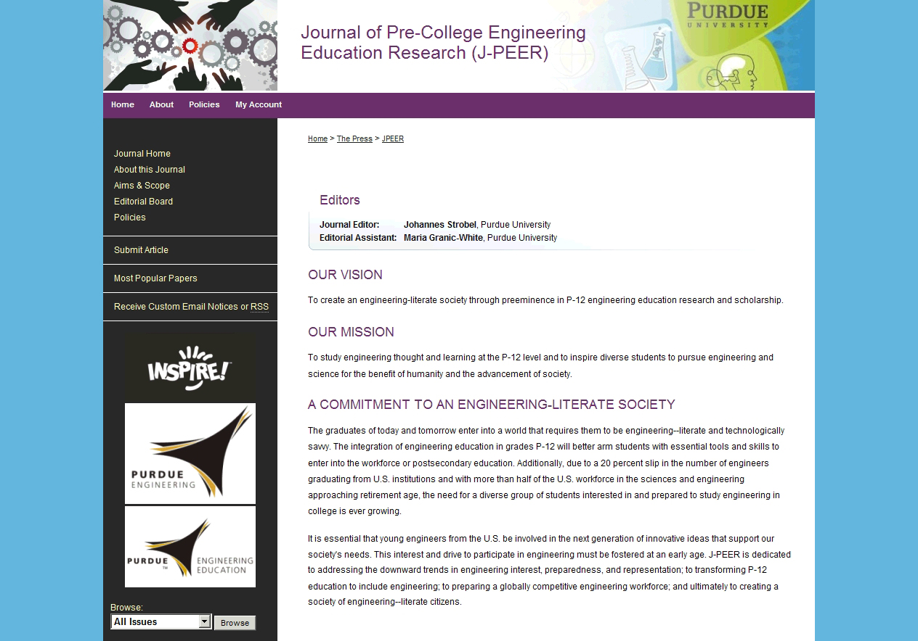

Slide 8
P-12 Engineering Assessment HUB
Dr. Senay Purzer, Dr. Monica Cardella, Juyeon Yun,
Elizabeth Gajdzik, Jason Stevens, Dr. Johannes Strobel

Slide 9
The Need
The most frequent comment we hear is the need for valid and reliable research and assessment tools:
Are instruments existing that do measure…?
How is the quality of the instruments?
How do I analyze the data (especially from non-researchers)?
How do I adapt an existing instrument?

Slide 10
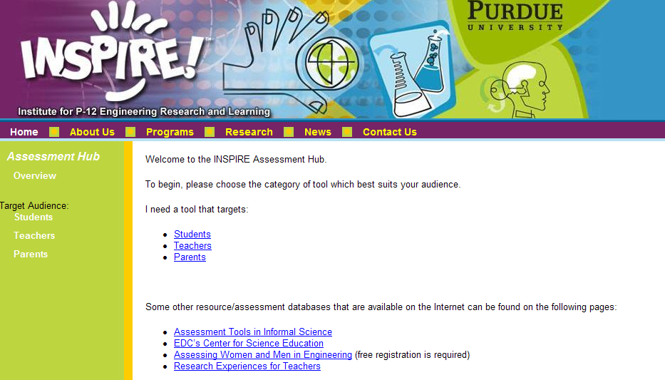
Prototype P-12 Engineering AssessmentHUB
https://engineering.purdue.edu/INSPIRE/assessmenthub

Slide 11
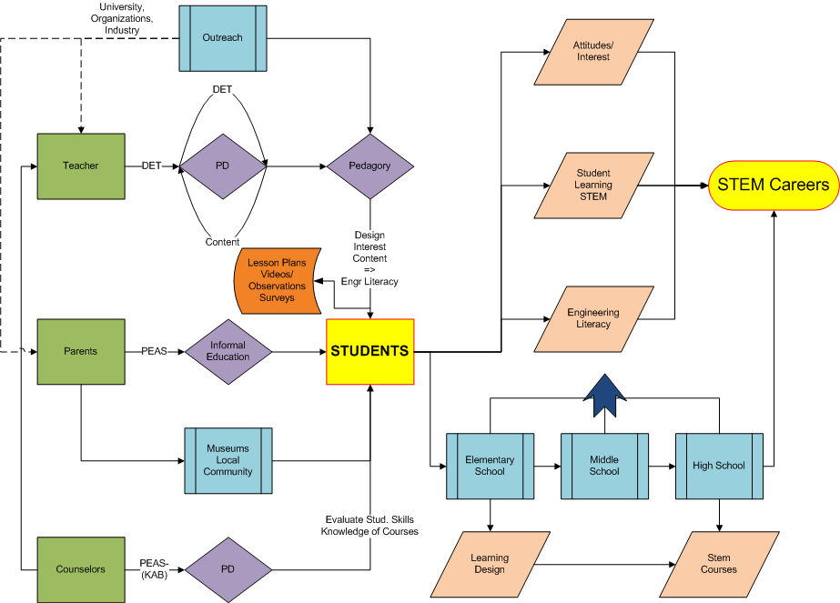

Slide 12
Teacher-in-Residence Research Project
Dr. Johannes Strobel, Dr. Jenny Daugherty, Elizabeth Gajdzik, Ron Carr, Soo Shin, Noah Salzman, Dan Somerville

Slide 13
Engineering Teacher-in-Residence
Exceptional and experienced elementary and middle school educators
Serve as facilitators for other teachers as they integrate engineering into their classrooms.
Act as onsite research coordinators
Other tasks include:
Providing support to teachers in their school and district
Submitting progress reports at the end of each month and participate in monthly teleconference meetings.
Documenting the support/activities that they provide.
Organizing and running engineering professional development workshops for teachers in their district.

Slide 14
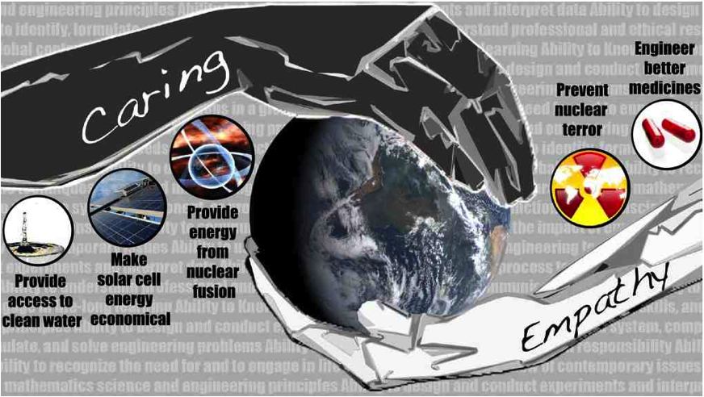
Trends and Trendsetting
“Engineering as a caring and empathetic discipline”
Theoretical framework
Curricula Development framework
- People-oriented objects (to overcome people vs. object oriented)
Social good (as positive reason students leave engineering
Authentic (process, outcome, identity, task)

Slide 15
Engineering in P-12 - Overview
Case for “P” instead of “K” → Pre-school engineering
Direction and Presumption
“Early Engineering” = Everybody does engineering, engineering-literate society
AND
“Pre-Engineering” = Preparedness for College Engineering
Engineering as invasive species or addition to ecological diversity in schools?

Slide 16
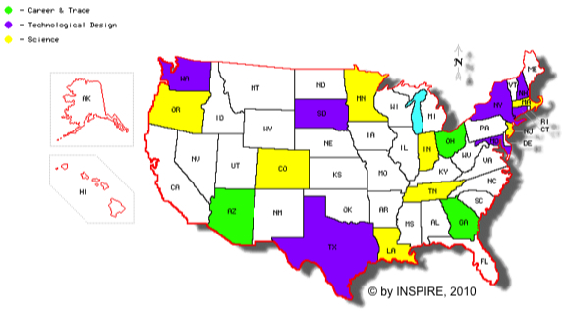
Landscape of K-12 Engineering

Slide 17
What do we really know – what works? Large Questions
Which location in standards is better?
For student learning?
For preparing qualified teachers?
Lack of a common understanding of engineering
What is portrayed as engineering?
Which metaphor is more effective?
How to implement successful “conversations”?
Measurement of students learning (engineering and math/science/language arts)
Measurement of teachers’/administrators’ understanding
Empirical questions require empirical research

Slide 18
What is Engineering Education Research?
Two conceptualizations:
Educational Research Methods in Engineering
Experimental research (treatment – control studies)
Randomized Field Trials (large scale treatment research)
Ethnographic studies (i.e. change in school system)
Longitudinal studies (tracking of students/teachers over years)
Design-based (iteration between intervention and research)
Other technical engineering research to improve education (emerging)
Engineering to improve the educational system (analogy from healthcare engineering)
End-user-centered design/System Engineering already at works

Slide 19
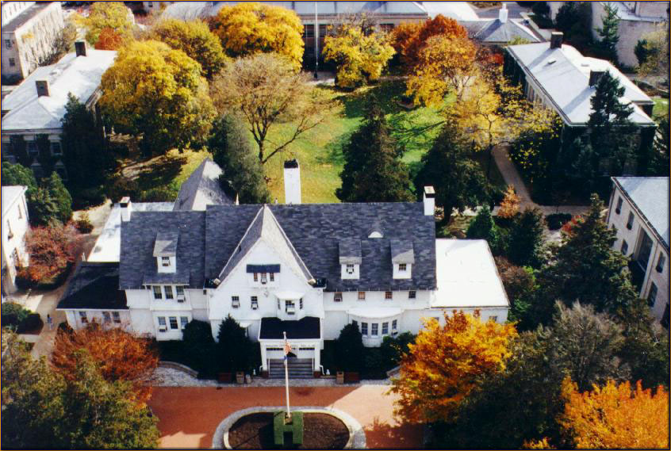
TRANSFORMING TECHNOLOGY EDUCATION
Michael Hacker
Co-Director
Center for Technological Literacy
HOFSTRA UNIVERSITY
CTL
www.hofstra.edu/ctl

Slide 20
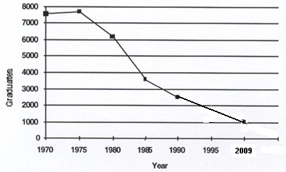
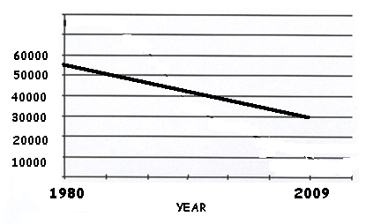
TECHNOLOGY EDUCATION IN TRANSITION
Technology Education has long been
a subject in transition
Crafts Industrial Arts Industrial Technology Technology Education Engineering
TRENDS IN GRADUATION RATES SUPPLY OF TECHED TEACHERS
87% decline vs.51% in mathematics
Going, Going, Gone? Recent Trends in
Technology Teacher Education Programs
Kenneth S. Volk , JTE Spring 1997, Updated April 2009
From Kendal Starkweather,
Executive Director, ITEA, April 2009

Slide 21
Despite the Promise of Technology Education…
PUBLIC PERCEPTION ISSUES
Technology is not well understood
Technology Education is tainted by its traditions
POLITICAL ISSUES
Limited policy-level Support
Funding is limited
STRUCTURAL CHANGE ISSUES
The school day is a zero-sum game. Extra time often apportioned to remediation
New millennium student needs and teacher capabilities are mismatched (pre-service reform implications)
Notes:
Matthew Crawford

Slide 22
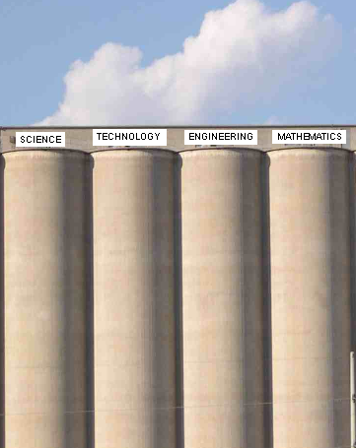
A ROLE OF OUR CENTER
To support the transition from
To
S
S
T
E
M
T
E
M
…with Engineering and Technology Education helping to make the connections and to provide context.
Notes:
Our projects have tried to accelerate the transition from traditional silo based visions of the disciplines to one where E&T help make connections and provide context.

Slide 23
Recent Hofstra Efforts in Support of the Transition to ETE
Current/Recent NSF Projects with a Focus on ETE Include:
The MSTP Project: Mathematics, Science and Technology
Education Partnership (MSP)
Project ESTEEM: Equitable Science, Technology, Engineering, Education, and Mathematics (ATE)
CCfT: Core Curriculum for Technology Education (ATE)
SMTE: Simulations and Modeling in Technology Education
(Hybrid modeling - DR K-12)
The overall mission of the Center is to improve STEM literacy for K-16 students and faculty with a particular emphasis on ETE.

Slide 24
Initial curriculum design considerations have emerged from prior projects:
ETE should:
Focus on integrated STEM learning in authentic, gender equitable technological contexts.
ENSURE ACADEMIC RIGOR by infusing core disciplinary concepts into engineering and technological contexts.
Use an INFORMED DESIGN Pedagogy (KSBs)
Notes:
So, we’re suggesting some ideas in moving toward what might be a transformative approach to technological ed.

Slide 25
Technology Education ETE
Recent major developments in the field:
ITEA renamed to ITEEA (March, 2010)
Massachusetts statewide science and technology/ engineering requirement and state test (2003, 2006)
Many articles in professional journals and yearbooks
ITEA Engineering by Design Curriculum launched (2005)
NYSED Principles of Engineering HS program (1987)

Slide 26
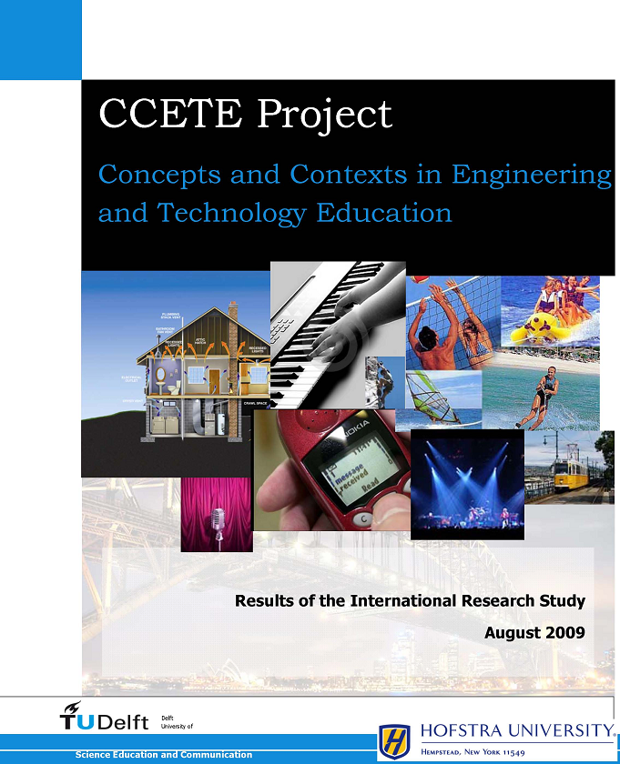
DELPHI RESEARCH STUDY
2009-2010
HOFSTRA AND DELFT
UNIVERSITIES
32 EXPERTS IN
NINE COUNTRIES
Came to consensus on
overarching themes
and appropriate contexts for curriculum in ETE

Slide 27
Where We’re Headed: A Potentially Transformative Approach toward ETE…
Change we can believe in.
Focus on integrated STEM learning in authentic, gender equitable technological contexts.
ADD ACADEMIC RIGOR by infusing core disciplinary concepts into engineering and technological contexts.
Using an INFORMED DESIGN Pedagogy
Adopt a “HYBRID MODELING” approach
Focus on UNIFYING THEMES
Engender the vision of engineering articulated in the NAE’s Grand Challenges as “seeking solutions to broad realms of human concern — sustainability, health, vulnerability, and joy of living.”
Notes:
So, we’re suggesting some ideas in moving toward what might be a transformative approach to technological ed. Engineering can contextualize math and science provide an alternative to more math through remediation.
A motivating force is the facility of today’s students with technology-enhanced instruction and the realization that students’ interests and educational expectations are being reframed by online interactive learning experiences.

Slide 28
Thanks for your kind attention

Slide 30
Implications of Next Generation Standards and assessments
Cary Sneider, Portland State University
“Engineering Education in 2011 and Beyond”

Slide 31
NAEP 2014 technology and engineering literacy
National Assessment of Educational Progress (NAEP) known as The Nation’s Report Card.
NAEP has broad influence since it is the only means of comparing states.
For the first time in 2014 students will be tested in all STEM fields.
What does this mean for science education?

Slide 32
Implications of NAEP 2014
What is tested is taught.
Technology and Engineering Literacy includes:
Technology and Society
Design and Systems
ICT
Where do these subjects fit in the curriculum?
Social Studies, Mathematics, Language Arts & Science

Slide 33
Implications of New Standards
Infuse the curriculum with: Biotechnology, Biomimicry Biomedicine, Chemical Engineering, Materials Science, Mechanics, Nanotechnology, Aerospace, Electrical Engineering, Environmental Engineering
Focus on Careers: technicians, technologists, and engineers in addition to scientists.
A good answer to the question: “Why do we have to do this, Mr. Sneider?”

Slide 34
What will the new focus on technology and engineering mean to you?

Slide 35
Invite Audience Participation – Ideas and Questions (15 minutes) Small group reactions and frame a recommendation (15 minutes) Sharing with large group (Until the End of the Session)
K-12 ENGINEERING EDUCATION
PANEL PROGRAM

