Slide 1
Science Coordinators Advancing a Framework For Outstanding Leadership Development (SCAFFOLD)
Brooke A. Whitworth, Julie A. Luft

Slide 2
RESEARCH QUESTIONS
How, if at all, does the SCAFFOLD PD program impact the knowledge, practices and work of the DSCs (e.g., implementation of PD programing in their districts, work with science teachers)?
How, if at all, do DSCs (in the SCAFFOLD program and the business as usual program) impact the practice of science teachers (e.g., their use of 3D instruction, equitable instruction)?

Slide 3
CONCEPTUAL FRAMEWORK

Slide 4
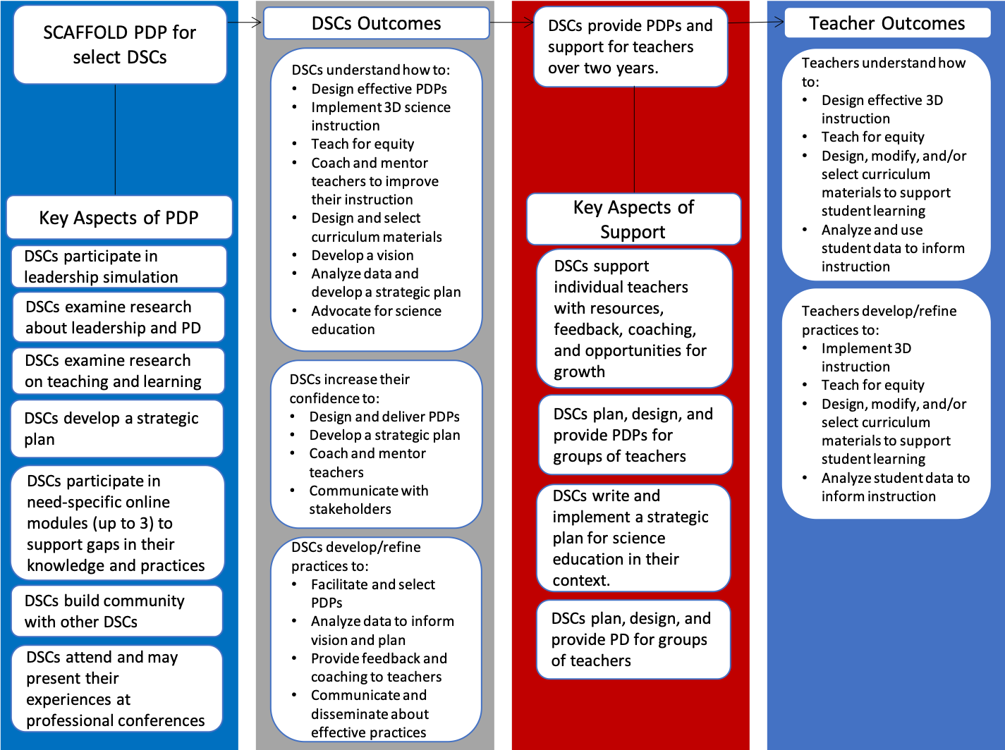
THEORY OF ACTION

Slide 5
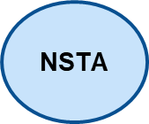
SCAFFOLD PROJECT: PD Component
Virtual
6 hours
Principles of Effective PD & Change
Virtual
6 hours
SEPs and Equity
Virtual
6 hours
CCCs and Assessment
Online Programming – 45 hours
Equitable 3D Teaching
Professional Learning in Science
Coherent Curriculum
NSTA
Monthly Follow-ups
YEAR 1 Fall 2020- Spring 2021
YEAR 2 Fall 2021- Spring 2022
Notes:
Reminder of the project

Slide 6
Year 1 Core PD Program
September/October – Core Module 1 (3 days/6 hours) – Leadership Simulation
November – Introduction to developing strategic plans (2 hours)
December – Refining the vision and developing goals (2 hours)
January – Core Module 2 (3 days/6 hours) – Science & Engineering Practices & Equity
February – Refining goals and developing a plan (2 hours)
March – Refining the plan and evaluation (2 hours)
April – Core Module 3 (3 days/6 hours) – Cross cutting practices, Assessment, and Strategic Plan Feedback
May – Reflecting on game, modules, strategic plans, & year (2 hours)
There was required time outside of class, approximately 4 hours a month.

Slide 7
Differentiated On-line Modules
Modules
Equity Emphasis Within the Modules
Differentiated Modules:
3D Equitable Science Instruction
Coherent Curriculum
Professional Learning Programs
Optional Module:
Instructional Technology & Online Learning
3D Equitable Science Instruction:
Racial and gender equity
Cultural differences
Coherent Curriculum:
Orientations of curriculum – hidden and explicit curriculum
Supporting diversity through curriculum
Professional Learning Programs:
Differentiation of Teacher Professional Learning
Coaching for Equity
Notes:
DSCs providing feedback on each section of module
External review

Slide 8
COMMON FEATURES OF MODULES
Module Pre-assessment determined what modules they completed
Signature Artifacts
Introduction to Modules
Includes video, learning goals, and outcomes
Submission of initial signature artifact
Release Conditions
Each section of a module has release conditions to complete before moving on
As part of the release conditions, DSCs are asked to revisit their signature artifact for the module to determine what additions and/or changes need to be made
Conclusion to Modules
Includes video, review of learning goals, and outcomes
Submission of finalized signature artifact

Slide 9
EXAMPLE OF MODULE INTERIOR: What is the role of professional learning in teacher growth?
4. Reflection Questions on reading
5. Read: Chart the stages of teacher development
6. Conclusion slide: Question, Goals, Overview
7. Release Condition: Select the five statements that best represent the landscape of supporting teacher learning
1. Introduction slide: Question, Overview
2. True/False questions to engage learner
3. Read: The K-12 Science Teaching Workforce

Slide 10
EQUITABLE 3D INSTRUCTION
Signature Artifact: Design of Professional Learning Program around Equitable 3D Instruction
Introduction to Module
What is 3D teaching?
How does 3D teaching differ from traditional instruction?
How can phenomena drive instruction?
How do students learn?
How do we address racial and gender equity when teaching science?
How do we address cultural differences when teaching science?
How do we assess student learning in the midst of equitable 3D instruction?
How do we analyze student data to inform equitable 3D science instruction?
Conclusion of Module

Slide 11
COHERENT CURRICULUM
Signature Artifact: Curriculum Map and Evaluation of Sample Curriculum
Introduction to Module
What makes good curriculum?
What are the different orientations to curriculum?
How does curriculum support learning of diverse learners?
How do we identify good curriculum and/or instructional resources?
How do we ensure curricular coherence? How do we design curriculum?
Conclusion to Module

Slide 12
PROFESSIONAL LEARNING
Signature Artifact: Design of a Professional Learning Program and it’s Evaluation
Introduction to Module
What is the role of professional learning in teacher growth?
How do we support teacher learning?
What makes professional learning programs good?
What makes professional learning programs good for all teachers?
What makes for a good professional learning facilitator?
How do we evaluate a professional learning program?
What is the future of good professional learning programs?
Conclusion to Module

Slide 13
SCAFFOLD Participants
 | DSCs | Teachers
SCAFFOLD PD DSCs | 12 | 24
Business as Usual DSCs | 5 | 9
Teachers no DSCs |  | 9

Slide 14
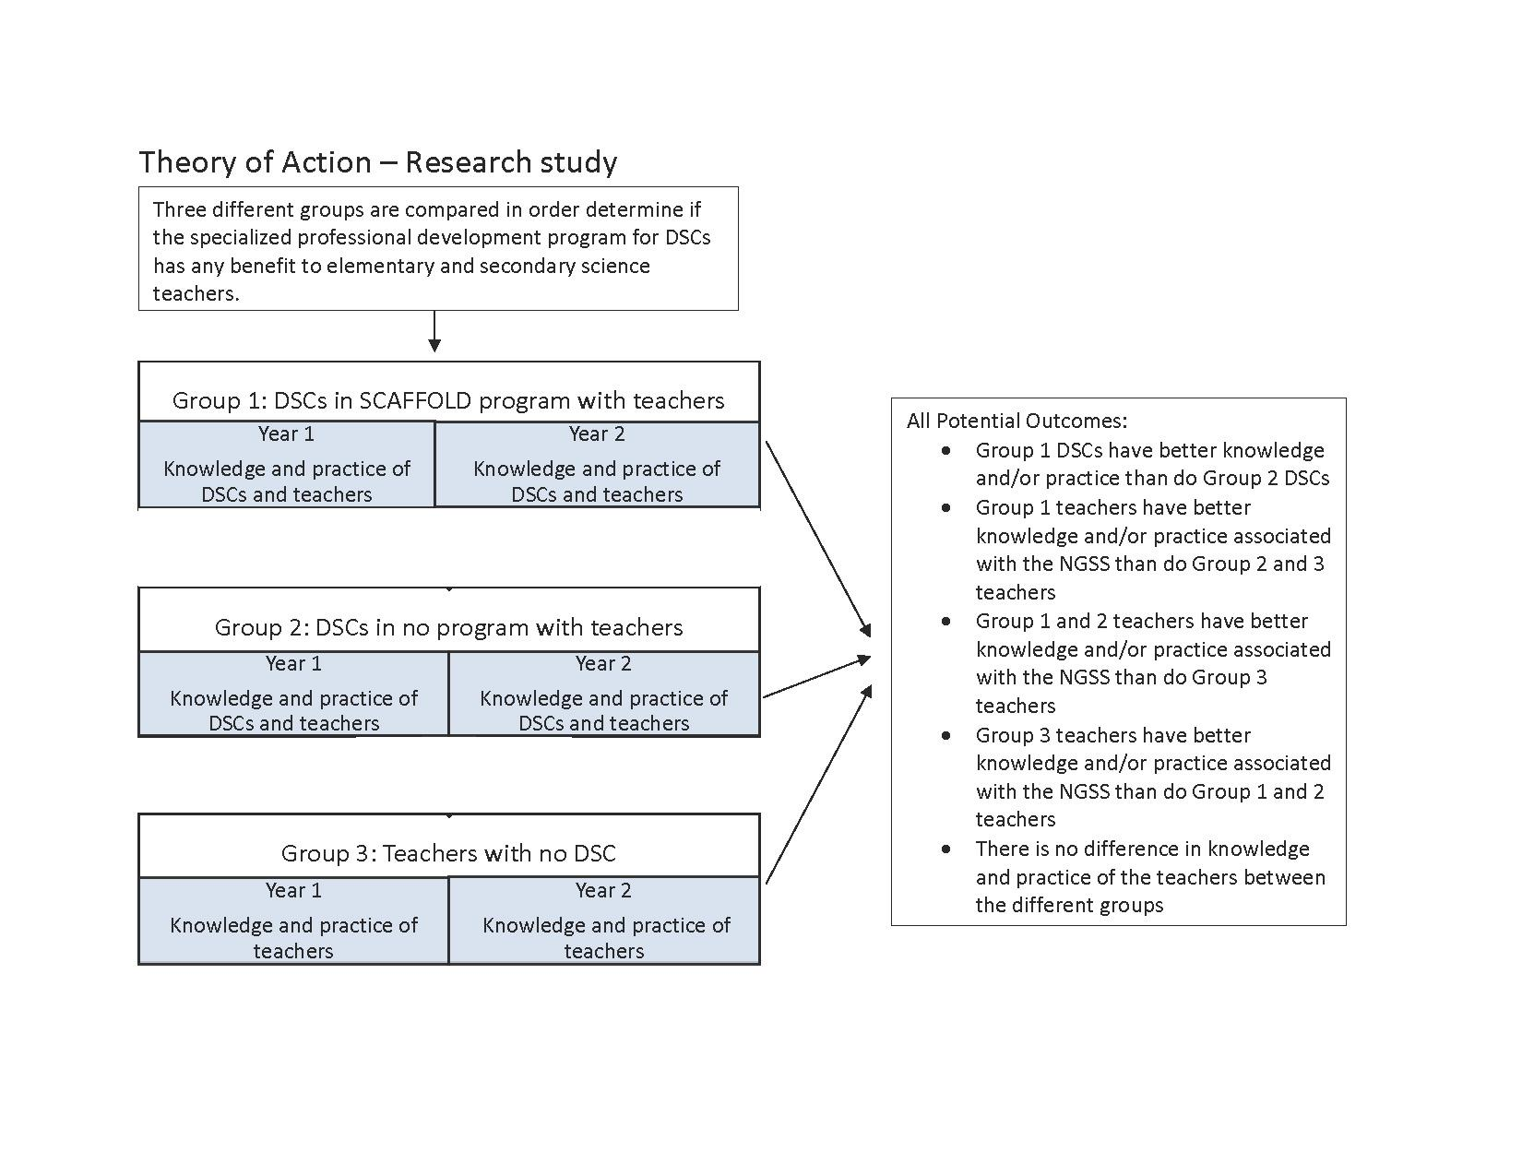
THEORY OF ACTION: RESEARCH

Slide 15
SCAFFOLD PROJECT: Data Collection
Face-to-Face
8 hours
Face-to-Face
6 hours
Face-to-Face
8 hours
On-line Programming – 45 hours
Conduct PDP with Teachers
NSTA
YEAR 1 Fall 2020- Spring 2021
YEAR 2 Fall 2021- Spring 2022
INT
Artifact Collection
INT & Focus Group
Artifact Collection
INT & Focus Group
OBs of DSCs & Teachers
OBs of DSCs
OBs of DSCs & Teachers
OBs of DSCs & Teachers
OBs of DSCs
OBs of DSCs & Teachers
Instruments
Age of NGSS & Leadership
Instruments
Age of NGSS & Leadership
Instruments
Age of NGSS & Leadership
Notes:
Reminder of the project

Slide 16
Surveys and Interviews
NGSS survey
Equity survey
Leadership survey
DSCs only
Pre-program interview
Classroom and Professional Learning Interview
Notes:
Revise the classroom interview and Professional Learning protocol
Set up a site that is housing all of the data – we have way to code the data for storage

Slide 17
Year 1 Data Collection Completed
Before the start of school
Interview
Fall
Professional learning or Classroom interview
Spring
Spring
After school year
Examination of emerging ideas and review of summaries or studies
Surveys – Equity, Leadership, NGSS
Professional learning or Classroom interview
Professional learning or Classroom interview
Focus Groups or Review of Documents
Post interview
Surveys – Equity, Leadership, NGSS

Slide 18
For questions, please contact Brooke A. Whitworth at bwhitwo@clemson.edu
This project is funded by the National Science Foundation, grant #1908431. Any opinions, findings, and conclusions or recommendations expressed in these materials are those of the author(s) and do not necessarily reflect the views of the National Science Foundation.

