Slide 1
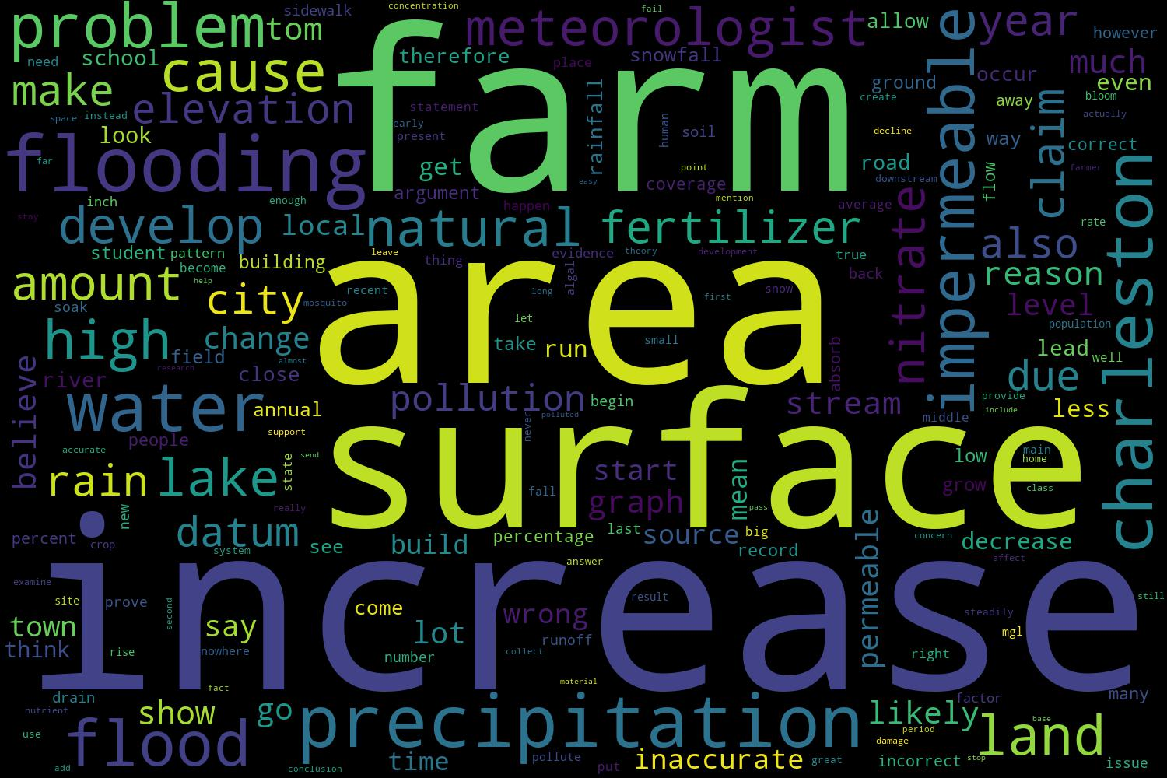
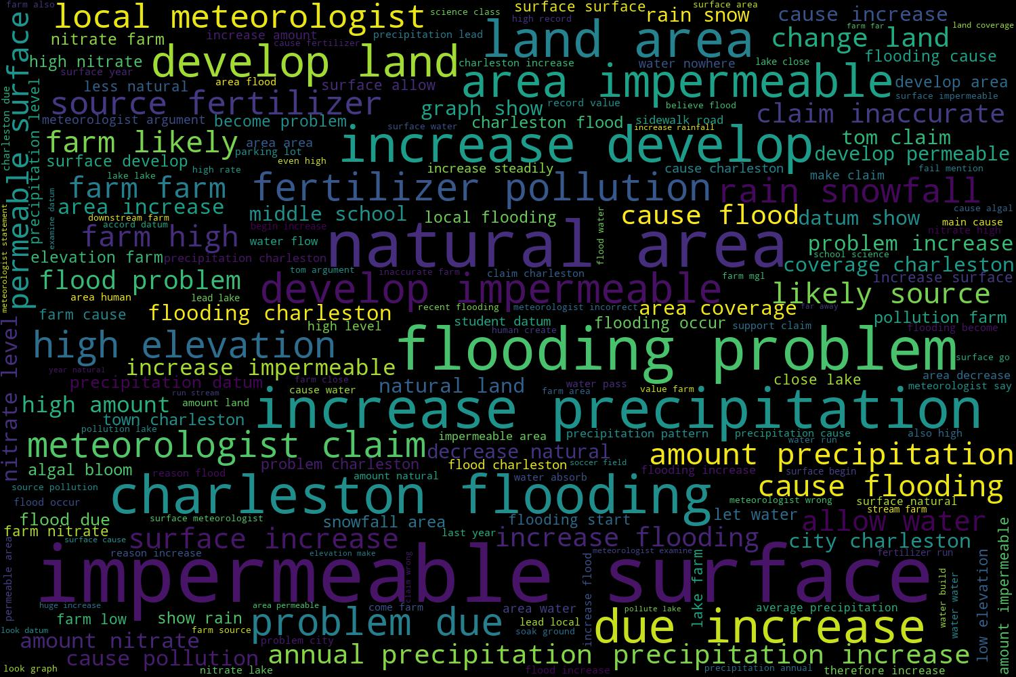
Scenario-based assessment of claim-evidence reasoning (CER) shows that CER constitutes a progression of competencies. Students start with the ability to establish purpose, and move toward use of evidence, communication, and integration of quantitative reasoning as literacy increases.
Non-Cognitive Predictors of Student Success: A Predictive Validity Comparison Between Domestic and International Students
Non-Cognitive Predictors of Student Success: A Predictive Validity Comparison Between Domestic and International Students
How do Students Express their Claim-Evidence-Reasoning on Scenario-based Assessments Grounded in Real-World Issues?
Validity Comparison Between Domestic and International Students
William Romine PhD², Amy Lannin PhD¹, Ankita Agarwal², Maha Kareem¹, Emily Burwell²
1: University of Missouri; 2: Wright State University, OH
Reliability, construct validity, and item hierarchy were established using the Rasch model. Ordinal logistic regression was used to evaluate uniform and non-uniform differential item functioning (DIF) (Swaminathan & Rogers, 1990) between the two scenarios.
Natural language processing was used to understand how the semantic structure of students’ responses changed with CER.
RESULTS
The scale was reliable (r_{person} = 0.96) and unidimensional (1st eigenvalue from PCA on Rasch residuals = 1.57 < 2)
All 6 competencies displayed satisfactory fit with the Rasch partial credit model and had point biserial correlations above 0.7.
No significant uniform or non-uniform DIF existed between the two scenarios. This means that there is no evidence that the difficulty and discrimination power of the scenarios differ. This was confirmed by p-values above 0.1 for the scenario factor (difficulty) and the scenario-by-measure interaction (discrimination) in the model for the responses on each competency.
The Rasch model predicted that 53.5% of the students were able to establish purpose, but only 40.2% were able to make effective quantitative arguments.
CONCLUSIONS
The scenario-based assessments suggest that CER represents a progression of competencies which scaffold one another. High reliability, unidimensionality of the scale, and satisfactory fit of the items with the Rasch model provide evidence for the validity of this progression.
The absence of significant difference in difficulty and discrimination between CER competencies suggests that these two scenarios can be used interchangeably to generate parallel testing forms.
Quantitative skill is an especially difficult CER competency (Figure 1) which needs special attention.
Most responses tend to focus on the topic of the issue, but terms related to evidence processing and quantitative reasoning are relatively infrequent (Figure 2). This illustrates the necessity of focusing on quantitative reasoning when teaching argumentation in the classroom.
INTRODUCTION
The ability to make a claim, support it with evidence, and communicate one’s stance using quantitative reasoning is a key component of science literacy aligning with the NGSS scientific practices (NGSS Lead States, 2013).
Increased use of Claim-Evidence-Reasoning (CER) is a key target outcome for instruction focused on Vision 2 scientific literacy (Gotwals & Songer, 2010).
We utilize the CER framework to construct scenario-based assessments (SBA’s) of science literacy. These assessments present a scenario based on a socioscientific issue and ask students to use evidence to argue for the best course of action to take.
Adding a quantitative focus to CER is a new development. Before utilizing this assessment for summative evaluation, we explore (1) the assessment’s adherence to the CER framework, (2) the ability of the tasks to generate repeatable measures of CER, and (3) the types of responses students at different levels of CER tend to generate.
RESEARCH QUESTIONS
How does the SBA measure CER in terms of: reliability, construct validity of the scale and tasks, and consistency between scenarios?
What progression do students tend to follow as they increase their levels of CER?
How do students express their CER in written responses to the SBA’s?
METHODS
Responses from 107 students were analyzed. They hailed from multiple school districts in the Midwestern United States.
Each student completed one of two scenarios: Charleston’s Flooding Problem (n = 74) or Farm Pollution (n = 33). These contained 5 parallel items (ordinal 1-4 scale) which measured ability to establish purpose, provide evidence, use quantitative reasoning, understand content, and communicate in writing.
Table 1. Measures for item difficulty and fit with the Rasch model. Expected fit = 1, excessive misfit > 1.50.
LOGITS %STUDENTS MEETING COMPETENCIES
2 +
|
|
1 40.2% + 3=Quantitative
|
43.9% | 4=Content 5=Communication
0 +
48.6% | 2=Evidence
|
-1 +
53.5% | 1=Purpose
|
-2 +
|
|
Item | Competency | Difficulty | SE | Infit | Outfit | % Achieved
1 | Purpose | -1.34 | 0.28 | 0.97 | 0.99 | 53.3
2 | Evidence | -0.49 | 0.30 | 1.34 | 1.09 | 48.6
4 | Content | 0.44 | 0.29 | 0.53 | 0.36 | 43.9
5 | Communication | 0.48 | 0.26 | 0.70 | 0.48 | 43.9
3 | Quantitative | 0.90 | 0.28 | 1.05 | 1.36 | 40.2
Figure 1. Hierarchy of the CER competencies on the Rasch scale (r_{item} = 0.87).
Figure 2. The most frequent single words (unigrams) and pairs of words (bigrams) occurring in the responses.
The statement above that says the town Charleston is considerably flooding is inaccurate because it is missing crucial points to prove that there has been considerable water precipitation. One point they fail to put was how much precipitation has increased by from 2005 to this point. They also forgot to mention which type of precipitation was the main cause of the flooding and how they could solve it.
Charleston’s flooding problems are due to the increases in developed land areas with impermeable surfaces. Impermeable surfaces do not allow water to go through to the soil; this will increase water runoff. If the services are distributed throughout the city, the water will flow with change to run towards areas that are permeable (man-made surfaces that allow water to flow through such as baseball fields or golf courses) and naturally occurring areas (parks, forest, fields), causing flooding to occur. In the 40 years of recorded data, the following changes have occurred: It is evident that the vast increase in developed-impermeable surfaces as compared to changes in the developed permeable in natural areas is the over-riding factor in the flooding problem. The local meteorologist has stated in error that the flooding problem is due to increased precipitation. His error is in looking at a small range of data; the increase he cited was only over the last eight years and we are given 40 years of data. Additionally, if you are to look at the data in total, the precipitation follows an up and down pattern and 2013 is in the predictable upward trend. Add the predictable upward pattern in precipitation to the major change in the land area coverage; the overwhelming change has been the development of land with impermeable surfaces this is the accurate cause of Charleston’s flooding problems.
Research reported in this poster was supported by the National Science Foundation Award Number 671284. The content is solely the responsibility of the authors and does not necessarily represent the official views of the National Science Foundation.
Example of a lower CER response
Example of a high CER response
Notes:
Notes:
In Powerpoint, click View > Guides
Keep text within gutter guides.
Author list: Don’t split names onto two lines (e.g., “Jimmy [break] Smith”). If that happens, use a new line, unless you need the space. Bold the first names of anybody who’s presenting in person.
Intro/methods/result: Do not drop below font size 28, but if you have extra space, jack up the font size until the space is full.
Do not use color in the sidebars except in graphs/figures. It’ll pull attention from the center and slow interpretation for passersby.

