Slide 1
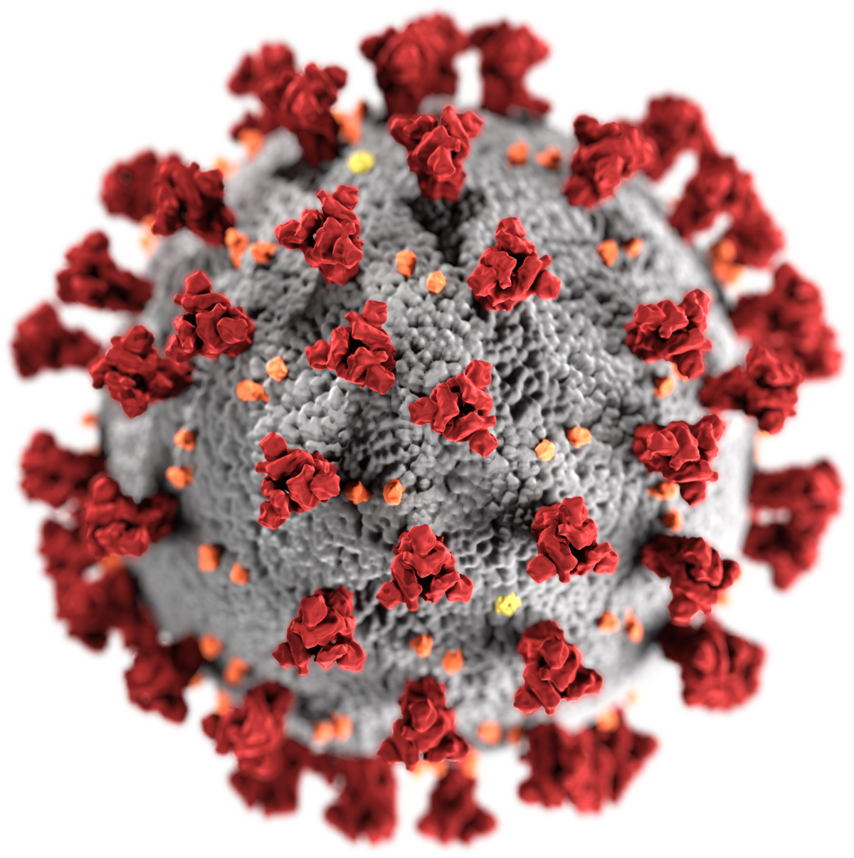


Project Goals
Collaborate with high school science teachers to create & enact COVID-related curriculum materials.
Study how teachers enact COVID-related materials
Study student interests, perceptions of their learning needs, and strategies for information seeking & evaluation in the midst of a pandemic.
RAPID-Responding to an Emerging Epidemic through Science Education
https://epiclearning.web.unc.edu/covid/
Underlying Assumptions
The COVID-19 pandemic offers an example of why scientific literacy is so critical.
We contend that science classrooms should be spaces in which learners explore complex issues, like pandemics, and how science can be used to inform societal solutions and personal decision-making.
However, issues-based teaching is challenging. Science teachers often struggle with the emerging nature of the science, limited curriculum materials, connections between science and social dimensions.

Slide 2
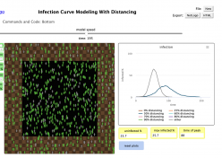
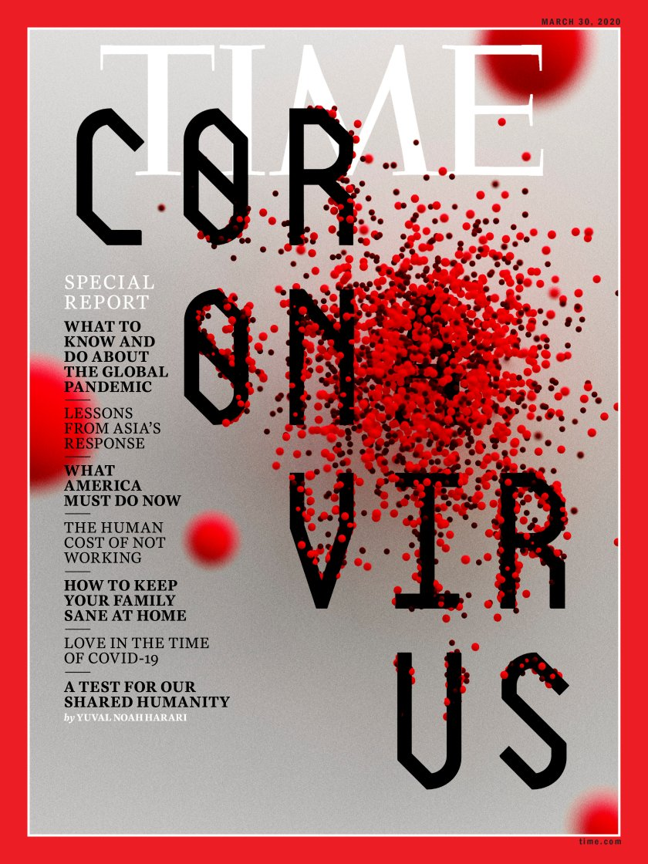
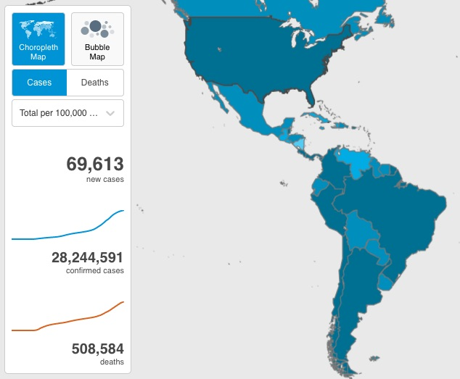
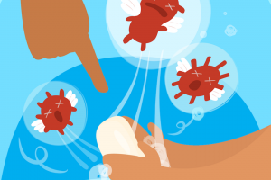
Project Goal 1: Curriculum Development & Enactment
Engaging with Scientific Models
Modeling viral spread
Simulating infection curves
Mapping causal factors within the pandemic system
Media & Information Literacy
Tools & heuristics for assessing information sources
Creating media
Exploring the Socio-political dimensions of COVID-19
National responses to the pandemic
Creating a policy for my city
Social vulnerabilities associated w/ COVID
Understanding Key Science Ideas to Explain the Pandemic
Why handwashing stops viral spread
Exploring the effectiveness of masks
Learning activities available: https://epiclearning.web.unc.edu/covid/

Slide 3
Project Goal 2: Teacher Focused Research
Data Sources
Field notes from PD & Co-design
Teacher interviews (after PD; after enactment)
Instructional logs
Artifacts: teacher design products & student work
Project
Iterations
Key Findings
*a: Teachers were concerned with the potential mental health impacts associated with teaching about COVID-19
in the midst of the pandemic. Addressed through discussions with a pediatric psychologist.
*a: Teachers struggled to align COVID-themed instruction with NGSS. Resolved by focusing on scientific modeling
and characteristics of life (a required unit in existing curriculum).
*b: District policies around re-opening had an out-sized impact on teachers’ abilities to enact the curriculum as
they saw fit.
*c: Teachers modified the COVID-19 materials based on the needs of their student populations and constraints
associated with online and hybrid instruction.

Slide 4
Project Goal 3: Student Focused Research
Data Source
Student Survey (n=240)–sections on
1) Preferences for information sources and
formats (Likert)
2) Media literacy strategies (Likert)
3) Interest & perceptions of importance (Likert)
4) Concerns & impacts (open-ended)
Interest & Perceptions of Importance
Rasch analysis suggests the following priorities for learning & information seeking about COVID-19
Top priority: Self Protection
Preventing Spread
Social Impacts
Low Priority: Biology of the Virus
Information Sources & Formats
Cluster analyses suggest three preference groups for FORMATS for information about COVID-19:
Online Media
Traditional Media
Low-information Seekers
Four preference groups for SOURCES of information about COVID-19:
Online Interactions
Personal Relationships
Low Information Seekers
Media Literacy Strategies
Exploratory factor analysis suggest three sets criteria that students rely on for COVID-19 related information–Attending to
Validity of the content
Expertise of the source
Popularity of the source
Preference clusters (information sources & formats) were associated with unique patterns for media literacy strategies; e.g., Low Information Seekers are less likely than others to check for expertise of the source.

Slide 5
Project Papers:
Sadler, T. D., Friedrichsen, P., Zangori, L., & Ke, L. (2020). Technology-supported professional development for collaborative design of COVID-19 instructional materials. Journal of Technology and Teacher Education, 28, 171-177. https://www.learntechlib.org/p/216087/
Ke, L., Sadler, T. D., Zangori, L., & Friedrichsen, P. (in press). Developing and using multiple models to promote scientific literacy in the context of socio-scientific issues. Science & Education. DOI: 10.1007/s11191-021-00206-1 https://link.springer.com/article/10.1007%2Fs11191-021-00206-1
Sadler, T. D., Friedrichsen, P., Zangori, L., & Ke, L. (2021). Responding to an emerging epidemic through science education (REESE): Project highlights spring 2021. Chapel Hill, NC: University of North Carolina (9 pp.). (REESE_summary-AERA_sym2021)
Project Website:
https://epiclearning.web.unc.edu/covid/
Project Video:
https://stemforall2021.videohall.com/presentations/2183

Slide 6
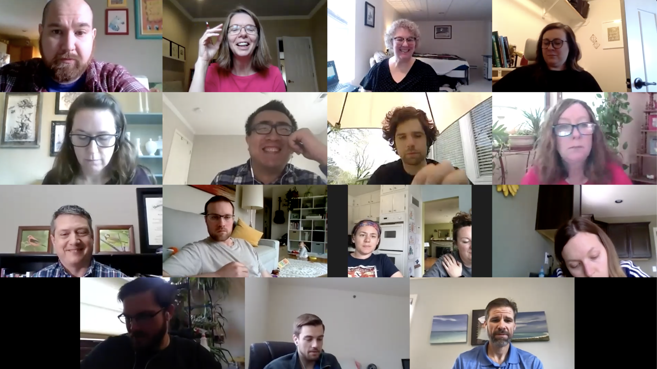
Principal Investigators:
Troy Sadler, UNC
Pat Friedrichsen, MU
Laura Zangori, MU
Postdoctoral Researcher:
Li Ke, UNC
Graduate Student Contributors:
Jamie Elsner
Eric Kirk
Tanner Oertli
Rebecca Rawson
Special thanks to the teachers who partnered with us to co-design and enact ambitious curriculum under unprecedented conditions.
Sarah Apple Dan Miller
Susanna Barchak Abigail Nahlik
Christy Darter Jessica Platto
Clayton Elmy Jordan Rockett
Andrew Kinslow Brandon Wagner
Rhiannon Mckee Melissa Wessel
This work was supported by National Science Foundation under grant No. 2023088 – RAPID: Responding to and Emerging Epidemic through Science Education (REESE). Ideas expressed in this material are those of the authors and do not necessarily reflect the views of the NSF.

