Slide 1

Developing Diagnostic Assessments of STEM Learning: Key Decisions and Alternative Approaches
Jere Confrey
North Carolina State University
William R. Penuel
SRI International
DELTA Support by NSF DRL 0733272. Qualcomm
Corporation and the Pearson Foundation
Contingent Pedagogies Support by NSF

Slide 2
Our Challenge
Designing diagnostic assessments presents a complex problem of bringing together teams of researchers who combine knowledge of student thinking, assessment, measurement and classroom practice, and who are committed to providing better support for teachers as they engage in instructional guidance.

Slide 3
Why focus on assessment?
Demands for accountability: Assessment resources, models, and technologies must keep pace to inform policy and instruction
  Alignment to standards (e.g., Common Core)
  Probing understanding and application of core disciplinary concepts
“Assessing the full scope of mathematical, scientific, and technological proficiency in valid and reliable ways presents conceptual, psychometric, and practical challenges.”
From the DRK-12 Program Solicitation

Slide 4
Diagnostic Assessments require:
Processes designed to identify common obstacles, landmarks, intermediate transformative states, and essential components, that act as indicators of what students are likely to encounter in order to advance in learning. They are based on an explicit cognitive growth models supported by empirical study using cross sectional or longitudinal sampling. It is important that diagnostics measure healthy growth in conceptions as well as to identify deficits or misconceptions.
                Confrey and Maloney, 2010

Slide 5
Common Features of Diagnostic Assessment Systems in Development
Guided by models of cognition
  Learning trajectories or progressions focused on conceptual development in domains
  Facets of student thinking
  Learning trajectories or progressions focused on participation in practices (within the disciplines, of practices)
Informed by a variety of sources of validity evidence, mostly gathered and interpreted by project teams
  Literature synthesis
  Ethnographic studies of expert practice
  Clinical interviews
  Field tests of items
  Psychometric modeling
  Efficacy of use in classrooms

Slide 6
Common Features of Diagnostic Assessment Systems in Development
Make use of technology
  For delivery of assessments
  For automation of scoring
  For informing everyday instruction
Are intended to support improvements to teaching and learning
  Helping teachers draw inferences about how to adjust instruction to better meet learning needs of individual students, small groups, the class
  Helping students reflect on and revise their own thinking
    Developed at “Designing Technology-Enabled Diagnostic Assessments for K-12 Mathematics" November 17-18, 2010, Raleigh, NC

Slide 7
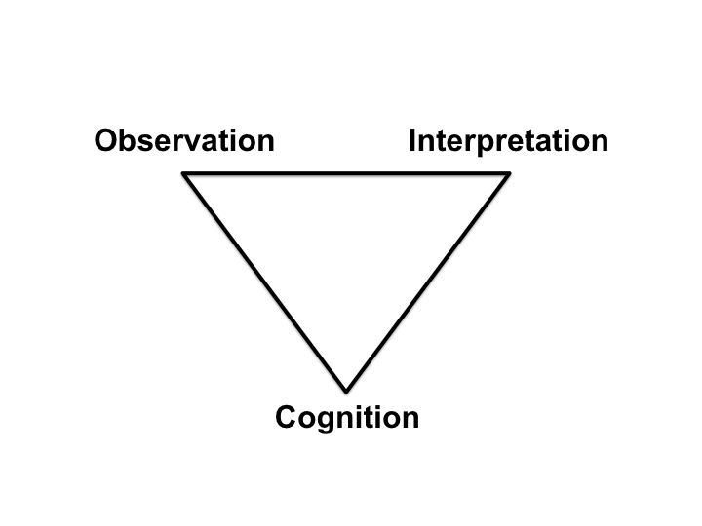
The Assessment Triangle
Adapted from the National Research Council (2001), Knowing What Students Know

Slide 8
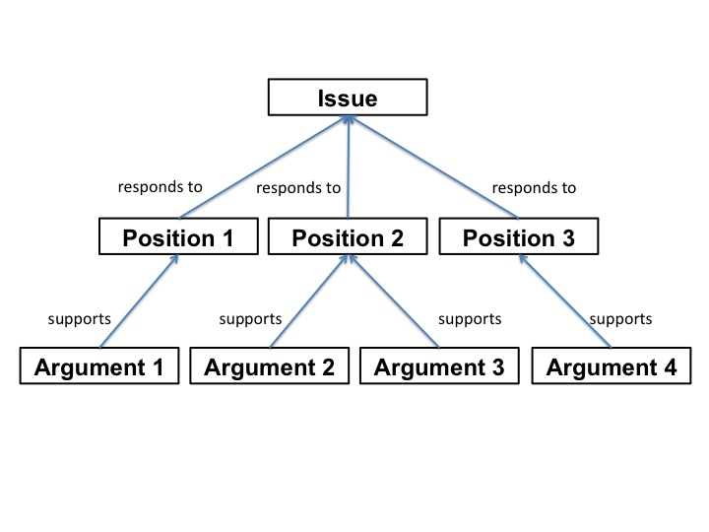
Design Decisions & Rationales
A design rationale is an account of the decisions teams make and the reasons for their decisions (Jarczyk, Loffler, & Shipman, 1992; Lee & Lai, 1991; Moran & Carroll, 1996).
The need for a design rationale arises from a particular view of design as aimed at closing a gap between what ought to be and what is, given a set of resources that constrain what can be done (Conklin, 2005; Tatar, 2007).
A design rationale can be thought of and represented as an argument (Burge & Brown, 2000)
Interface of an IBIS-inspired Design Rationale System from Regli et al. (2000)

Slide 9
Diagnostic E-Learning Trajectories Approach (DELTA)
Goals
  Build learning trajectories on an equipartitioning/splitting foundation for rational number
  Develop a methodology to validate trajectories and related items
  Design a diagnostic assessment system aligned with Common Core standards for use with formative assessment practices and LTBI instruction (Stzajn, Confrey and Wilson, in progress)

Slide 10
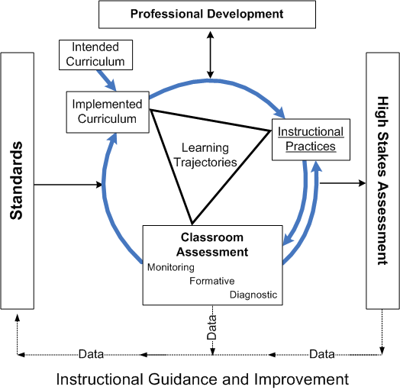
INSTRUCTIONAL GUIDANCE SYSTEM
Confrey and Maloney, 2010

Slide 11
Three dominant meanings of a/b built on an equipartitioning foundation
RNR Learning Trajectories

Slide 12
Learning Trajectory Matrix:Equipartitioning
Equipartitioning Learning Trajectory Matrix (grades K-8) Task Classes Proficiency Levels |  | A | B | C | D | E | F | G | H | I | J | K | L | M
 |  | Collections | 2-split (Rect/Circle) | 2^{n} split (Rect) | 2^{n} split (Circle) | Even split (Rect) | Odd split (Rect) | Even split (Circle) | Odd split (Circle) | Arbitrary integer split | p = n + 1; p = n-1 | p is odd, and n = 2^{i} | p >> n, p close to n | all p, all n (integers)
16 | Generalize: a among b = a/b
15 | Distributive property, multiple wholes
14 | Direct-, Inverse- and Co-variation
13 | Compositions of splits, mult. wholes
12 | Equipartition multiple wholes
11 | Assert Continuity principle
10 | Transitivity arguments
9 | Redistribution of shares (quantitative)
8 | Factor-based changes (quantitative)
7 | Compositions of splits; factor-pairs
6 | Qualitative compensation
5 | Re-assemble: n times as much
4 | Name a share w.r.t. the referent unit
3 | Justify the results of equipartitioning
2 | Equipartition single wholes
1 | Equipartition Collections

Slide 13
DELTA Methodology

Slide 14
Data from Trajectory IRT analysis

Slide 15
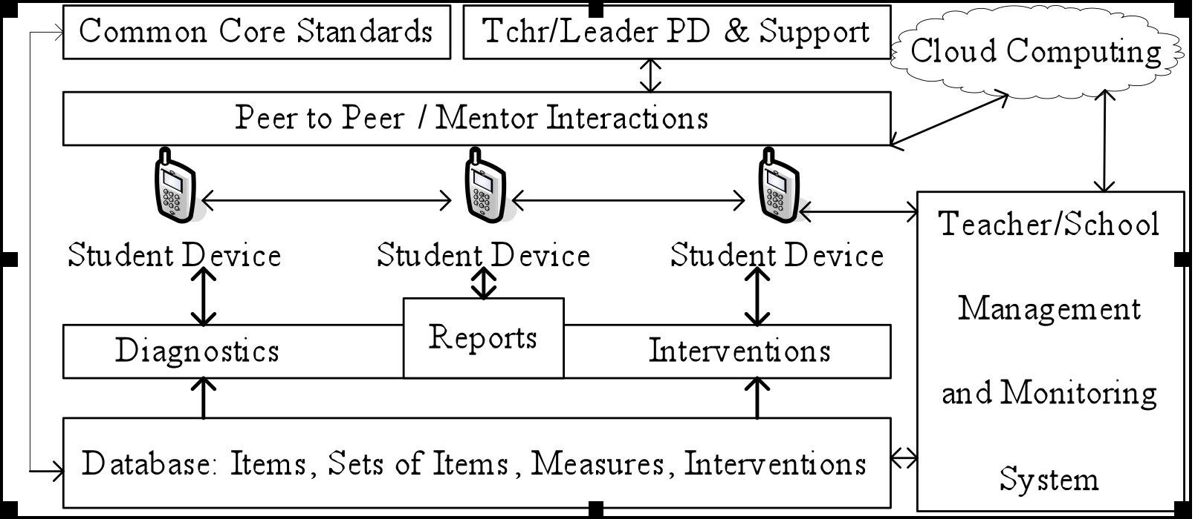
LPP-Sync Design
Prototyping
a Diagnostic Assessment System

Slide 16
LPP-Sync Design of Diagnostic System

Slide 17
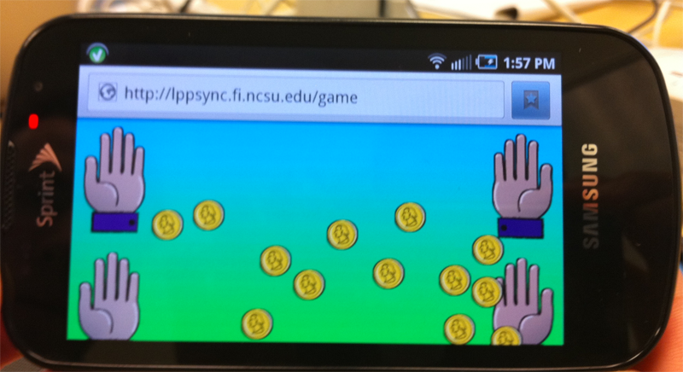

Applets for Diagnostics and Activities: Packet 1
Equipartitioning Learning Trajectory
Proficiency levels:
1 (Collections)
3 (Justification)
4 (Naming)

Slide 18
Major DELTA Design Decisions
Identifying and focusing on equipartitioning
Creating a matrix separating proficiency levels from task classes to represent the LT
Building a database tool for items, outcomes spaces, rubrics, and videos
Recognizing multiple validation sources for items and the LT
Balancing resources for preparing the ground (CCSS) and the scientific work
Deciding how often to refine a trajectory
Designing the diagnostic system to support interactive classroom practices and scientific reports

Slide 19
Goals of the Contingent Pedagogies Project
Providing technologies and pedagogical patterns to help teachers:
  Find out what students know at the beginning and end of each IES investigation
  Make sense of student thinking
  Decide what to do next, if students need additional review or still have problematic conceptions of the content
  Introduce strategies that focus on the goals of the Investigating Earth Systems (IES) curriculum but that are different from IES, in case the curriculum does not provide enough support for student learning
So that students master the knowledge and skills taught in the IES curriculum

Slide 20




Project Partners

Slide 21
Three Supports for Formative Assessment
Align assessments to standards, curriculum, and facets of student thinking
Provide pedagogical patterns that help teachers and students together enact all the steps critical for effective formative assessment using clicker technologies
Provide a suite of tools to address each of the typical challenges to assessment

Slide 22
What are FACETS?
Facets describe ways of student thinking about Earth science.
Facets are grouped into clusters that focus on big ideas and important phenomena:
  Weathering
  Erosion and Deposition
  Patterns with the Locations of Volcanoes, Mountains and Earthquakes
  Causes of Earthquakes, Volcanoes and Mountain-Building
  Why Plates Move
  How Plate Movement Affects the Shape of Continents and Species of Life on Continents
Goal facets focus on learning goals.
Problematic facets are partial or problematic ways that students commonly think about the science concepts.

Slide 23
Alignment
Standards
What do the state and district expect students to know and be able to do?
Curriculum
What does the curriculum provide students the opportunity to learn?
Facets
How do students typically think about scientific phenomena?

Slide 24
Alignment
Standards
What do the state and district expect students to know and be able to do?
Define fair targets for assessment
Address problematic ideas that could interfere with mastery
Curriculum
What does the curriculum provide students the opportunity to learn?
Facets
How do students typically think about scientific phenomena?
Elaborate key components of the standard

Slide 25
Facets for Weathering Cluster
Goal Facets
01- Physical process weathering can happen by rocks rubbing together (through abrasion), by rocks being split apart (when plants grow or water freezes in cracks or holes in rock), or by rocks expanding or contracting (through heating and cooling).
02- Chemical process weathering can happen when chemicals in the rocks go into solution or when they combine with other chemicals in the air or water.
03- The effects of weathering typically take a long time before they can be observed (at least several decades).
04-Weathering may result in the wearing down of rocky landforms.
Problematic Facets
  20- The student thinks that only weathering affects landforms and so all landforms eventually will become flat.
  30- The student thinks that the power, force, and/or pressure of wind and water always have an immediate impact on rocks and landforms.
  50- The student overgeneralizes water’s impact on weathering.
  51 Water alone is enough to shape rocks.
  52 Only water has to present for chemical weathering to occur. For example, students do not understand that oxygen in the air is also needed for rocks to oxidize.
  80- The student confuses weathering and erosion.
  90- The student thinks that rocks do not change over time/are the same as they have always been.
Notes:
25

Slide 26
Examples of Student Responses
Question
What do you think will happen to Earth after millions of years of weathering? Will it become completely flat? Say why or why not.
Student Responses
Yes, it will go flat because of erosion.
Yes, because the wind will press it down.
Yes, because there will be changes in air such as hot and cold.
Yes, the air molecules are moving so fast that they slowly break up everything they hit .
Rain and floods will wash away the mountains.
Notes:
26

Slide 27
Pedagogical Patterns
Patterns are designed to be useful for different phases of instruction
  Elicitation Patterns: When beginning an investigation (can replace Key Question discussion)
  Boomerang and Reflect and Revise Patterns: At the conclusion of an investigation (can replace Review and Reflect questions)
  Model-based Reasoning Pattern: For Contingent Activities
Although each is “new” to this project, the patterns are based on patterns of interaction can promote deep science learning
  Feel free to develop your own questions for use with the patterns
  Try to follow the pattern as best as possible, even if you discover you need to modify specific instructions to suit your class’ needs

Slide 28
Suite of Tools
Key Element in Formative Assessment | Contingent Pedagogies Tools
Posing questions that require deep thinking focused on learning goals | Elicitation and Reflect and Revise questions for each investigation linked to facets of student thinking
Giving students time to think | Clicker Technology: require time for response Spark Discussion Questions: Students to prepare an explanation for their answer
Providing students with feedback | Clicker Technology: Anonymous display for all to see
Engaging students in discussing their ideas | Classroom Norms to encourage students to contribute, listen, and revise ideas Discussion Moves to elicit questions, probe thinking, and encourage students to take responsibility for learning
Adjusting instruction | Decision Rules to guide adjustments Contingent Activities when many students still hold problematic ideas

Slide 29
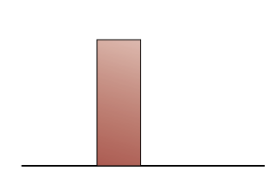
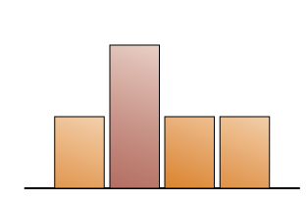
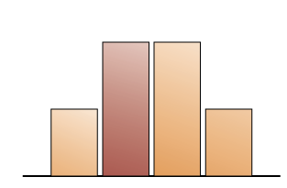
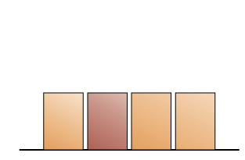
Tools: Decision Rules

Slide 30
Tools: Contingent Activities
Provide an alternate entry point into the content
  Making sense of visualizations (animations, images, data tables) that represent important processes
  Applying knowledge strategically to make a prediction or develop an explanation for how something came to be
Address problematic facets
  Constructive and Destructive Forces: When many students believe landforms are only the result of weathering and erosion
  Seafloor Spreading: When many students believe large gaps are opened up on Earth’s surface when plates diverge

Slide 31
Validity Argument for CP
Claim:
  Teachers can use the suite of tools to adjust instruction in ways that improve students’ science learning.
Evidence:
  Student learning assessments aligned to national standards Video analysis of teachers
Warrant:
  Instructional validity of assessments relates to their usability for guiding instructional decision making (Confrey, 2008; Donovan & Pellegrino, 2003) and efficacy for improving instruction (Yoon & Resnick, 1998)
Some potential qualifiers:
  Threats to internal validity: Quasi-experimental, rather than experimental design
  Generalizability of findings: to other curricula
Notes:
Confrey, J. (2008b). Framing effective and fair data use from high-stakes testing in its historical, legal, and technical context. In E. B. Mandinach & M. Honey (Eds.), Data-driven school improvement: Linking data and learning (pp. 33-54). New York: Teachers College Press.
Donovan, S., & Pellegrino, J. W. (2003). Learning and instruction: A SERP research agenda. Washington, DC: National Research Council.
Yoon, B., & Resnick, L. B. (1998). Instructional validity, opportunity to learn and equity: New Standards Examinations for the California Mathematics Renaissance. CSE Technical Report 484. Los Angeles, CA: Center for the Study of Evaluation, National Center for Research on Evaluation, Standards, and Student Testing.

Slide 32
Design Decisions on the Contingent Pedagogies Project
Anchor development in a specific curriculum
Develop the project elements in the order teachers are likely to need to learn them
Iteratively refine elements, to tighten alignment among them over time

Slide 33
Comparing Design Decisions of DELTA and Contingent Pedagogies
Dimension | DELTA | Contingent Pedagogies
Models of Cognition | Learning Trajectories Approach | Facets Approach Scientific practices of explanation supported by norms and moves
Primary Sources of Validity Evidence | Literature Synthesis Clinical Interviews Item Modeling with IRT analysis | Facets identification: Open-ended, pencil-and-paper questions Quasi-experimental study of value-added to curriculum
Technology | Mobile phones networked to Cloud Computing | Group Scribbles, clickers
Supports for Improving Teaching and Learning | Dissertation studies with pre-service and in-service teachers LBTI Project (Stzajn, Confrey,and Wilson 2010) | IES Curriculum Classroom norms Contingent activities for developing model-based reasoning

