Slide 1
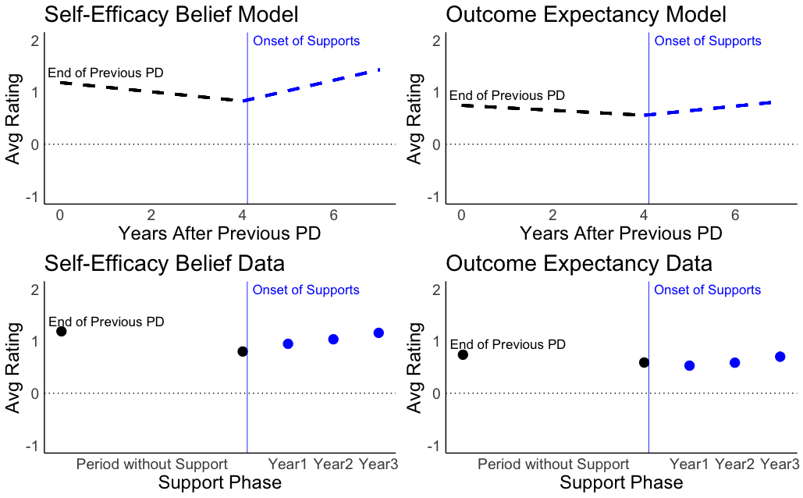
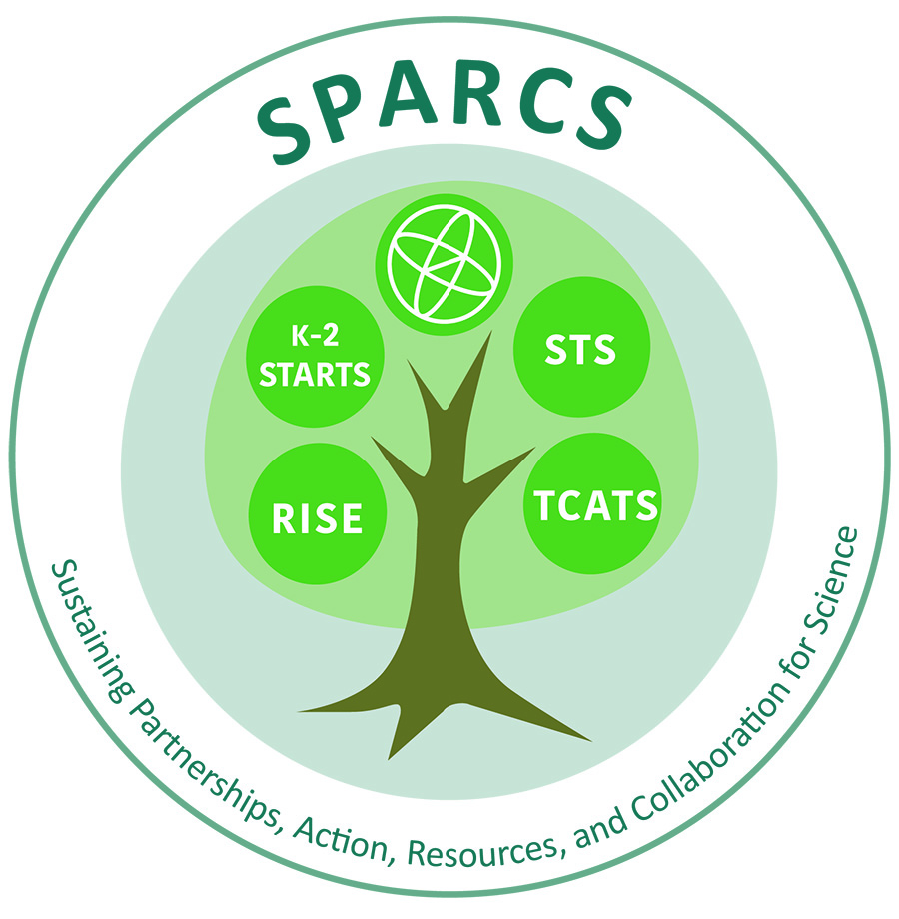
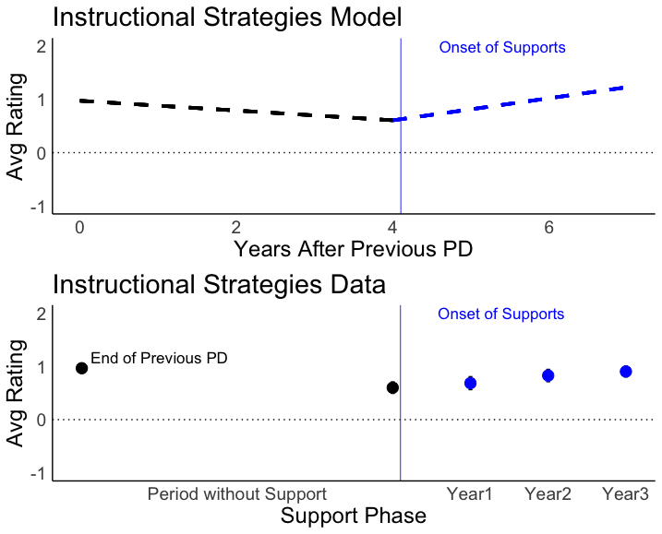
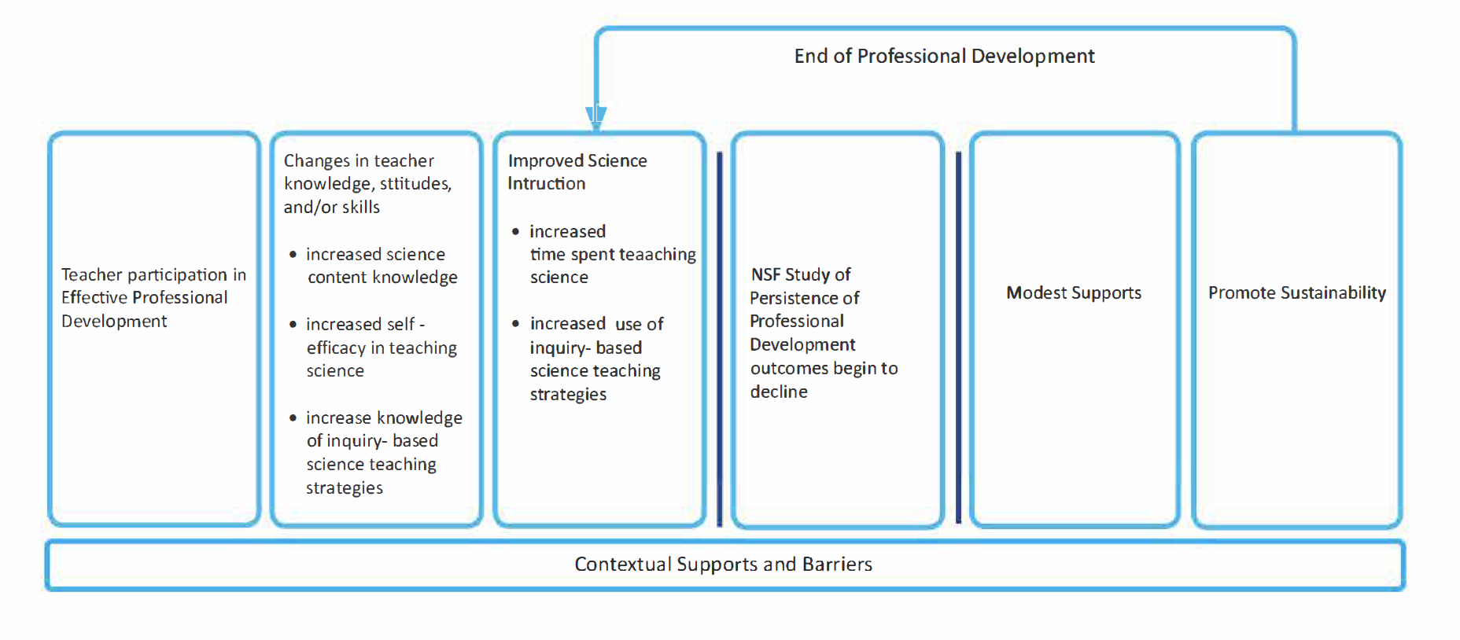
Providing Modest, Blended Professional Development to Improve Elementary Science Instruction
Cathy Ringstaff (WestEd) • Judith Haymore Sandholtz (UC Irvine) • Jessica Triant (WestEd)
Background and Research Questions
Study Intervention
Findings
Professional development is a key strategy for improving science education in elementary schools and has been linked to teachers’ growth in self-efficacy and pedagogy. Researchers document short-term changes in science instruction after teachers participate in professional development, but the extent to which professional development can prompt long-term changes is not yet established. This research addresses the need for more studies that investigate the longevity of professional development outcomes. This longitudinal study examined the sustainability of outcomes for elementary teachers who participated in four professional development programs designed to improve science education and, after a period of no professional development, received modest follow-up supports.
Refresher Sessions | Teacher Meetings | Virtual Collaborations & Webinars | Electronic Supports | Science Material Reimbursements
Two-day face-to-face refresher sessions that were scheduled in the summer and included opportunities for teachers to collaborate on lessons, share strategies, make connections with new colleagues, and reconnect with participants from their original programs | After-school face-to-face meetings held twice during each academic year with teachers grouped by geographic proximity | Synchronous webinars or virtual collaborations facilitated by a science expert or PD leader, focused on topics requested by teachers, and offered approximately once a month | Four forms of electronic support including a dedicated email address, a closed Facebook group page, an electronic newsletter sent via email, and an online repository of materials | $150 per teacher each year to directly purchase needed science materials and supplies
The results of the piecewise model identified similar patterns on all subscales analyzed. Figure 1 provides a visual representation of both the model predictions and the plotted data of three subscales (self-efficacy belief, outcome expectancy, and instructional strategies subscales). Other subscales analyzed included: sense of preparedness, student activities, principal support, and general support. Instructional time spent teaching lessons was analyzed separately.
Figure 1. Models Compared to Data
Specific research questions included:
To what extent did professional development outcomes persist or decline after programs ended?
To what extent did an intervention of modest supports foster the sustainability of professional development, received modest follow-up supports.
Theory of Action
Methods and Data Sources
Our operational theory of how professional development influences teachers, their instructional practice, and student learning (Desimone, 2009) includes four steps:
Teachers participate in effective professional development
Participation increases teachers’ knowledge and skills or changes their attitudes and beliefs
Teachers use new knowledge and skills to improve their instruction through changes in content, pedagogy, or both
Instructional changes promote increased student learning
Our theory of action:
Builds on evidence from our prior research
Adds follow-up support as a key variable that influences teachers’ attitudes and skills as well as their instructional practices
Places greater recognition of contextual influence on entire process and includes both external and internal contextual factors.
Sample
This longitudinal study took place in rural communities across California
Final sample included 37 K-6 teachers who previously completed one of four science-focused PD programs
Teachers in this study came from 30 schools located in 19 different districts
Most teachers were either the only participant or one of two participants from a given school
Data Sources
Teachers completed a number of instruments throughout the entirety of the study including The Science Teaching Efficacy Beliefs Instrument (STEBI, developed by Riggs and Enochs, 1990) and the Horizon survey (Horizon Research, Inc., 2000).
Both instruments have been used widely and were administered at five timepoints during the study:
The end of the previous PD program (2011 -2014)
Pre-intervention (2017)
Year 1 of the intervention (2018)
Year 2 of the intervention (2019)
Year 3 of the intervention (2020)
Methods
Teacher responses were coded and averaged across the various survey subscales for each teacher and timepoint
Primary analyses for the subscales at each timepoint involved fitting mixed effects hierarchical models in order to account for the nested structure of the data – timepoints within teachers
Our aim was to compare growth rates at two time points – the growth rate after the original PD (No Support Phase) as well as the change in growth after the provision of modest supports (Support Phase)
We analyzed data using a piecewise growth model, directly assessing both growth rates by allowing the slopes to vary between these two time periods
As evident from the visuals above, teachers scored positively at the end of the initial PD. The models predicted that during the period of “No support,” teacher ratings decreased at statistically significant levels. These negative trends reversed during the “Support” period, with positive gains on all subscales for every year of the project. The models suggest that the significant gains observed during the support period can reverse the significant decrements observed during the “No Support” period.
Conclusion
This longitudinal study found that the modest supports offered to teachers in the years after participation in three-year, science-based professional development programs to helped to sustain long-term impacts on teachers’ sense of preparedness to teach science, self-efficacy, instructional time in science, and use of targeted instructional strategies and inquiry-based student activities in science. The provision of modest supports significantly improved teachers’ ratings, reversing the initial decline that potentially could undo the positive effects of those programs. Additional research should be conducted on the sustainability of professional development outcomes and the associated impact on instruction, including a cost-analysis of supports offered (which is currently underway).
This material is based on work supported by the National Science Foundation under Grant #1620979. Any opinions, findings, and conclusions or recommendations in the material are those of the authors and do not necessarily reflect the views of the National Science Foundation.

