Slide 1
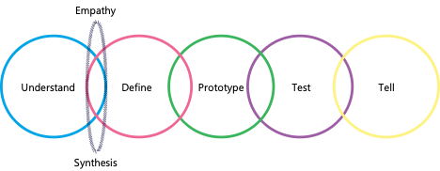
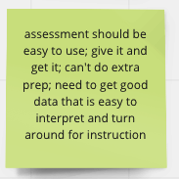
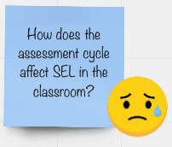
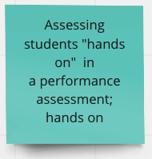
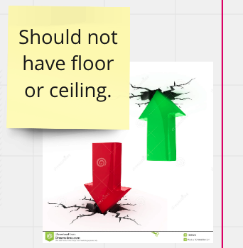
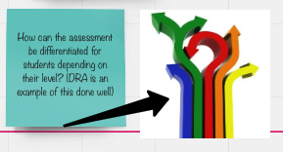
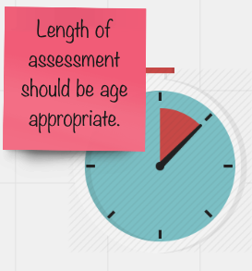
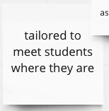
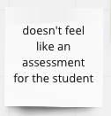
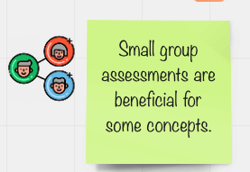
New Methods for Virtual Data Collection
In 2020-21 for the MMaRS Project
Leanne Ketterlin-Geller (PI), Jennifer McMurrer, Qadeer Haider, & Cassandra Hatfield
Southern Methodist University
Background & Context
Think Aloud Methods & Processes
TAP Methods & Processes
Measuring Early Mathematical Reasoning Skills (MMaRS)
The primary goal of the MMaRS project is to create formative assessment resources focused on Numeric Relational Reasoning (NRR) and Spatial Reasoning (SR) for students in grades K-2. Teachers may use the results of these assessments to guide their instructional decision making to support student learning.
Due to IRB restrictions and school closures caused by COVID-19, two primary research activities were conducted remotely in 2020-21 using various methods. The purpose of this poster is to illustrate these methods and share the successes and challenges.
The Teacher Advisory Panel (TAP) served as the voice of practitioners through which teachers offered their input and guidance about the development and use case of the formative assessments and accompanying resources. All TAP activities were conducted virtually through focus group sessions.
Think-aloud interviews with children in grades K-2 were conducted to collect information about the functioning of items in relation to their ability to elicit the intended construct with minimal construct-irrelevant variance. Interviews were conducted by project staff virtually and supported by parents.
Tools for the Virtual Think-Aloud Process
Mailed materials
Zoom Features
Video instructions for virtual workspace
number line
balance scales
counters
Unifix® cubes
base 10 blocks
Pin
Recording
Screenshare
TAP study component anchored within Human Centered Design (HCD) process to design with—not just for—teachers.
TAP meetings and think-aloud interviews were conducted virtually via Zoom. Special tools used to collaborate with the teachers included a virtual whiteboarding tool (Miro) and the breakout room feature to work in and move across small groups for facilitate the Define and Protype phases of HCD using:
Design charettes
Participatory co-design sessions
Preliminary Findings
Lessons for the Field
Goals & Research Questions
TAP
Think Aloud
Challenges in Virtual Data Collection | Experience-Based Solutions:
TAP: Teachers comfort-level using Miro whiteboard in real-time Connectivity and comfort-level with participants using Zoom | Built-in practice time with Miro in a low-stakes environment Offer alternative options (e.g. printed copies of the prototype for teachers to cut and redesign then submit via photo) for teachers to share their work
Think-aloud Interviews: Limitations of visibility of student actions within camera/Zoom range Providing clear, verbal instructions to parents during data collection with young students without compromising the fidelity of the data collection Keeping students engaged in a remote environment | Video demonstration and written instructions for study participant parents to know how to set-up the data collection space and materials for their child Scheduled and purposeful time within the interview protocol for brain-brakes and play with the interview or other materials
Ideal Assessment Ideas
Assessment Challenges
TAP primary research goals:
Introduce the learning progressions to the TAP and study how they may best facilitate the use of the NRR and SR formative assessments to inform its design.
Iteratively redefine the use case by building on the findings of prior TAP meetings to understand how the TAP would like to use the MMaRS formative assessments and their corresponding learning progressions in their K-2 classrooms.
Think-aloud interview research questions:
Do students understand what to do in response to the draft item prompts?
Do the draft items adequately elicit the intended content and reasoning strategies for students to solve the items?
Are there components of the item instructions or task (e.g. manipulatives, materials, instructions) that introduce construct irrelevant variance?
MMaRS Formative Assessment Suite
The Measuring Early Mathematical Reasoning Skills (MMaRS): Developing Tests of Numeric Relational Reasoning and Spatial Reasoning project is funded by the National Science Foundation Grant #1721100. Any opinions, findings, and conclusions or recommendations expressed in these materials are those of the authors and do not necessarily reflect the view of the National Science Foundation

