Slide 1
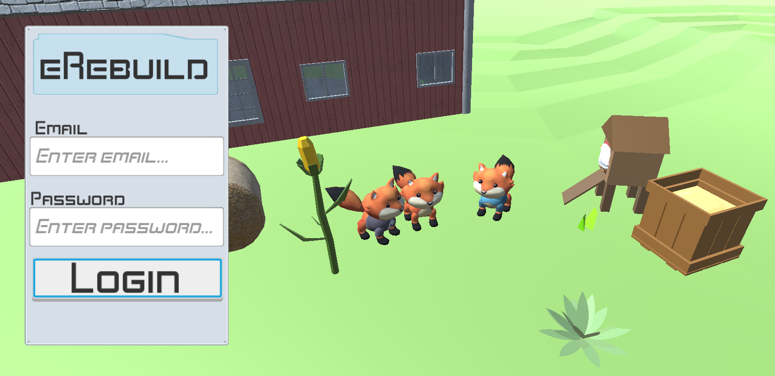
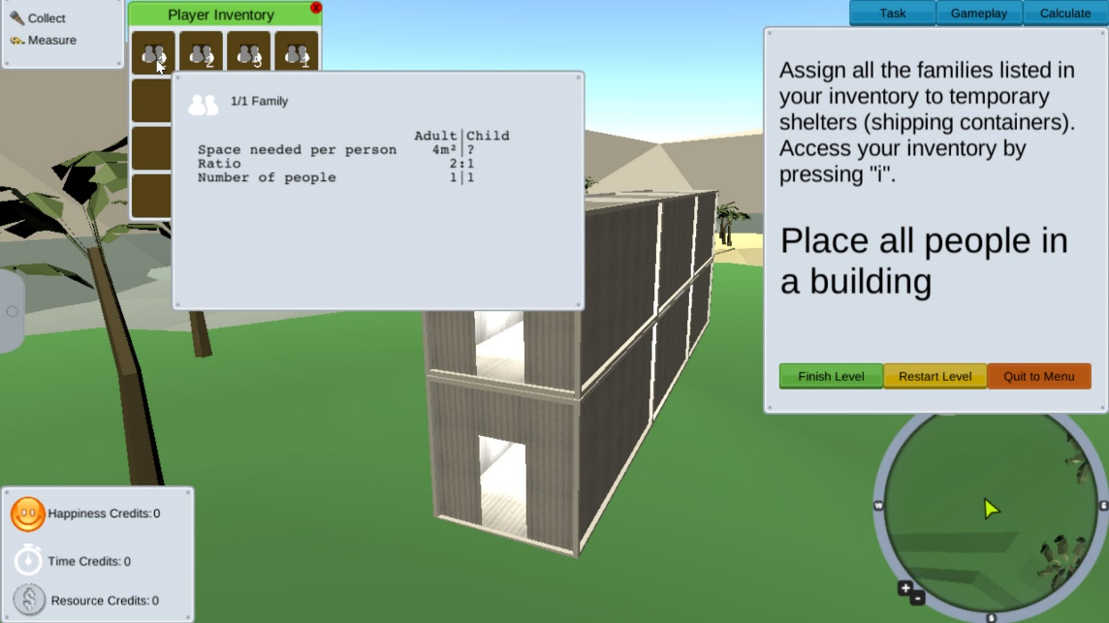
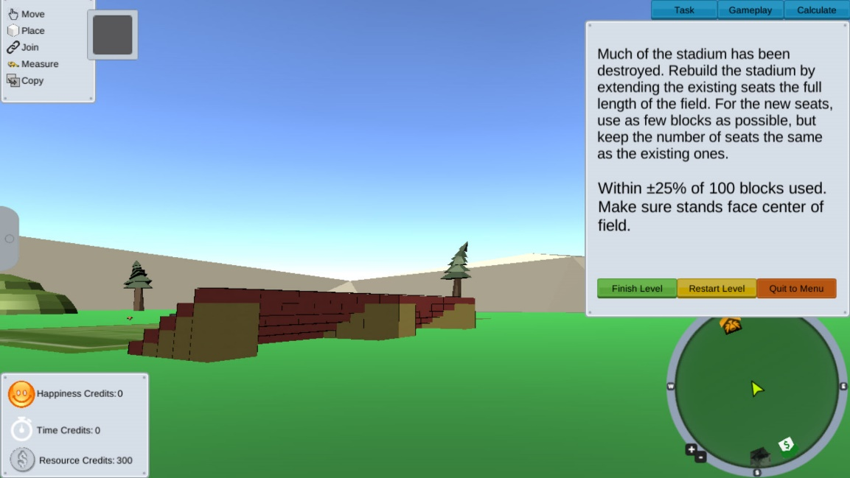
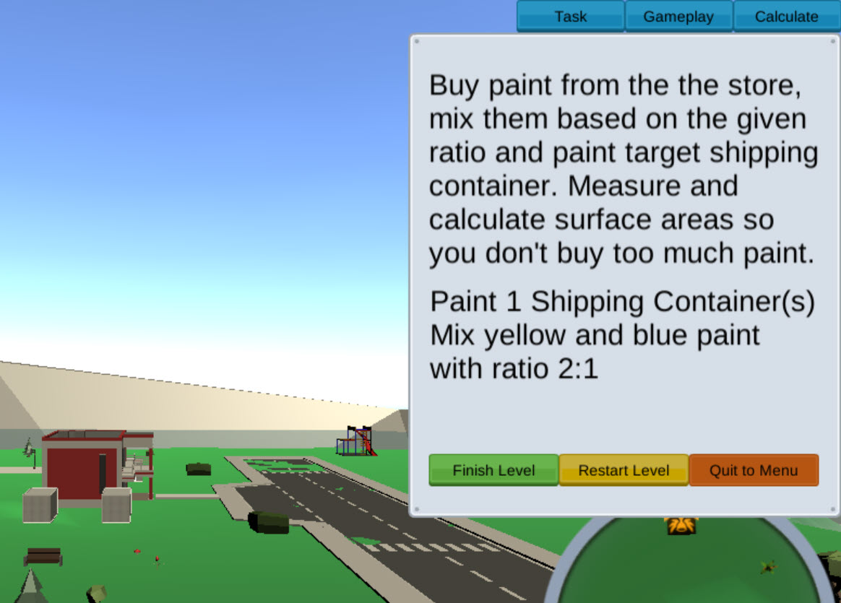
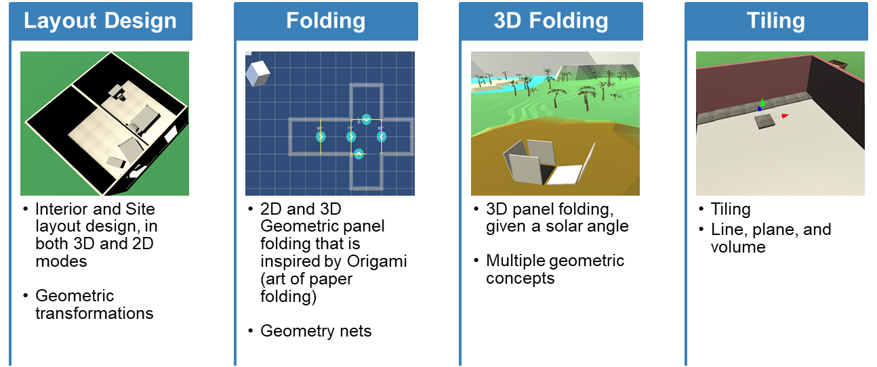
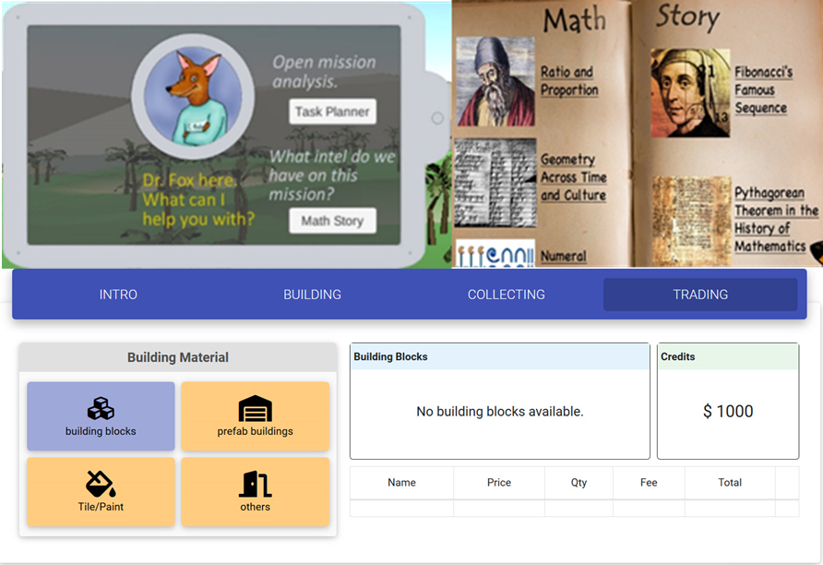
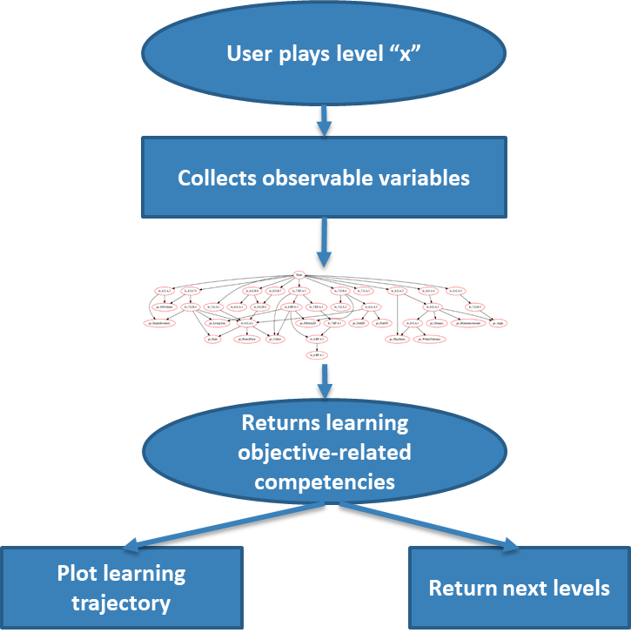
Mathematical Learning via Architectural Design and Modeling Using E-Rebuild
Fengfeng Ke, Kathleen Clark, Russell Almond, Valerie Shute, Gordon Erlebacher, & E-Rebuild team | Florida State University | DRK-12 PI Meeting 2021
Research Question
Core Game Actions: Building, Allocation, Trading
Iterative Mixed-Method Studies & Findings
How and to what extent will participating in three-dimensional architectural design and modeling via a game-based learning platform will support math representation and problem solving for middle school students?
Five iterative mixed-method studies conducted with a total of 217 6th-8th grade students from 3 middle schools.
There was a significant improvement with a large effect size from pretest to posttest by the E-Rebuild participants in the math problem-solving test performance, Cohen’s d = .85.
Controlling for the pretest performance, the E-Rebuild group significantly outperformed the “business-as-usual” control group in the post-treatment math problem-solving test with a medium-large effect size, partial η² = .22.
There was a significant positive association between in-game task performance and the gain score of the math problem-solving test performance.
Teachers demonstrated engagement and creativity in using the game level editor for mathematical problem posing during the teacher workshops.
Project Overview
E-Rebuild, a 3D architecture game that is designed and studied as a learning, assessment, and professional development tool
For middle-school students and teachers: Tool for learning, assessment, and professional development
Available for multiple platforms
Evidence-centered design and integration of game-based learning task, assessment, learning support, and game level editing.
https://mileresearch.coe.fsu.edu/eRebuild
In-Game Learning Supports
Real-time Learning Assessment & Accuracy Plot
Conjectures
Multimodal external representations of mathematical problems and concepts via interactive game objects in the game world
Core game actions, such as building, allocation, trading, folding, will necessitate active encoding of the external math representations and foster problem solving and conceptual development.
Mathematical competence development, elicited by the core gaming actions and interactions with the in-game objects, is documented by the game logs and analyzed via the in-game stealth learning assessment using the Bayesian network.
A customizable learning platform will enable a localized, scalable implementation for teacher users in school settings.
Objective-driven Game Level Editor
Current E-Rebuild Components
More Information
Game/ Learning mechanic
24 game action/rule archetypes
Mapped with targeted math competencies
Real-time learning tracking
Bayesian network model
Real-time competency estimate
Adaptive learning trajectory and support
Game level editor
Learning objective driven
Level prototyping and development
WYSIWYG interface
51 game levels with continuous task development
In-Game learning support
Interactive task planner
Mathematical history and story
Core levels + adaptive or guided level selection
This project is funded by the National Science Foundation, grant # 1720533. Any opinions, findings, and conclusions or recommendations expressed in these materials are those of the author(s) and do not necessarily reflect the views of the National Science Foundation.
E-Rebuild web: https://mileresearch.coe.fsu.edu/eRebuild/
Contact: fke@fsu.edu

