Slide 1
Diagnostic Assessment for Rational Number Learning (DELTA Project): Opportunities and Challenges for Developing Assessments
Alan Maloney and Jere Confrey
NSF DRK-12 Principal Investigators’ Meeting
Session: Opportunities and Challenges for Developing and Evaluating Diagnostic Assessments in STEM Education
December 3 , 2010
The William and Ida Friday Institute for Educational Innovation
College of Education
North Carolina State University
Raleigh, NC
Support from—
Diagnostic E-Learning Trajectories Approach (DELTA) – National Science Foundation DRK-12 Grant #0531120
3rd-Party Scoring of Field Tested Assessment Items - Pearson Foundation

Slide 2
Goals of research programme
Goals/products:
  Synthesize and empirically extend large body of research on student learning on rational number (math education, cognition)
  Construct and validate learning trajectories for rational number
  Develop diagnostic assessments
  Develop diagnostic assessment system with rapid feedback of student response data, formative use model

Slide 3
Why Diagnostic Assessment for Rational Number Reasoning?
Rational Number Reasoning (RNR) is prerequisite to success in algebra and advanced mathematics large body of literature on rational number
Summative assessment not based on models of student thinking and provide little actionable feedback for instruction
Innovative curricular approaches are constrained by assessments ( lack of sensitivity to important differences in student thinking)
Teachers engaging in formative assessment often miss opportunities to promote growth in student learning

Slide 4
Challenges--
Further our understanding of how students progress through big ideas in rational number reasoning (learning trajectories)
Combine knowledge of student thinking, assessment, measurement, and classroom practice
Develop diagnostic assessments based on first 2, to provide instructional guidance support for teachers

Slide 5
Orientation of research programme (Challenges)
  Instruction is central to support and direct student learning
  Use Model: Improve instructional inclusive fitness
    high value on student learning,
    actionable feedback to teachers and students w.r.t. student learning and responsive instruction
    promote teacher understanding of 1) content and 2) student learning
    readily used (teachers and students in the flow of classroom formative practice)
    minimal impact on teacher workload: in long-run, better learning and wiser instruction, less teacher labor.
  Technology (mobile device) based
    rapid (formative) feedback
    support peer-peer and peer-mentor interaction / collaboration
    support teacher as facilitator of learning
    support students as high-value resource in their own learning

Slide 6
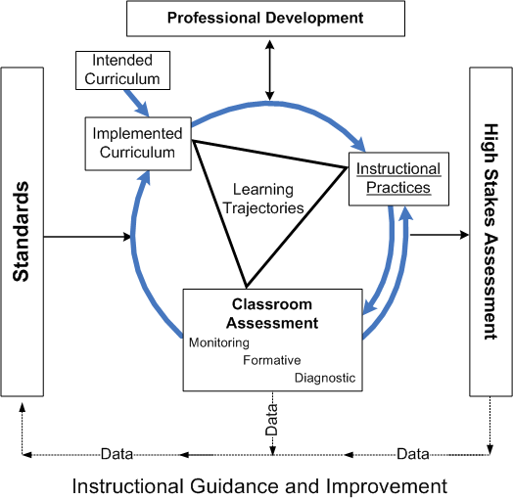
INSTRUCTIONAL GUIDANCE SYSTEM
Confrey and Maloney, 2010

Slide 7
Diagnostic Assessments require:
Processes designed to identify common obstacles, landmarks, intermediate transformative states, and essential components, that act as indicators of what students are likely to encounter in order to advance in learning. They are based on an explicit cognitive growth models supported by empirical study using cross sectional or longitudinal sampling. It is important that diagnostics measure healthy growth in conceptions as well as to identify deficits or misconceptions.
                Confrey and Maloney, 2010

Slide 8
Diagnostic Assessment--
Based on an explicit cognitive model, itself supported by empirical study, of how students’ thinking progresses over time (a learning trajectory).
Supports the formal delineation of characteristics of student reasoning, with concomitant strengths and weaknesses, as a means to identify students’ positions relative to learning trajectory proficiency levels.
Should afford sufficient descriptive detail to observe, measure or explain the related behaviors and to make inferences.
Both diagnostic and formative assessment provide windows into student thinking within instructional planning and feedback cycles.
Has the potential to drive formative assessment forward by specifying a lens (learning trajectories) through which to interpret the rich artifacts of student reasoning.

Slide 9
Conceptual corridor
Confrey (2006) Design Studies Chapter
Cambridge Handbook of the Learning Sciences

Slide 10
Learning trajectories
…a researcher-conjectured, empirically-supported description of the ordered network of constructs a student encounters through instruction (i.e. activities, tasks, tools, forms of interaction and methods of evaluation), in order to move from informal ideas, through successive refinements of representation, articulation, and reflection, towards increasingly complex concepts over time (Confrey et al. 2009)

Slide 11
RNR Learning Trajectories

Slide 12
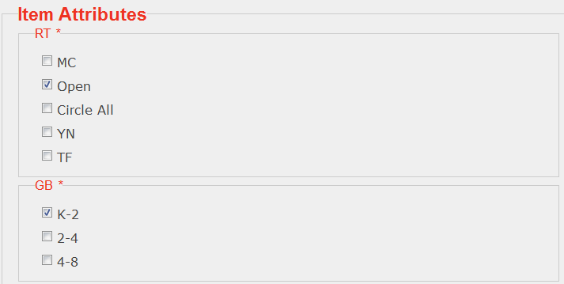
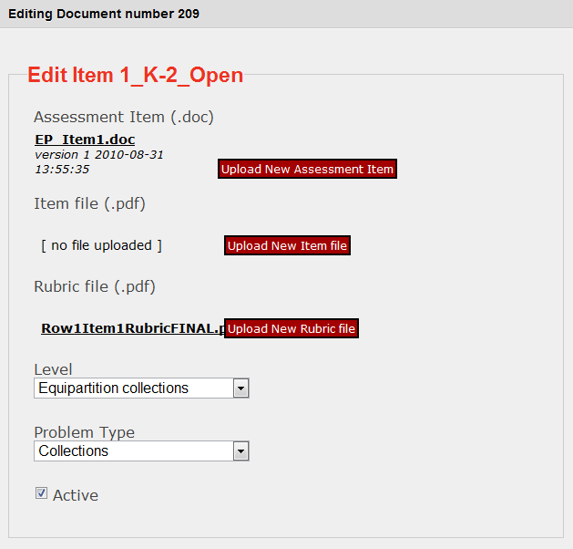
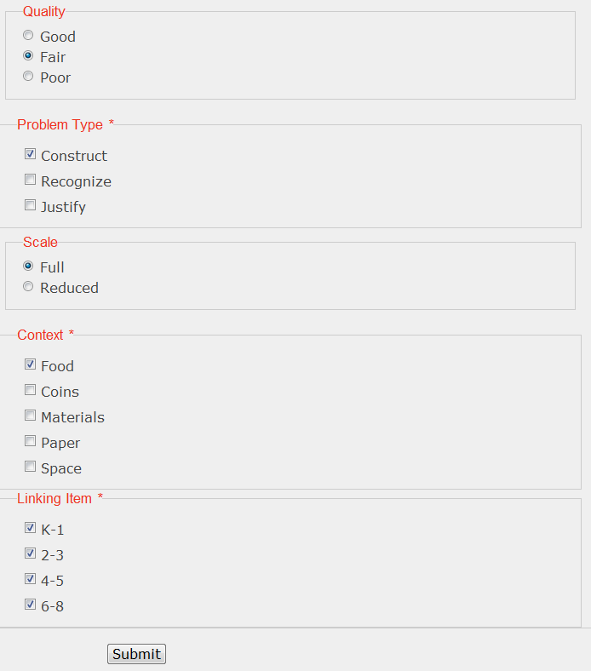
Assessment/Item Development Database

Slide 13
DELTA Methodology

Slide 14
Learning Trajectories: Assumptions
Based on synthesis of existing research and empirical study to validate;
Identify domain and a goal level of understanding.
Children’s relevant yet diverse experiences serve as effective starting points.
Assume progression of cognition from simple to complex; not linear, nor random; can be ordered as “expected tendencies” or “likely probabilities”.
Progress through a learning trajectory assumes a well-ordered set of tasks (curriculum), instructional activities, interactions, tools, and reflection.

Slide 15
Equipartitioning LT Matrix
Equipartitioning Learning Trajectory Matrix (grades K-8) Task Classes Proficiency Levels |  | A | B | C | D | E | F | G | H | I | J | K | L | M
 |  | Collections | 2-split (Rect/Circle) | 2^{n} split (Rect) | 2^{n} split (Circle) | Even split (Rect) | Odd split (Rect) | Even split (Circle) | Odd split (Circle) | Arbitrary integer split | p = n + 1; p = n-1 | p is odd, and n = 2^{i} | p >> n, p close to n | all p, all n (integers)
16 | Generalize: a among b = a/b
15 | Distributive property, multiple wholes
14 | Direct-, Inverse- and Co-variation
13 | Compositions of splits, mult. wholes
12 | Equipartition multiple wholes
11 | Assert Continuity principle
10 | Transitivity arguments
9 | Redistribution of shares (quantitative)
8 | Factor-based changes (quantitative)
7 | Compositions of splits; factor-pairs
6 | Qualitative compensation
5 | Re-assemble: n times as much
4 | Name a share w.r.t. the referent unit
3 | Justify the results of equipartitioning
2 | Equipartition single wholes
1 | Equipartition Collections

Slide 16
Key Findings:
Rational Number Reasoning is complex, and yields to a Learning Trajectories strand analysis;
Equipartitioning/Splitting is the foundation for Rational Number Reasoning;
Division and multiplication should be derived from equipartitioning/splitting, and coordinated with counting, addition, and subtraction;
Three dominant meanings for a/b capture most of RNR reasoning.

Slide 17
Challenges / Opportunities
  Measurement / psychometric approaches as one tool for development and validation of learning trajectory
    IRT, CTT perspectives on item difficulty mapping to proficiency levels;
    Complexities in response patterns identify targets for further investigation: interaction of item type, task class and proficiency level interaction that will further clarify structure of LT, enrich interpretation of student response / cognitive development

Slide 18
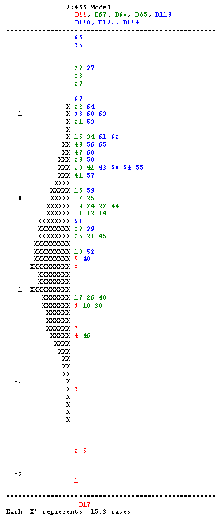
EqP Learning Trajectory Validation
Wright Map from IRT analysis:
Grades 2-3-4-5-6
Numbers indicate the item number;
Colors represent location of item in the framework for
understanding
Each X represents
10 student cases.
KEY
Strategies and representations :
Mathematical Practices :
Emergent Relations:
Generalizations:
Red
Green
Blue
Notes:
Need to read up a little to give a succinct description of a Wright map. Remember that Andre, Rich and Paul will be in the room, too.

Slide 19
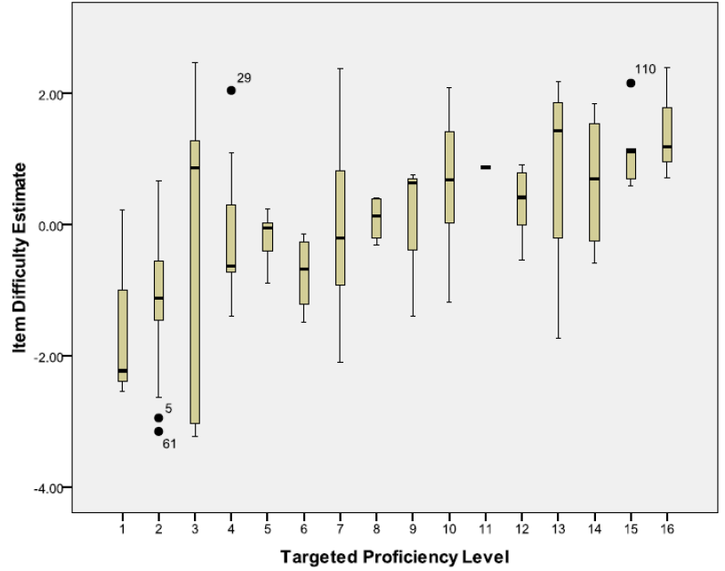
Variance around means

Slide 20
Opportunities
  Could we use diagnostic assessment system on mobile devices to efficiently field test diagnostic items and analyze student responses?
  Accelerate learning trajectory validation?
  Accelerate deployment of valid diagnostic instructional guidance for teachers’ classroom practice?
  Support continuous systemic improvement and psychometric modeling to explore appropriate balance of validity and reliability of diagnostic assessment within formative setting.

Slide 21
LPPSync System
Diagnostic Assessment System Design Considerations—
  Learning Trajectories-based
  Assessment items scored quickly, minimal effort from teachers, but informative to teachers and students
  Usefulness in classrooms: rapid formative feedback to teachers and students
  Engaging--game-like, technology-infused, virtually manipulative
  Flexible, rich representations / reports of student results: feedback to teachers and students
  Supports both sequestered assessment AND student-student interactions around practice and exploration
  Data collection for both formative and long-term analytics purposes

Slide 22
From Items to Diagnostic Assessment
Applets are designed to address different proficiency levels and to be parameterized to produce different task classes in the Equipartitioning LT matrix.
A sampling of items is created, to have a student take six items of varying difficulty, in each diagnostic assessment.
This produces both a score and description of the outcomes based on the item rubrics.
Score determines whether they progress to new proficiency levels.
Rubrics used to provide feedback within Practice Mode, and, eventually to guide development of interventions.
Leverage social networking features==Student-student and student-mentor interactions around chat, screen shots, shared items, replays, rubrics and scores.

Slide 23
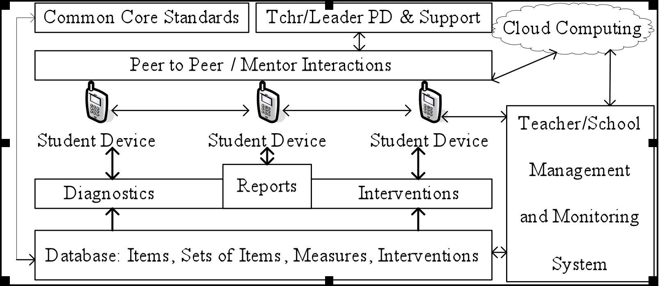
Prototyping a Diagnostic Assessment System

Slide 24
LPPSync Structure

Slide 25
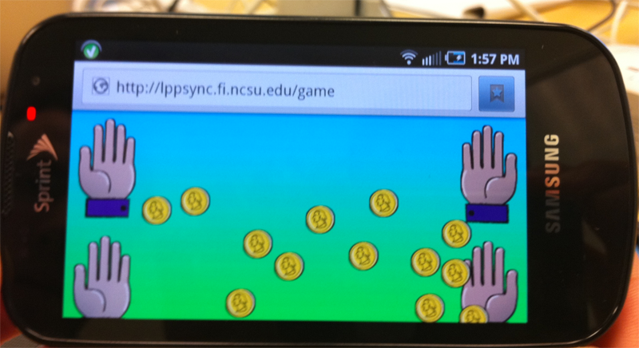

Applets for Diagnostics and Activities: Packet 1
Equipartitioning Learning Trajectory
Proficiency levels:
1 (Collections)
3 (Justification)
4 (Naming)

Slide 26
Applets for Diagnostics and Activities: Packet 2
Proficiency levels:
2 (Collections)
3 (Justification)
4 (Naming)
(5 Reassembly)
(6 Qualit. Compens)
(7 Composition)
(8 Factor-based)
(9 Quant. Redistr.)
(10 Transitivity)

Slide 27
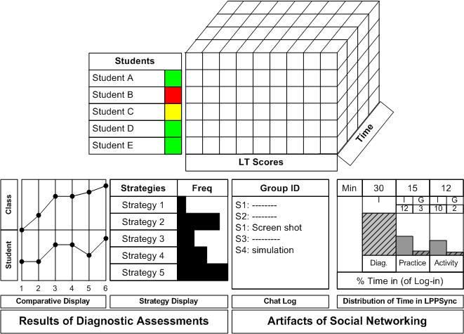
  Feedback to teachers and students:
  Flexible, rich representations / reports of student results

Slide 28
Challenges / Opportunities redux
  Combine student thinking-based cognitive progressions and assessments with modern psychometric modeling to elaborate features of valid diagnostic tools that are viable within classroom use model.

Slide 29
Opportunities / Challenges
Criteria for success within classroom instruction: improved instruction and learning practices
    Diagnostic assessment practices for learning and for instructional guidance : informing both students and teachers and supporting their understanding of their own learning
    Diagnostics support inclusive fitness of instruction: continual growth (improvement) in teacher knowledge of constructs and of student learning in the domain throughout teaching continuum;
    Data analysis methods support LTs and Assessments improvement and effectiveness with broader use
    Assessment system flexible to accommodate continuing research on instruction-mediated progressions of student learning;

Slide 30
Opportunities / Challenges
Criteria for success of diagnostic assessments, with respect to psychometric qualities--
    Measures support improved inclusive fitness of instruction
    Psychometric modeling supports a formative use model of student outcomes / patterns and adaptive instruction
      lower consequential validity, higher instructional and construct validity
    New combinations of IRT, MIRT, DCM, new (combinations of) models?

Slide 32
DELTA Project Goals
  Build learning trajectories on an equipartitioning/splitting foundation for rational number
  Develop a methodology to validate trajectories and related items
  Design a diagnostic assessment system aligned with Common Core standards for use with formative assessment practices and LTBI instruction (Sztajn, Confrey and Wilson, in progress)

Slide 33
Identification and Validation of Learning Trajectories and Related Assessments (DELTA)
Research
Practice
Policy
Design of a Use Model to Support Instructional Guidance and Student Interactions (LPPSync)
Interpretation and Elaboration of the Common Core Standards around Learning Trajectories

Slide 34
Conclusions--
Goal: to provide feedback that informs instruction at a variety of levels
Through doing careful research on equipartitioning, we are able to set a strong seed into the system that can be iteratively improved.
Once the systems generate enough data, through data mining we can determine when patterns in student performance make a difference in real progress.

