Slide 1
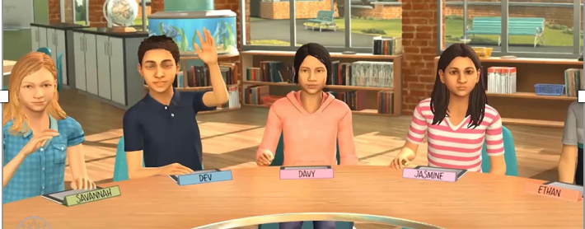
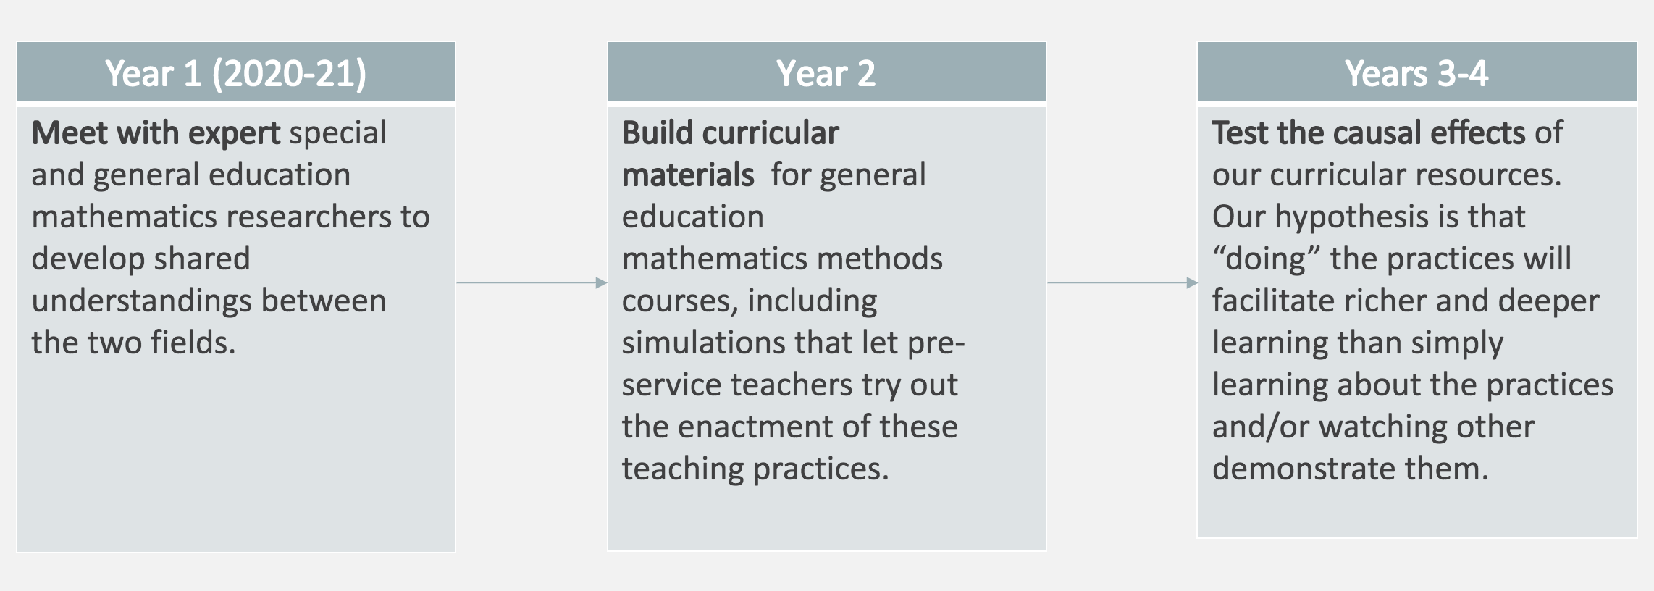
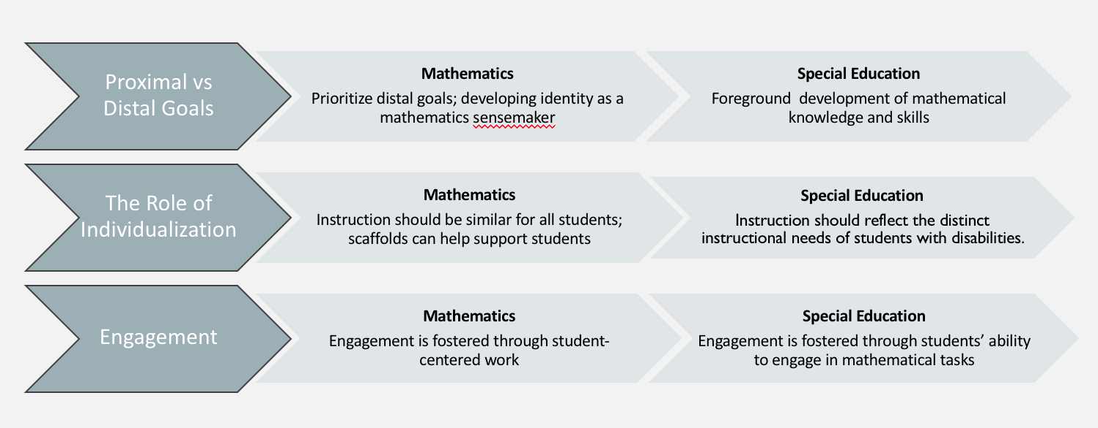
Leveraging Simulations in Preservice Preparation to Improve Mathematics Teaching for Students with Disabilities
Formal Goal
To better prepare general education elementary school teachers to engage in ambitious mathematics instruction that is accessible for all learners.
Nathan Jones, PI (Boston University)
Julie Cohen, PI (University of Virginia
Lynsey Gibbons, Co-PI (University of Delaware)
Robert Berry, Co-PI (University of Virginia)
Core Challenge #1
Preservice teachers in general education typically enter the field with limited preparation to work with students disabilities.
Core Challenge #2
Teacher education has long been highly localized and context-dependent, challenging the accumulation of knowledge.
Year 1 Activities
Expert Consensus Panels
6 leading special educators and math educators
Use established NIH consensus panel structures
January and June 2021
Establish shared perspectives on making ambitious mathematics instruction accessible to all learners
Researcher Interviews
25 semi-structured interviews (October – December 2020)
National experts in mathematics education and special education who have done considerable work in these areas
Prioritized including diverse voices—scholars squarely focused on equity in mathematics teaching and learning
Landscape Analysis (Ongoing)
Review mathematics methods course syllabi from a national sample of teacher education programs to investigate the extent to which instruction for students with disabilities is represented in course topics, readings, and assignments
(Particularly Thorny) Core Challenge #3
Special education and mathematics education do not see eye-to-eye on what “good teaching” looks like. Candidates are given different messages about:
The goals of math learning
The role of the teacher
The role of students
Candidates are left to themselves to navigate competing messages
Sample Researcher Interview Themes from Year 1 Data Collection
This project is funded by the National Science Foundation, grant #2010298 and # 2009939. Any opinions, findings, and conclusions or recommendations expressed in these materials are those of the author(s) and do not necessarily reflect the views of the National Science Foundation.

