Slide 1
Why Aren’t Students Motivated
to Study Algebra?
Christian Hirsch
Western Michigan University
2010 DR K-12 PI Meeting

Slide 2
National Mathematics Advisory Panel National Survey of Algebra Teachers
Conducted by the National Opinion Center, University of Chicago in spring and summer 2007
Of 310 public schools identified, 258 agreed to participate
743 randomly selected Algebra I teachers completed the questionnaire

Slide 3
Key Survey Findings
In response to 10 options describing the challenges they face, a majority of the teachers (62%) rated “working with unmotivated students” as the “single most challenging aspect of teaching Algebra I successfully.”
Their second highest-rated challenge—11%—was making mathematics accessible and comprehensible.

Slide 4
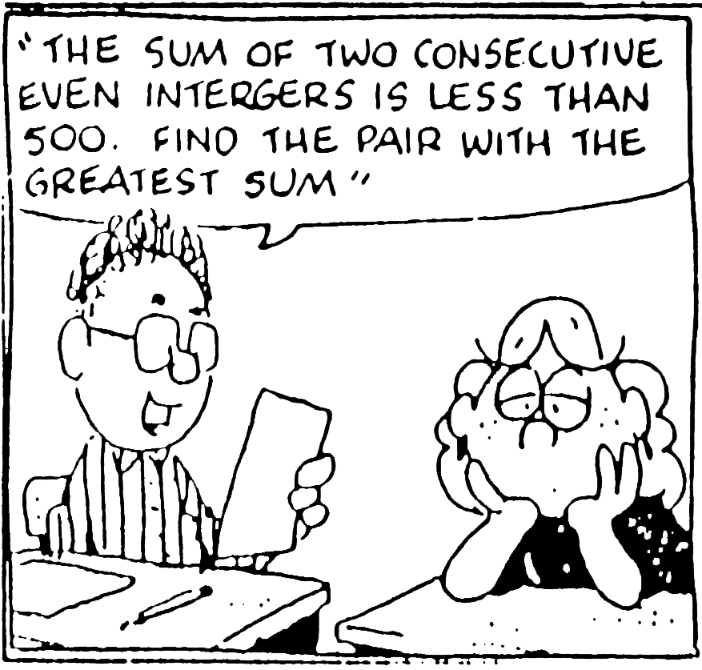
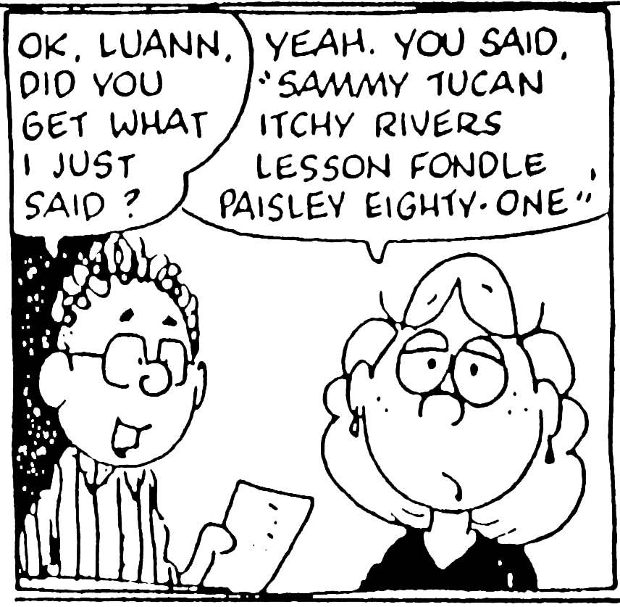
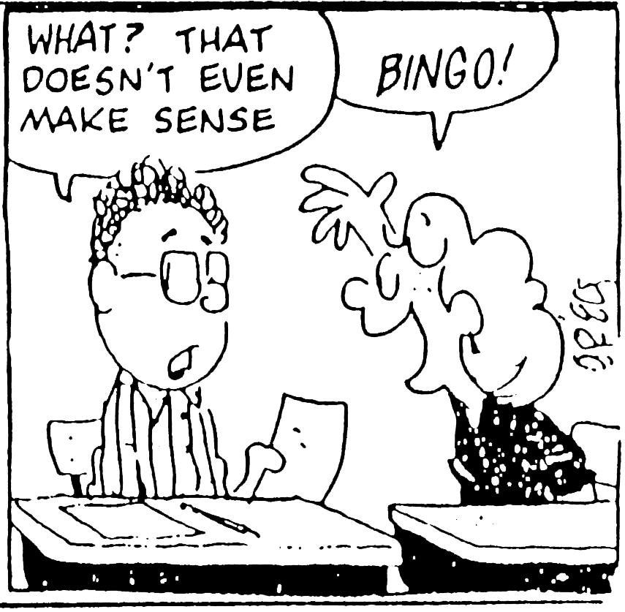
Key Survey Findings
These recent findings have characterized algebra over the last 30 plus years.
LUANN by Greg Evans

Slide 5
Additional Survey Findings
Teachers reported that their students had the poorest background preparation in rational numbers, word problems, and study habits.
U.S. Dept. of Education, 2008

Slide 6
Panel Recommendations for the Major Topics of School Algebra
Symbols and Expressions
Linear Equations
Quadratic Equations
Functions
Algebra of Polynomials
Combinatorics and Finite Probability

Slide 7
Turning Algebra on Its Head
One of the most important transitions from middle- to high-school mathematics is the emergence of algebraic concepts and methods for studying general numerical patterns, quantitative variables and relationships among those variables, and important patterns of change in those relationships.
The mathematical ideas that are central to that kind of quantitative reasoning are variables and functions.

Slide 8
Algebra in High School
Organizing school algebra around the study of the major families of elementary functions (linear, exponential, power, quadratic and polynomial, rational, and periodic) and their use in mathematical modeling offers the opportunity to bring greater coherence to the study of algebra.
Fey & Good, 1985; Fey, Heid, et al., 1995

Slide 9
Algebra in High School
Situating the study of school algebra in explorations of contextual settings can provide more meaning to algebra, more motivation to its study, and can provide a broader population greater access to algebraic thinking.
Hirsch, Fey, et al., 2008, 2009, 2010

Slide 10
Goals and Approaches
From a functions perspective, the continued study of algebra at the high school level should enable all students to develop the ability to examine data or quantitative conditions; to choose appropriate algebraic models that fit patterns in the data or conditions; to write equations, inequalities, and other calculations to match important questions in the given situations; and to use a variety of strategies to answer the questions.

Slide 11
Goals and Approaches
Achievement of these goals would suggest that the study of algebra be rooted in the modeling of interesting data and phenomena in the physical, biological, and social sciences, in economics, and in students’ daily lives.
Achievement results support this “functions as models” approach to school algebra.
Teachers report seldom hearing students ask, “Where are we ever going to use this (algebra)?”
Huntley, M. A., Rasmussen, C. L., Villarubi, R. S., Sangtong, J., & Fey, J. T., 2000

Slide 12
Goals and Approaches
Answering questions about the situations being modeled leads to questions such as the following, some of which are at the heart of a traditional algebra program. For a given function modeling rule f(x), find
f(x) for x = a;
x so that f(x) = a;
x so that maximum or minimum values of f(x) occur;
the rate of change in f near x = a;
the average value of f over the interval (a,b).

Slide 13
The Motivation Problem Revisited
For further work in this area, see:
“Beliefs about Mathematics and Mathematics Learning in the Secondary School: Measurement and Implications for Motivation” by Peter Kloosterman, in Beliefs: A Hidden Variable in Mathematics Education? (2002). G. C. Leder, E. Pehkonen, & G. Törner (Eds.). Kluwer Academic Publishers.

