Slide 1

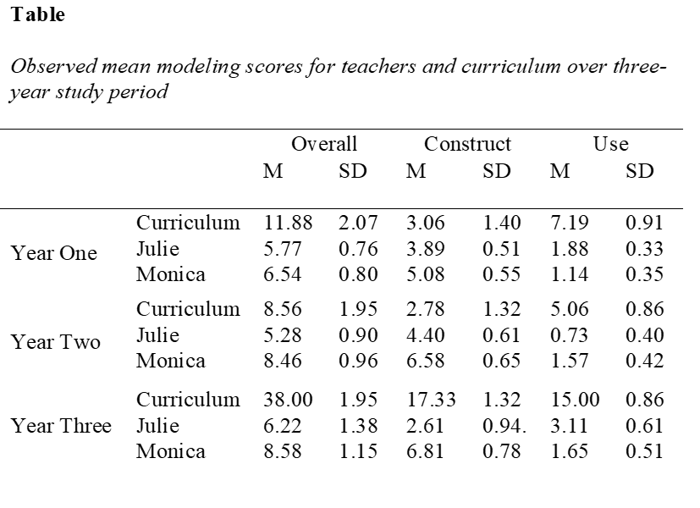



High School Students’ Climate Literacy through Epistemology of
Scientific Modeling (CliMES)
Kimberly Carroll Steward¹,Cory T. Forbes¹, & Mark A. Chandler²
¹School of Natural Resources, University of Nebraska-Lincoln, Nebraska, ²Columbia University, NASA Goddard Institute for Space Studies
0
0
INTRODUCTION
RESEARCH QUESTIONS
FINDINGS- SPRING 2018 PILOT STUDY
The High School Students’ Climate Literacy through Epistemology of Scientific Modeling (CliMES) project
aims to develop secondary students’ model-based reasoning about global climate change through investigations based on an online, computer-based global climate model grounded in authentic NASA data (EzGCM).
How do two secondary science teachers implement a model-based curriculum?
How do the teachers' implementation strategies evolve over the three-year study?
How do two secondary science teachers implement a model-based curriculum?
Scores from the modeling protocol for the overall curriculum, as well as subscores for modeling practices, construct and use, were analyzed for each of the teachers and the written curriculum across the three years of the study.
Overall significant differences were identified between teachers and curriculum (F (2, 253) = 56.31, p= <0.0001), between years (F (2, 253) = 44.70, p= <0.0001), and within the interactions of teachers and the years (F (2, 253) = 27.57, p= <0.0001).
Both teachers increased in their average scores each from the first year to the three year of implementation, although these increases were minimal
2. How do the teachers' implementation strategies evolve over the three-year study?
Two individual case summaries, one for each of the teachers, that provide qualitative descriptions of how teachers engaged students in the modeling practices of construct and use and how the changes in these strategies changed over the three years of the study.
Julie
Shift in teaching and emphases over time
Monica
Very little change during the study
students how to be "critical consumers of knowledge."
Articulating climate-related phenomena is challenging, for all students.
(Bowen & Rodger, 2008; Kuhn 1993; Sandoval, 2005).
Emphasis on developing reasoning instead of learning facts about climate phenomena.
(Driver et al., 1996)
Model-based learning helps students in understanding climate phenomena and their functions.
(Baek et al. 2011;; Forbes et al. 2015; Halloun 2007; Schwarz et al. 2009)
Students reasoning about climate can be supported by epistemological investigations.
(Holthius et al., 2014; Huxter et al., 2013).
DATA COLLECTION- SPRING 2018 – FALL 2021
Participants: Two 9th-grade Geoscience teachers
Demographics: SES range 17-20% , class size: 20-25, implementation teacher experience 5-23 years,
Modeling experience< 1yr, white, females
Data sources: Teachers interviews (pre-post); Daily teacher reflections, classroom observations,
Data Analysis: Qualitative analysis of teacher interviews, reflections, and observations using a priori codes (Miles and Huberman, 1994), quantitative analysis of classroom observations and provided curriculum survey using SPSS.
CURRICULUM (CURRENTLY)
Guiding Principles for the CliMES project
☐ ▼ | 1. Understanding the Design and Use of Global Climate Models 2. Student Guided Practice- Using EzGCM
☐ ▼ | 3. Obtaining Data and Analyzing Data-based Evidence 4. How is Climate Data Obtained?
☐ ▼ | 5. What do we know about the change in average global surface temperatures? 6. How do we explore the Earth’s global average temperature increase using a global climate model (GCM)?
▼ ▼ ▼ | 7. Fingerprinting the causes of global warming- Why are the global average temperatures increasing? 8. Guided Practice- Using EzGCM to Prepare Global Climate Model Data for Analysis: Post-Processing 9 .Guided Practice- Using Scientific Visualization to Analyze Global Climate Model Data ☐ Activity-based ▼ EzGCM-based
RESEARCH FRAMEWORK
CURRENT STUDIES
The framework for this project is grounded in research on:
Developing students’ conceptual reasoning and understanding about climate.
Developing epistemological reasoning about climate.
Describing how students operationalize the practice of “using models” and consider the “purpose of models” in reasoning about the Earth’s climate and global climate change.
Mixed-methods studies of students’ model-based reasoning about climate.
Longitudinal multiple-case study of teachers implementing the unit.
Single year comparison of teacher enactment of the unit.
Scaled pre-/post evaluation of the curriculum in Year 4.
Professional Development and using the unit
0
RESEARCH DESIGN
REFERENCES
Construct Centered Design
(Shin, Stevens & Krajcik, 2010)
Baek, H., Schwarz, C.V., Chen, J., Hokayem, H., F., Zhan, L. (2011). Engaging elementary students in scientific modeling: the MoDeLS, 5th grade approach and findings. In: M.S. Khine & M Saleh, (Eds) Models and modeling: cognitive tools for scientific enquiry. (pp195- 218) Springer, Dordrecht.
Bowen, G. M., & Rodger, V. (2008). Debating global warming in media discussion forums: Strategies enacted by “Persistent Deniers” and implications for schooling. Canadian Journal of Environmental Education, 13(1), 89-106.
Driver, R., Asoko, H., Leach, J., Scott, P., & Mortimer, E. (1994). Constructing scientific knowledge in the classroom. Educational Researcher, 23(5), 5-12.
Forbes, C. T., Zangori, L., & Schwarz, C. (2015). Empirical validation of integrated learning performances for hydrologic phenomena: 3rd-grade students’ model-driven explanation-construction. Journal of Research in Science Teaching, 52(7), 895–921.
Gilbert, J.K., Boulter, C.J. & Elmer, R. (2000). Positioning models in science education and in design and technology education. In J.K. Gilbert & C.J. Boulter (Eds.), Developing models in science education (pp. 3-18). Kluwer Academic Publishers, Dordrecht.
Kuhn, D. (1993). Science as Argument: Implications for Teaching and Learning Scientific Thinking. Science Education, 77(3), 319-337.
Holthius, N., Lotan, R., Saltzman, J., Mastandrea, M., & Wild, A. (2014). Supporting and understanding students’ epistemological discourse about climate change. Journal of Geoscience Education, 62, 374–387.
Huxter, Joanna K., Uribe-Zarain, X. & Kempton, W. (2015). Undergraduate understanding of climate change: Influences of college major and environmental group membership on undergraduate knowledge and survey knowledge scores, Journal of Environmental Education, 46(3),149-165.
Miles, M.B., and Huberman, A.M. (1994). Qualitative data analysis: An expanded sourcebook. Sage Publications, CA.
Halloun, I. (2007). Mediated modeling in science education. Science & Education, 16(7-8), 653-697.
Sandoval, W. A., & Millwood, K. A. (2005). The Quality of Students' Use of Evidence in Written Scientific Explanations. Cognition and Instruction, 23(1), 23-55.
Schwarz, C. V., Reiser, B. J., Davis, E. A., Kenyon, L., Acher, A., Fortus, D., et al. (2009). Developing a learning progression for scientific modeling: Making scientific modeling accessible and meaningful for learner. Journal of Research in Science Teaching, 46(6), 632–654.
Year 1- Selecting the big idea, create a claim, identify the grade level
Year 2- Design learning performances and define Tasks based on EzGCM
Year 1, 2 and 3- Review and Refinement of the EzGCM curriculum
0
FUNDING
This material is based upon work supported by the National Science Foundation under Grant No. DRL 1720838 and 1719872. Any opinions, findings, and conclusions or recommendations expressed in this material are those of the author(s) and do not necessarily reflect the views of the NSF.

