Slide 1
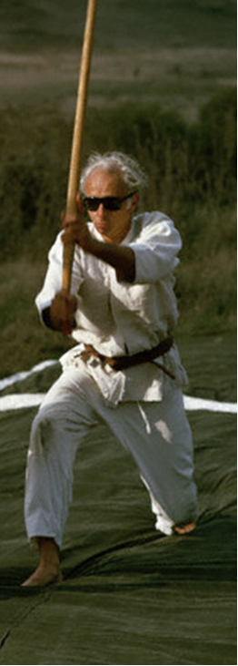

Aikido Grand Master Dies
George Leonard
1923-2010
…. sees this martial art as a means of staying alert and being fully engaged.

Slide 2

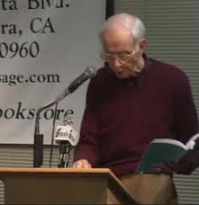
Education and Ecstasy - 1968
Leonard’s premise was that learning would be enhanced by computer technology so that children would find learning as ecstatic as a 16-year old learning how to drive.

Slide 3
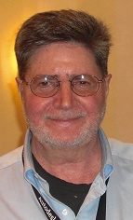

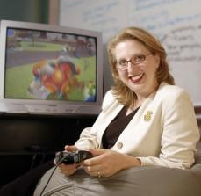
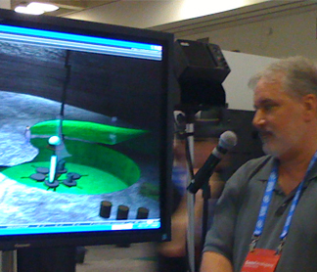

Gaming to Learn Panel
Mike Hacker
Hofstra University
Center for
Technological Literacy
Doug Clark
Vanderbilt University
Scaffolding Understanding by Redesigning Games for Education
(SURGE)
Barbara Chamberlain
New Mexico State University
Math Snacks;
Science Pirates
Jim Kiggens
Hofstra University
Survival Master
Jodi Asbell-Clarke
TERC
Arcadia:
A Science Center on Blue Mars
Our Panelists’ Mission:
To Make Learning Ecstatic

Slide 4
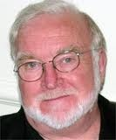
Research on Human Learning Helps Explain Why Gaming is so Appealing
Gaming meets the conditions of Flow Theory and Perceptual control theory.
  Flow: Being completely involved in an activity for its own sake.
  Proposed by Mikaly Csíkszentmihályi in 1975
Notes:
Gaming has the potential to meet the conditions of flow theory and perceptual control theory.

Slide 5
Conditions to Achieve the Flow State
  Completely involved in what we are doing – focused, concentrated.
  Knowing that the activity is doable – that skills are adequate to the task.
  Intrinsic motivation – whatever produces flow becomes its own reward.
  A sense of ecstasy – of being outside everyday reality. EKSTASIS (Greek): standing outside oneself.
From Csikszentmihalyi, M. Creativity, Fulfillment, and Flow. TED Talks. February, 2004

Slide 6




Slide 7
“If a man is called to be a street sweeper, he should sweep streets even as Michelangelo painted, or Beethoven composed music, or Shakespeare wrote poetry. He should sweep streets so well that all the hosts of heaven and earth will pause to say, here lived a great street sweeper who did his job well.”
Martin Luther King

Slide 8
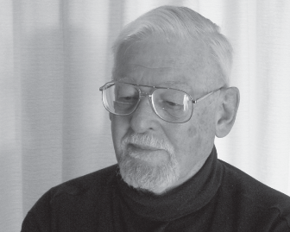
Perceptual Control Theory
  Presumes that humans are essentially intricate feedback control systems and are goal driven.
  Comes from engineering - control systems theory.
  Provides a framework that explains why people are riveted by games: Clear goals, they recognize that intervention is possible, and where their actions provide immediate and understandable feedback.
From: Powers, William T. (1973). Behavior: The Control of Perception. Hawthorne, NY: Aldine.

Slide 9
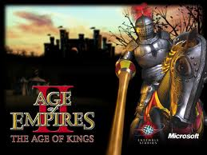

Goal: To develop a civilization from its humble beginnings to the glory years of a vast, world dominating empire.
Processes: military might, economic superiority, technology advances, diplomacy and trade.
Monitor: The Player
Feedback is immediate and understandable: If your civilization degrades you adjust the process. If you lose resources (coins, food, wood) you use that feed back you get your villagers to obtain them; If you’re getting attacked, you train more villagers to defend the civilization.
Notes:
So gaming meets the conditions of perceptual control theory and flow theory.

Slide 10
GAMING AND FAILURE
Gaming also redefines the concept of failure.
In our world, failure is to be avoided.
Kids see failure differently in gaming.
  They fail frequently
  they die in shooter games / lose points or energy in
  other games
  When they fail, they respawn
  they come back into the game at the place they left
  off and try again.
  They fail until they win!

Slide 11
On to our panel…….
Notes:
Each panelist will speak for 20 minutes; I’ll give a five-minute warning; then we’ll sound the revered meditation gong.

