Slide 1
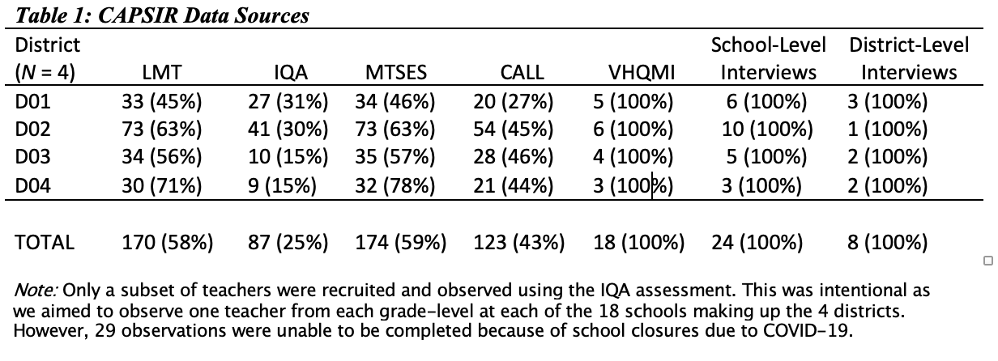
Managing tensions between research fidelity and math improvement at scale:
Findings from Collaborating around Sustainability of Processes and Instructional Routines (CASPIR Math)
Alison Castro Superfine, Benjamin M. Superfine & Craig De Voto
Learning Sciences Research Institute; Department of Mathematics, Statistics, & Computer Science; Department of Educational Policy Studies
University of Illinois at Chicago
Introduction
Research Design
Results (continued)
Recently, researchers have begun to explore how educational interventions can be adapted to local “problems of practice” that can vary across school and district contexts (Bryk et al., 2011). Some researchers suggest Design-based Implementation Research (DBIR) as a useful process for the adaptive integration of interventions as they go to scale (Penuel et al., 2011).
However, a DBIR process can involve tensions between (a) the goals of providing coherent organizational and instructional improvement in ways grounded in research and (b) adapting to changing contexts and conditions.
CASPIR draws on a wide range of data sources across four case districts (D01, D02, D03, and D04). To capture student-level outcomes, we are collecting student achievement data from NAEP, MAP, and state assessments. To capture teacher-level outcomes, we are employing the Learning Mathematics for Teaching assessment (LMT), the Instructional Quality Assessment observational tool (IQA), and the Math Teacher Self-efficacy Survey (MTSES). To capture school-level outcomes, we are using two surveys-- the Comprehensive Assessment of Leadership for Learning (CALL) and Visions of High-quality Math Instruction (VHQMI). We are also interviewing school administrators and other support staff. To capture district-level outcomes, we are conducting district leader interviews and gathering other documentary data.
While we are not yet implementing the EML model we will further observe all PD sessions in Year-2. To capture evidence about our DBIR process, we are also recording meetings with school and district personnel and taking notes of internal CASPIR team meetings. This paper analyzes all baseline data collected thus far to understand the tension between staying grounded in research on organizational and instructional improvement and adapting the EML model to local contexts. It also illustrates how the CASPIR team has built an internal and external infrastructure to manage this tension across cases and employs a case study design (Miles & Huberman, 1994).
On one hand, such varying expertise has created some challenges. CASPIR team meetings have repeatedly focused on the extent to which data collection/intervention development should attend to known problems of practice across districts versus those highlighted by research. On the other, these meetings have provided an opportunity to “thread the needle” between issues highlighted by the research and identified local problems. We have found that effectively negotiating different types of expertise requires particular structures and tools, such as monthly conceptual meetings, quarterly memos of each case district, and end-of-year memos highlighting all data points together including what areas we must learn more about across districts.
External infrastructure. Because DBIR is primarily a collaborative venture with external partners, many of the encountered challenges exist at the crossroads between the CASPIR team and its case districts. Notably, a tension exists between the general research expertise/orientation of the CASPIR team and the districts’ specific problems of practice. To address this tension, the presence of a “boundary spanner” has proven crucial. As discussed above, one member of the CASPIR team had existing relationships with each district. These relationships helped to inform the development and initial application of the eight domains comprising the conceptual framework and ultimately provided initial guidance about the types of PD that will likely be needed. Moreover, this person provided a certain amount of trust and credibility on behalf of the CASPIR team.
Mirroring elements of the internal infrastructure, we have employed routine meetings and specific tools to manage the tension. These meetings have: (a) provided an opportunity for both partners to ask questions about project goals; (b) built trust by continually informing districts of next steps, including data collection; and (c) provided both partners with opportunities to reflect on the data. Indeed, the quarterly memos to the districts have served as a basis for such conversations.
Research Question
What are the characteristics of the tensions between math improvement and local adaptability, what are the contributing factors and how has a DBIR approached sought to address them?
The CASPIR Math Project
CASPIR is a 4-year NSF-funded project aimed at co-developing and implementing the Elementary Math Leadership (EML) model in four K-8 school districts to improve K-8 math teaching and learning.
This is done by: (1) Gathering information about problems of practice collaboratively identified by districts/research team; (2) co-designing and co-implementing coherent PD; and (3) engaging in iterative cycles of co-development, implementation, and revision to productively adapt the PD model over a series of years.
CASPIR uses a DBIR approach that involves collaboration with each district over time.
Results
Conclusion
Like other RPPs, we have encountered many challenges when scaling up the EML model across varying district contexts. In particular, we have witnessed a tension between fidelity to the general research base and adaptability of the model in practice. To address this tension, we have constructed and employed both internal and external infrastructures.
Internal Infrastructures. As researchers, our role is to provide evidence-based interventions congruent to the four participating districts. However, because problems of practice are different and the EML model is aimed at various types of individuals and organizational levels, we recognized that we needed different kinds of research expertise within the CASPIR team itself. To this end, we brought on members who had expertise in math instruction, education leadership and organizations, quantitative analysis, and policy. In addition to personnel with research expertise, we included members with practice-based expertise and local district ties.
The attention required to developing both internal and external infrastructures highlights a fundamental challenge of using robust social science research for school improvement purposes:
Their effective application to new contexts necessarily involves some degree of adaptation.
Yet such adaptation can result in “lethal mutations” that compromise the principles upon which interventions are built
Thus, productive adaptation is far from assured, and it requires the development of infrastructure to manage tensions
This project is funded by the National Science Foundation, grant #1907681. Any opinions, findings, and conclusions or recommendations expressed in these materials are those of the author(s) and do not necessarily reflect the views of the National Science Foundation.

