Slide 1
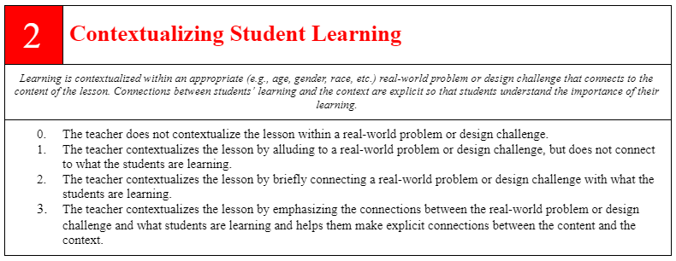
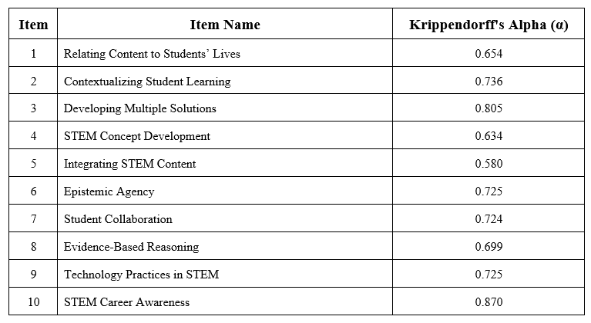
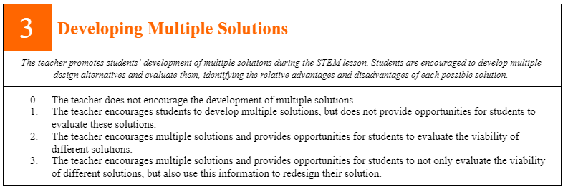
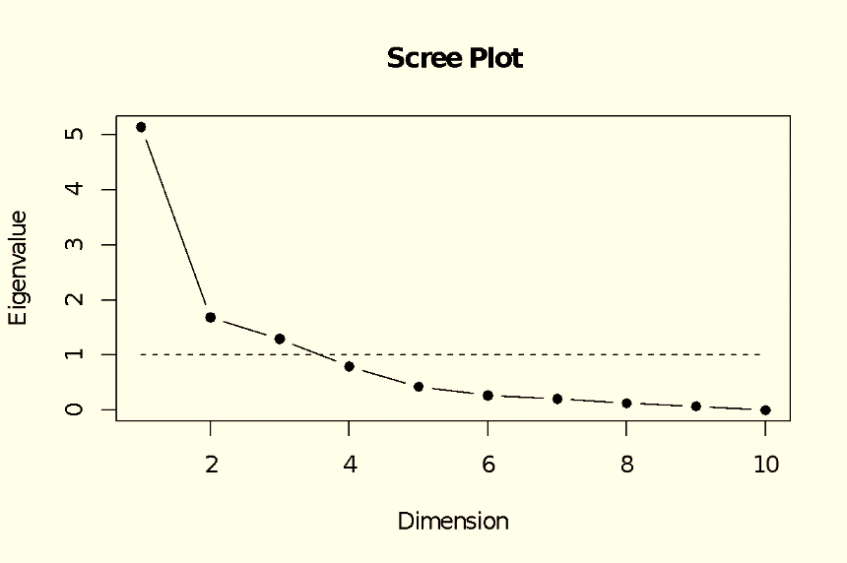
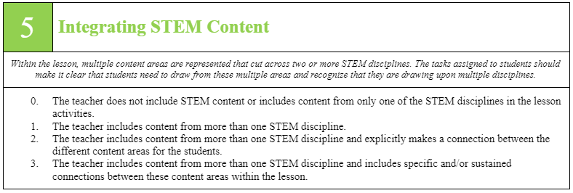
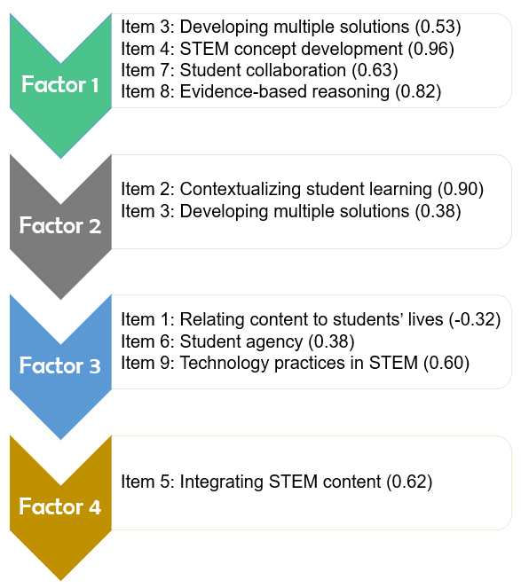
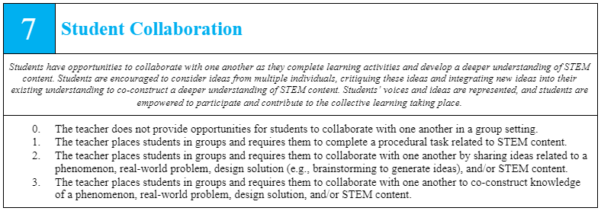
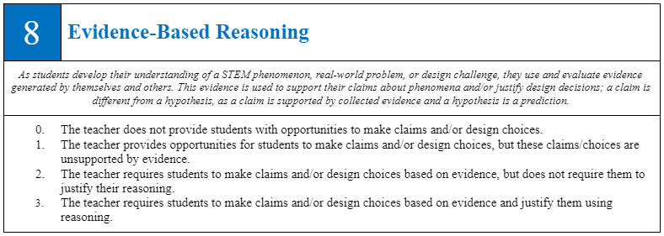
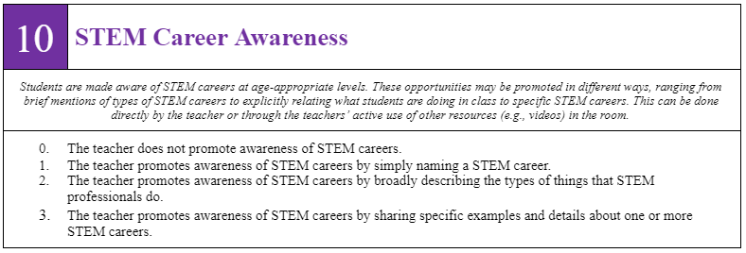
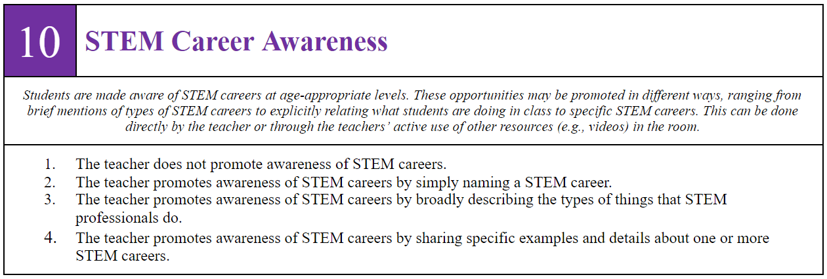
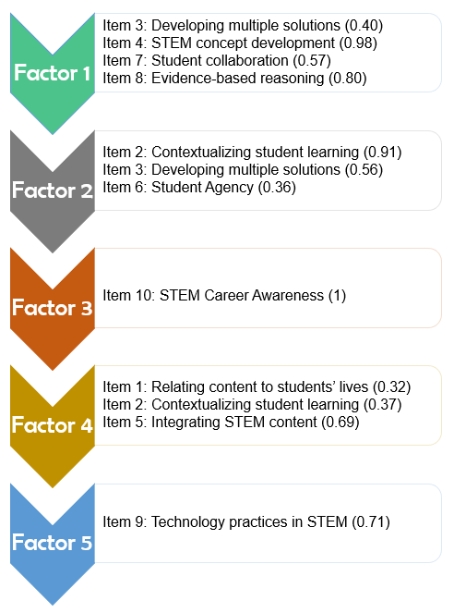
Collaborative Research: Design and Development of a K-12 STEM Observation Protocol
Dr. Emily Dare¹, Dr. Joshua Ellis¹, Dr. Elizabeth Ring-Whalen², Dr. Mark Rouleau³, Dr. Gillian Roehrig⁴
Florida International University¹, St. Catherine University², Michigan Technological University³, University of Minnesota⁴
Project Overview
Validation of the STEM Observation Protocol
The focus of this project is on the design and development of a new integrated STEM observation protocol for use in K-12 science and engineering classrooms. This valid and reliable instrument has been designed for use in a variety of educational contexts and by different education stakeholders to increase the quality of K-12 STEM education and education research. To this end, the STEM Observation Protocol (STEM-OP) has been designed not only for summative and evaluative purposes, but also for formative and reflective purposes. Exploratory factor analysis (EFA) has been performed to empirically evaluate our theoretical understanding of integrated STEM instruction. At the end of this project, the STEM-OP will be made available through an online platform that will include an in-depth training program.
STEM Observation Protocol Items
Exploratory Factor Analysis
The goal of our EFA was to uncover the underlying structure (or key dimensions) of integrated STEM instruction through an empirical investigation of our theoretical conjectures. The sample size of 314 was chosen to ensure a 10-to-1 subject-to-item ratio for the data used in our EFA as per the recommendations of Costello and Osborne (2005). Prior to the EFA, we determined the reliability index for our final items, as shown in Table 1 below. We used the maximum likelihood method to extract our factors and rotated our factor solution using ProMax rotation under the assumption that our extracted factors were likely to be correlated with one another. Upon initial inspection of the data (as per Cattell, 1966), we found that the Kaiser-Guttman rule (eigenvalues > 1) supported a 3-factor solution, whereas a scree plot of the eigenvalues left open the possibility of a 4- or 5-factor solution as well, as can be seen in the double-bend of the eigenvalue slopes in our scree plot.
For reasons such as poor model fit and some items not loading on any factors, we decided to abandon the 3-factor model as a plausible description of the underlying factor structure of integrated STEM instruction and chose not to interpret these factor loadings further. The 4-factor and 5-factor models are briefly described below.
The results of our EFA show that our theoretical understanding of integrated STEM instruction does appear to manifest itself as expected, with some minor but understandable exceptions, in real K-12 classrooms. We found statistical support for the key dimensions outlined in our conceptual framework using the 4- and 5-factor models. Specifically, we found there was strongest evidence for 21st Century STEM Skills and Contexts for STEM Learning in the classroom observations evaluated using our STEM Observation Protocol.
The final observation protocol includes ten items that use a Likert-scale from 0 to 3. The levels on each item include criteria-specific descriptions. In addition to the levels, each item includes an overall description of the intention of the item’s aim. In planning for future work, each item also includes a set of user guidelines, which includes non-exhaustive examples of the different levels of the items.
Conceptual Framework for Integrated STEM
Figure 3
STEM-OP Items
Our working definition of integrated STEM is consistent with that of Kelley and Knowles (2016), who define STEM education in general as, “an approach to teaching the STEM content of two or more STEM domains, bound by STEM practices within an authentic context for the purpose of connecting these subjects to enhance student learning” (p. 3). Beyond this, however, our conceptual framework provides the detail necessary to operationalize this broad definition.
Table 1
Inter-Rater Reliability of Final Protocol Items
Figure 4
Scree plot of eigenvalues used to determine the appropriate number of factors to extract in our EFA
Figure 5
Four-factor Model
Four-factor Model
p (χ2 goodness-of-fit test) = 0.353; total cum. var. = 50%; factor loadings from -0.32 to 0.96
Factor 1 (4 items) = 24%, Factor 2 (2 items) = 12%, Factor 3 (3 items) = 7%, Factor 4 (1 item) = 7%
Item 10 does not load on any factor.
There is a clean separation of items to factors for nearly all items except for Item 3.
Factor 1 closely resembles “21st Century STEM Skills” from our framework, Factor 3 for “STEM practices”, and Factor 4 for “Nature of STEM integration”.
Emerging theme for Factor 2 could be labelled as “Contexts for STEM Learning”.
- contextualization of learning through real-world problems and engineering design challenges
Note: values above refer to factor loadings of each item
Figure 6
Five-factor Model
STEMOP
Five-factor Model
p (χ2 goodness-of-fit test) = 0.61; total cum. var. = 61%; factor loadings from 0.32 to 1
Factor 1 (4 items) = 22%, Factor 2 (3 items) = 14%, Factor 3 (1 item) = 10%, Factor 4 (3 items) = 8%, Factor 5 (1 item) = 7%
Items 9 and 10 load on stand-alone factors.
Increased the total cumulative variance explained, but minimally reduced dimensionality of integrated STEM instruction to 5 factors.
Thematic clustering of items based on the conceptual framework is slightly different compared to the four-factor model.
- Student agency is linked (minimally) with contextualized learning and design-based activities such as engineering design challenges and solving real-world problems.
- Loading of Items 1 and 2 with Item 5 reflects the link between “STEM integration within lived experiences” and “STEM content integration”.
Development of the STEM Observation Protocol
Next Steps
We developed the STEM-OP and established interrater reliability among our coding team over the course of two years. Our team consisted of five principal investigators (four STEM education experts and one psychometrician), three post-doctoral researchers, and five doctoral students in STEM education. The overall process is outlined in Figure 2:
The STEM-OP is intended to allow its users to observe and characterize integrated STEM instruction. Continued research with this protocol includes better understanding of STEM integration differences across grade levels and content areas (e.g., physical vs. life science) as well as ways in which integrated STEM is manifested day by day within a STEM unit of instruction. In addition to on-going research, we are developing a protocol training program that will be shared online. We have developed a set of user guidelines that will assist future users in understanding the items’ intention, including non-exhaustive examples of how to score or what to look for with respect to each scoring level for any given item. This training will be made available to educators and educational researchers wishing to better understand the STEM-OP and learn how to use it in classroom settings as part of a formal training program.
Figure 2
Overview of the STEM-OP Development Process
Note: values above refer to factor loadings of each item
PI Contacts
Dr. Emily Dare: edare@fiu.edu
Dr. Joshua Ellis: jellis@fiu.edu
Dr. Elizabeth Ring-Whalen: eawhalen245@stkate.edu
Dr. Gillian Roehrig: roehr013@umn.edu

