Slide 1
Discovery Research K-12 (DR K-12) Program
Division of Research on Learning in Formal and Informal Settings
Program Solicitation: NSF 13-601

Slide 2
Important Dates
Full Proposals
October 16, 2014

Slide 3
Overview of the Session
Describe the DRK-12 Program & Project Expectations
4 Strands
2 Proposal Types
Relationship to Common Evidence Guidelines
Round 1 of Questions
Proposal Preparation and Review Process
Round 2 of Questions
Further Information and Resources
Final Questions
Notes:
Will highlight some of the changes from previous solicitation.
Please type your questions in the chat window and we will take them at the question periods.
I will get into the Proposal preparation and review process as it relates to the DRK-12 program. This information may be more familiar for very experienced PIs, so I will note some particular areas of difference
After a second round of questions, I will give you some information on further information and potential resources, then provide a final round of question and answer period.

Slide 4
Goal of the DR K-12 Program
Enhance STEM learning of teachers and students, preK-12, through research and development of innovative resources, models and tools (RMTs)
Catalyze new approaches
Develop students’ 21st century skills
Provide multiple pathways/resources

Slide 5
DRK-12 Projects
Build on fundamental research and STEM education development literature and practice
Have rigorous research and development plans
Reflect the needs of an increasingly diverse student and teacher population

Slide 6
DRK-12 Projects
Contribute to knowledge about learning and development
Large R&D projects are expected to produce RMTs that have been tested and that could be used by others

Slide 7
DRK-12 Research and Development Strands
Assessment
Learning
Teaching
Implementation

Slide 8
Assessment Strand: Propose to research and develop assessments of student and teacher practice, concepts, and skills
DRK-12 is particularly interested in assessments that:
Measure difficult disciplinary, cross-cutting or emerging STEM practices and concepts
Provide information that can be used to modify instruction
Use technology in new and innovative ways
Proposals in this strand must have appropriate plans to ensure validity and reliability
Notes:
There should be some emphasis that NSF wants to support assessments of knowledge, skills and processes now deemed difficult to assess. This is a strand that calls for innovation in the form of assessments that go substantially beyond what is currently available. Also emphasize the issues of fairness and cultural and linguistic sensitivity.

Slide 9
Learning Strand: Propose to research and develop RMTs for students
Help students learn emerging, cross-cutting and important practices and concepts in STEM
Engage students in meaningful scientific data collection, analysis, visualization, modeling and interpretation
Use technology in innovative ways
Are based on sound learning theory and have appropriate developmental designs
Notes:
Unlike strand 3, this strand allows for the addition of teacher materials to the extent that they are integral to the student materials.
Again, innovation based on sound theories and predictive models are encouraged.
These materials should go beyond what is commercially supported today.

Slide 10
Learning Strand: Propose to research and develop RMTs for students
DRK-12 is particularly interested in proposals that
Focus on new areas of learning not part of the traditional curriculum (i.e. engineering education, computational thinking, systems thinking)
Effectively engage all students
Have an explicit role in classrooms
Notes:
Also encouraged are new areas of learning not part of the traditional curriculum such as engineering education, computational thinking, systems thinking, and so forth.
In addition projects that organize materials in ways that promote learning (again, based on sound theory and a literature base) are encouraged.
Emphasize the requirement that these materials have an explicit role in classrooms and that they are developed for adoption! A reasonable plan for adoption should be included even if not implementable as part of the award.

Slide 11
Learning Strand: Proposals may focus on
RMTs that could be implemented in current educational settings
Proposals need to show how this could enhance learning
Proposals must demonstrate how the focus is related to important current challenges
RMTs that challenge current practice and envision a fundamentally different learning environment
Notes:
The emphasize in current educational settings requires the PI to demonstrate that the RMT is a significant change to what currently exists

Slide 12
Teaching Strand: Propose to research and develop RMTs to help teachers provide high quality STEM education
Innovative models to recruit, develop, induct, and retain STEM teachers
Resources for helping pre- and in-service teachers develop content and pedagogical knowledge and skills
Tools for sharing teaching expertise within schools, districts and states
Tools to help teachers customize instruction
Notes:
Emphasize that these projects should have a direct impact on teaching and teachers and the measurable outcomes should include demonstrable changes in teaching practice.

Slide 13
Teaching Strand: Propose to research and develop RMTs to help teachers provide high quality STEM education
Full proposals must have appropriate research designs that explore the relationships among teacher knowledge, teacher practice and use of the RMT, and student learning.
Pre-service projects are encouraged but funding cannot be used for tuition for undergraduates.

Slide 14
Implementation Research Strand: Propose to research the factors that contribute to successful high-quality innovations
Proposals that examine how a community of practice (researchers, developers and practitioners) forms to identify, refine or develop appropriate RMTs
Proposals that investigate the factors that enhance or impede the implementation of an RMT to determine what works for whom and under what conditions

Slide 15
Implementation Research Strand: Propose to research the factors that contribute to successful high-quality innovations
Proposals that study the conditions necessary for implementation of RMTs in wider contexts
Proposals that develop evidence of the efficacy or effectiveness of a previously developed RMT
Notes:
Bullet number 3 is redundant if the community of practice on the previous

Slide 16
Types of Proposals
Exploratory
Full Design and Development

Slide 17
Exploratory Proposals
Undertake early research and development of innovative RMTs or substantively revise an existing RMT.
Establish plausible hypotheses for research and development activities
Develop appropriate measures for assessing the RMT including ways to determine appropriate levels of technical quality

Slide 18
Exploratory Proposals
Produce empirical evidence to inform further research and development
Are consistent with the Early Stages and Exploratory type of research and development in the Common Guidelines for Educational Research and Development

Slide 19
Full Design and Development
Build on promising projects funded by NSF or others where there is evidence of effectiveness from small studies
Build on solid theories of learning
Have plans for creating, validating or using existing instruments to assess learning
Have appropriate research designs and analysis plans to assess learning

Slide 20
Full Design and Development
Result in useable products that have evidence of feasibility and effectiveness
Are expected to contribute to theory and lead to peer reviewed publications
Are consistent with the Design and Development type of research and development in the Common Guidelines for Educational Research

Slide 21
Conferences, Workshops, & Syntheses
Need to be well-focused and related to the goals of DRK-12
Should generate a product that is useful to those who did not attend the meeting
Involve a diverse set of attendees

Slide 22
What are the Common Guidelines?
NSF 13-126 - Joint effort between NSF and the Institute for Education Sciences at the U.S. Department of Education
http://www.nsf.gov/pubs/2013/nsf13126/nsf13126.pdf?WT.mc_id=USNSF_124
NSF 13-127 - Set of FAQs
http://www.nsf.gov/pubs/2013/nsf13127/nsf13127.pdf

Slide 23
Goals of the Common Guidelines Project
Improve the quality and pace of findings from education research and development proposals
Develop an education infrastructure that supports more rapid and efficient knowledge development
Aid NSF and ED in making informed choices about where to invest scarce research and development dollars
Provide clarity for the field (and within the two agencies)

Slide 24
Types of Studies
Foundational research and development studies
Generate fundamental knowledge that may contribute to teaching and/or learning
Early stage/exploratory studies
Examine relationships among constructs to establish logical connections
Design and development studies
Design and iteratively develop particular interventions (programs, policies, practices or technologies); can also pilot test fully developed intervention to see if it achieves its intended outcomes

Slide 25
Types of Studies - Impact
Efficacy research and development
Testing of a strategy or intervention under “ideal” circumstances, including with a higher level of support or developer involvement than would be the case under normal circumstances
Effectiveness research and development
Effectiveness of a strategy or intervention under circumstances that would typically prevail
Scale-up studies
Effectiveness in a wide range of populations, contexts, and circumstances, without substantial developer involvement in implementation or evaluation.

Slide 26
Example: Design & Development - Purpose
Develop new or improved interventions or strategies to achieve well-specified learning goals or objectives
Development of a solution
Creation of measures to assess implementation of the solution
Collection of data on the feasibility of implementation
Conduct a pilot study to examine promise

Slide 27
Design & Development - Justification
Policy and/or practical significance
Proposal should provide a compelling rationale
Theoretical and Empirical Basis
Strong justification for development
Description of the initial concept for the planned investigation
Notes:
I think we should raise the issue of a theory of action or logic model.

Slide 28
Design & Development - Evidence
Project Outcomes
Fully developed version of RMT
Well-specified theory of action
Descriptions of major design iterations
Empirical evidence of adjustments made
Measures with evidence of technical quality
Pilot data on promise

Slide 29
Design & Development - Evidence
Research Plan – methods for
Development of intervention
Collecting evidence on feasibility of implementation
Obtaining pilot data on the promise of the intervention for achieving the expected outcomes
Notes:
This addresses one of the elements for ensuring that the R & D product can be used.

Slide 30
Common Guidelines for Educational Research and Development
Potential PIs and grant writers are encouraged to use the information in the Common Guidelines for Educational Research and Development and the set of NSF FAQs regarding them to help in the preparation of proposals

Slide 31
Questions

Slide 32
Proposal Preparation

Slide 33
Proposal Preparation
DR K-12 Solicitation: NSF 13-601
(Section V. Proposal Preparation and Submission Instructions)
Proposals must be prepared in accordance with the NSF Grant Proposal Guide (GPG 13-1)

Slide 34
Project Summary
First Sentence
Type of Proposal – exploratory, full R&D, conference/workshops
Main strand addressed
Second Sentence
STEM Discipline(s)
Grade or Age level(s) addressed
Intellectual Merit and Broader Impacts
Must include separate statements on each of these two NSB criteria
Notes:
Emphasize that proposals are sorted into panels based on this project summary. It should be clear and informative.

Slide 35
Goals and Purposes
Why is this project important?
How will the project improve STEM education?
How will it advance knowledge?
What are the anticipated outcomes and/or products of this project?
How might these products or findings be useful on a broader scale?
Notes:
Add..how will they be adopted broadly.

Slide 36
What Have You and Others Done?
Describe the theoretical and research basis on which the proposal is based
Discuss how the proposal is innovative and different from similar research and development projects
If you have been funded by NSF, provide evidence about the effectiveness and impact of that work

Slide 37
How Are You Going To Do It?
State clear research questions or hypotheses that the project will test
Describe the plan for developing, adapting or implementing the proposed innovative resource, model, or tool
Describe the research methods, including data analysis plans, sampling plan, and assessments
Briefly describe the work plan and timeline

Slide 38
Who Will do The Work?
Briefly describe the expertise of the persons included in the proposal and why they are needed:
Educational researchers and evaluators
Teachers
STEM content experts
Upload two page bios for all senior personnel and
Notes:
The bios of all key personnel should be included in the proposal.

Slide 39
External Evaluation
A proposal must describe appropriate project-specific external review and feedback processes.
The review might include an external review panel or advisory board or a third-party evaluator
The review must independent and rigorous
The proposal must
Describe the expertise of the external reviewer(s)
Explain how that expertise relates to the goals and objectives of the proposal
Specify how the PI will report and use results of the project's external, critical review process
There can be different groups providing formative and summative evaluation

Slide 40
Research vs Evaluation
Research is integral to the project
Research is conducted by appropriate team members
Research aims to contribute to theory and to what is known about practice

Slide 41
How Will Others Learn About The Project?
A plan and specific strategies for Dissemination of products and/or findings to researchers, policy makers, and practitioners
Requirement to share design, findings, and products with the DR K-12 Resource Network, CADRE

Slide 42
Supplementary Documents
Brief letters of commitment or cooperation*
List of personnel on the proposal
Data Management Plan
Post Doc Mentoring Plan
NO OTHER DOCUMENTS
*be careful not to include attachments to the letters
Notes:
Remind people not to include evaluation or planning documents like Logic Models as a supplementary document. If the Logic Model is important it needs to be included in the 15 pages of text

Slide 43
Budget
Should be consistent with level of work – you do not have to request the maximum!
Two months salary: No more than two months of salary for senior personnel with academic positions on all NSF grants unless justified
Indirect cost rates: Set by the institution and auditors and is non-negotiable
No cost sharing
Limited equipment; no undergraduate tuition
Notes:
The statement about direct costs is not 100% correct since it depends on what that institution includes in the indirect costs. There are (or were) institutions that had indirect cost rates that did not include typical support activities. I don’t know if this is still true. You might need to insert a weasel word.

Slide 44
Reasons for Return Without Review
Violation of formatting rules of the Grant Proposal Guide (e.g. font, page length etc)
Failure to address specifically intellectual merit and broader impact in the project summary and description
Unauthorized documents/data in the appendix or supplementary document section
No post doc plan if post docs are included on budget
No data management plan
Notes:
Letters of support, Data Management Plan, Post Doctoral Mentoring plans, and list of personnel… are included in the supplementary documents or appendices

Slide 45
Proposal Review Process
Proposals are reviewed in panels composed of a range of external experts (e.g. educational researchers, content experts, teachers, developers)
Each proposal will have about 4 reviews
Each reviewer rates each proposal as Excellent, Very Good, Good, Fair or Poor

Slide 46
Proposal Review Process
Proposals with an average score of Good or better, or that have a Very Good or Excellent rating are discussed in a panel.
The panel writes a summary of the reviews and ranks the proposal as highly competitive, competitive or non-competitive.
All elements of the review are advisory to NSF

Slide 47
Review Criteria
All proposals are reviewed under two criteria: Intellectual Merit and Broader Impact:
What is the potential for the proposed activity to:
advance knowledge and understanding within its own field or across different fields (Intellectual Merit); and
benefit society or advance desired societal outcomes (Broader Impacts)?
To what extent do the proposed activities suggest and explore creative, original, or potentially transformative concepts?
Is the plan for carrying out the proposed activities well-reasoned, well-organized, and based on a sound rationale? Does the plan incorporate a mechanism to assess success?
How well qualified is the individual, team, or institution to conduct the proposed activities?
Are there adequate resources available to the PI (either at the home institution or through collaborations) to carry out the proposed activities?

Slide 48
January 2014 Proposals
Proposals to panels: about 450
Funded: about 50

Slide 49
Number of Awards (FY 2015)
Anticipated number of awards: 35 to 50
Anticipated funds: $50,000,000 for new awards
Exploratory projects – (15-20 awards)
up to $450,000, max 3 years
Full D&D projects (15-20 awards)
A) Full D&D up to $3,000,000, max 4 years
Conferences, Workshops, synthesis – (5-10) awards)
up to $100,000, max 2 years

Slide 50
Questions

Slide 51
For Further Information
Call 703-292-8620
Email: DRLDRK12@nsf.gov
Contact a DR K-12 Program Director

Slide 52
Program Directors
The emails and phone numbers of DR K-12 PDs are listed in the announcement.
Please write to one at a time.
The following list will help you select which PD might be most related to your topic or area of interest.
A PD might refer you to someone else after talking with you.

Slide 53
Content Expertise
Mathematics Education: Karen King, Margret Hjalmarson
Science Education – Physical, Chemical: Michael Ford, Rebecca Kruse, Joe Reed
Science Education – Biology: Julia Clark, David Campbell, David Haury, Julio Lopez-Ferrao
Engineering and Technology Education: David Campbell
CyberLearning: Elizabeth VanderPutten, Chris Hoadley, John Cherniavsky
Environmental/Climate/Social Science: Dave Campbell, Elizabeth VanderPutten

Slide 54
Strands
Assessment Julio Lopez-Ferrao, Karen King, Elizabeth VanderPutten
Learning All DRK-12 Program Directors
Teaching All DRK-12 Program Directors
Implementation Andres Henriquez, Elizabeth VanderPutten, Karen King
Notes:
You should probably add me for questions and as a place holder under Strand 2 (Michael)

Slide 55
About CADRE
CADRE is the resource network for the DR K-12 Program.
http://cadrek12.org; cadre@edc.org
http://facebook.com/cadrek12; http://twitter.com/cadrek12
In 2015-2016, CADRE will:
Provide opportunities for project staff to learn more about research, evaluation, development, and specific areas of STEM;
Assist in disseminating the DR K-12 projects’ results within the program and throughout the STEM education community through webinars, the CADRE website, project Spotlights, newsletters, workshops, Facebook, Twitter (@cadrek12), and other outreach efforts; and
Support early career researchers and developers through the CADRE Fellowship program

Slide 56
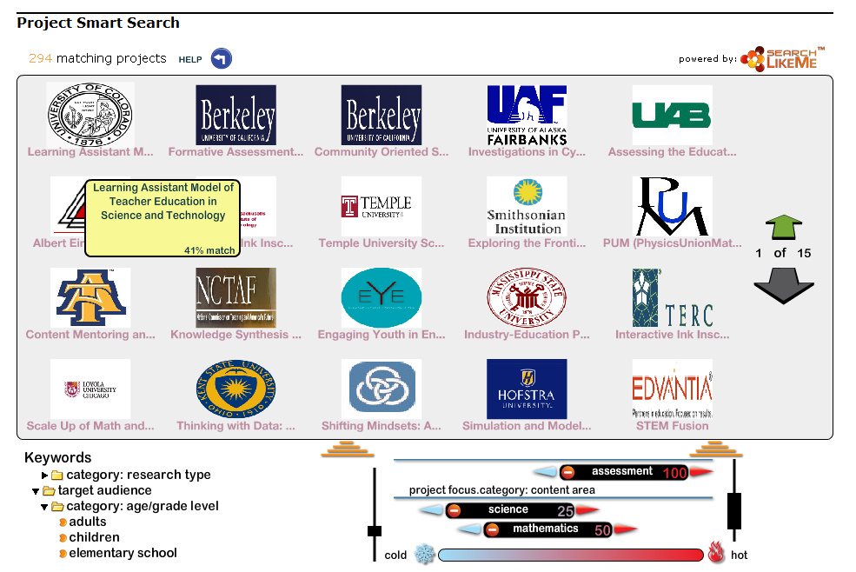
CADRE Resources
Project Smart Search:
Find DR K-12 funded projects that match your interests at
http://cadrek12.org/project-smart-search
CADRE Toolkit:
CADRE has created a toolkit of resources that provides information on the research that is currently funded and includes a variety of measurement instruments; strategies for effective partnering, dissemination, evaluation, and knowledge use; and results of selected targeted studies.
http://cadrek12.org/cadre-sponsored-products-tools

Slide 57
CADRE Resources
Proposal Writing Resources:
Review information about the DR K-12 program and solicitation, guidelines and FAQs for proposal submission, and other related resources.
http://cadrek12.org/resources/nsf-proposal-writing-resources

Slide 58
Thank you for your time and attention!

