Slide 1

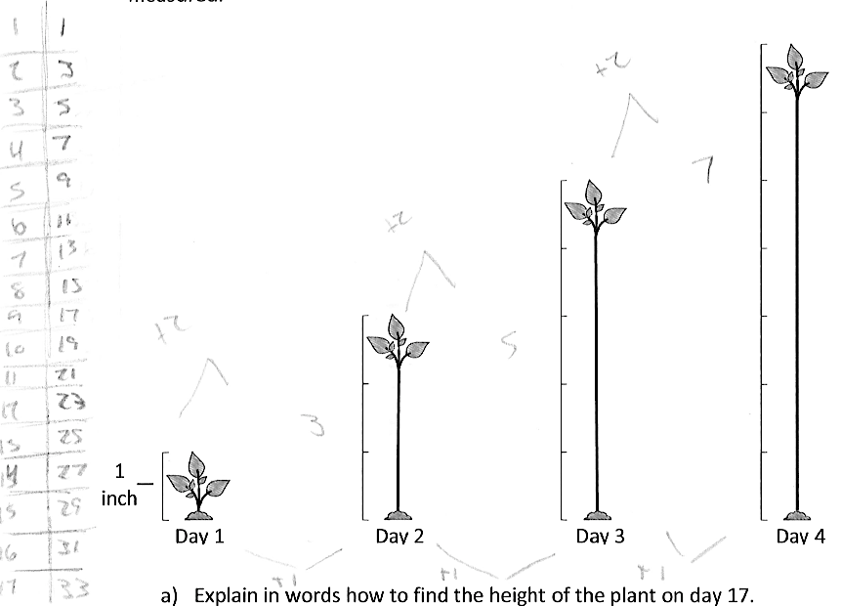
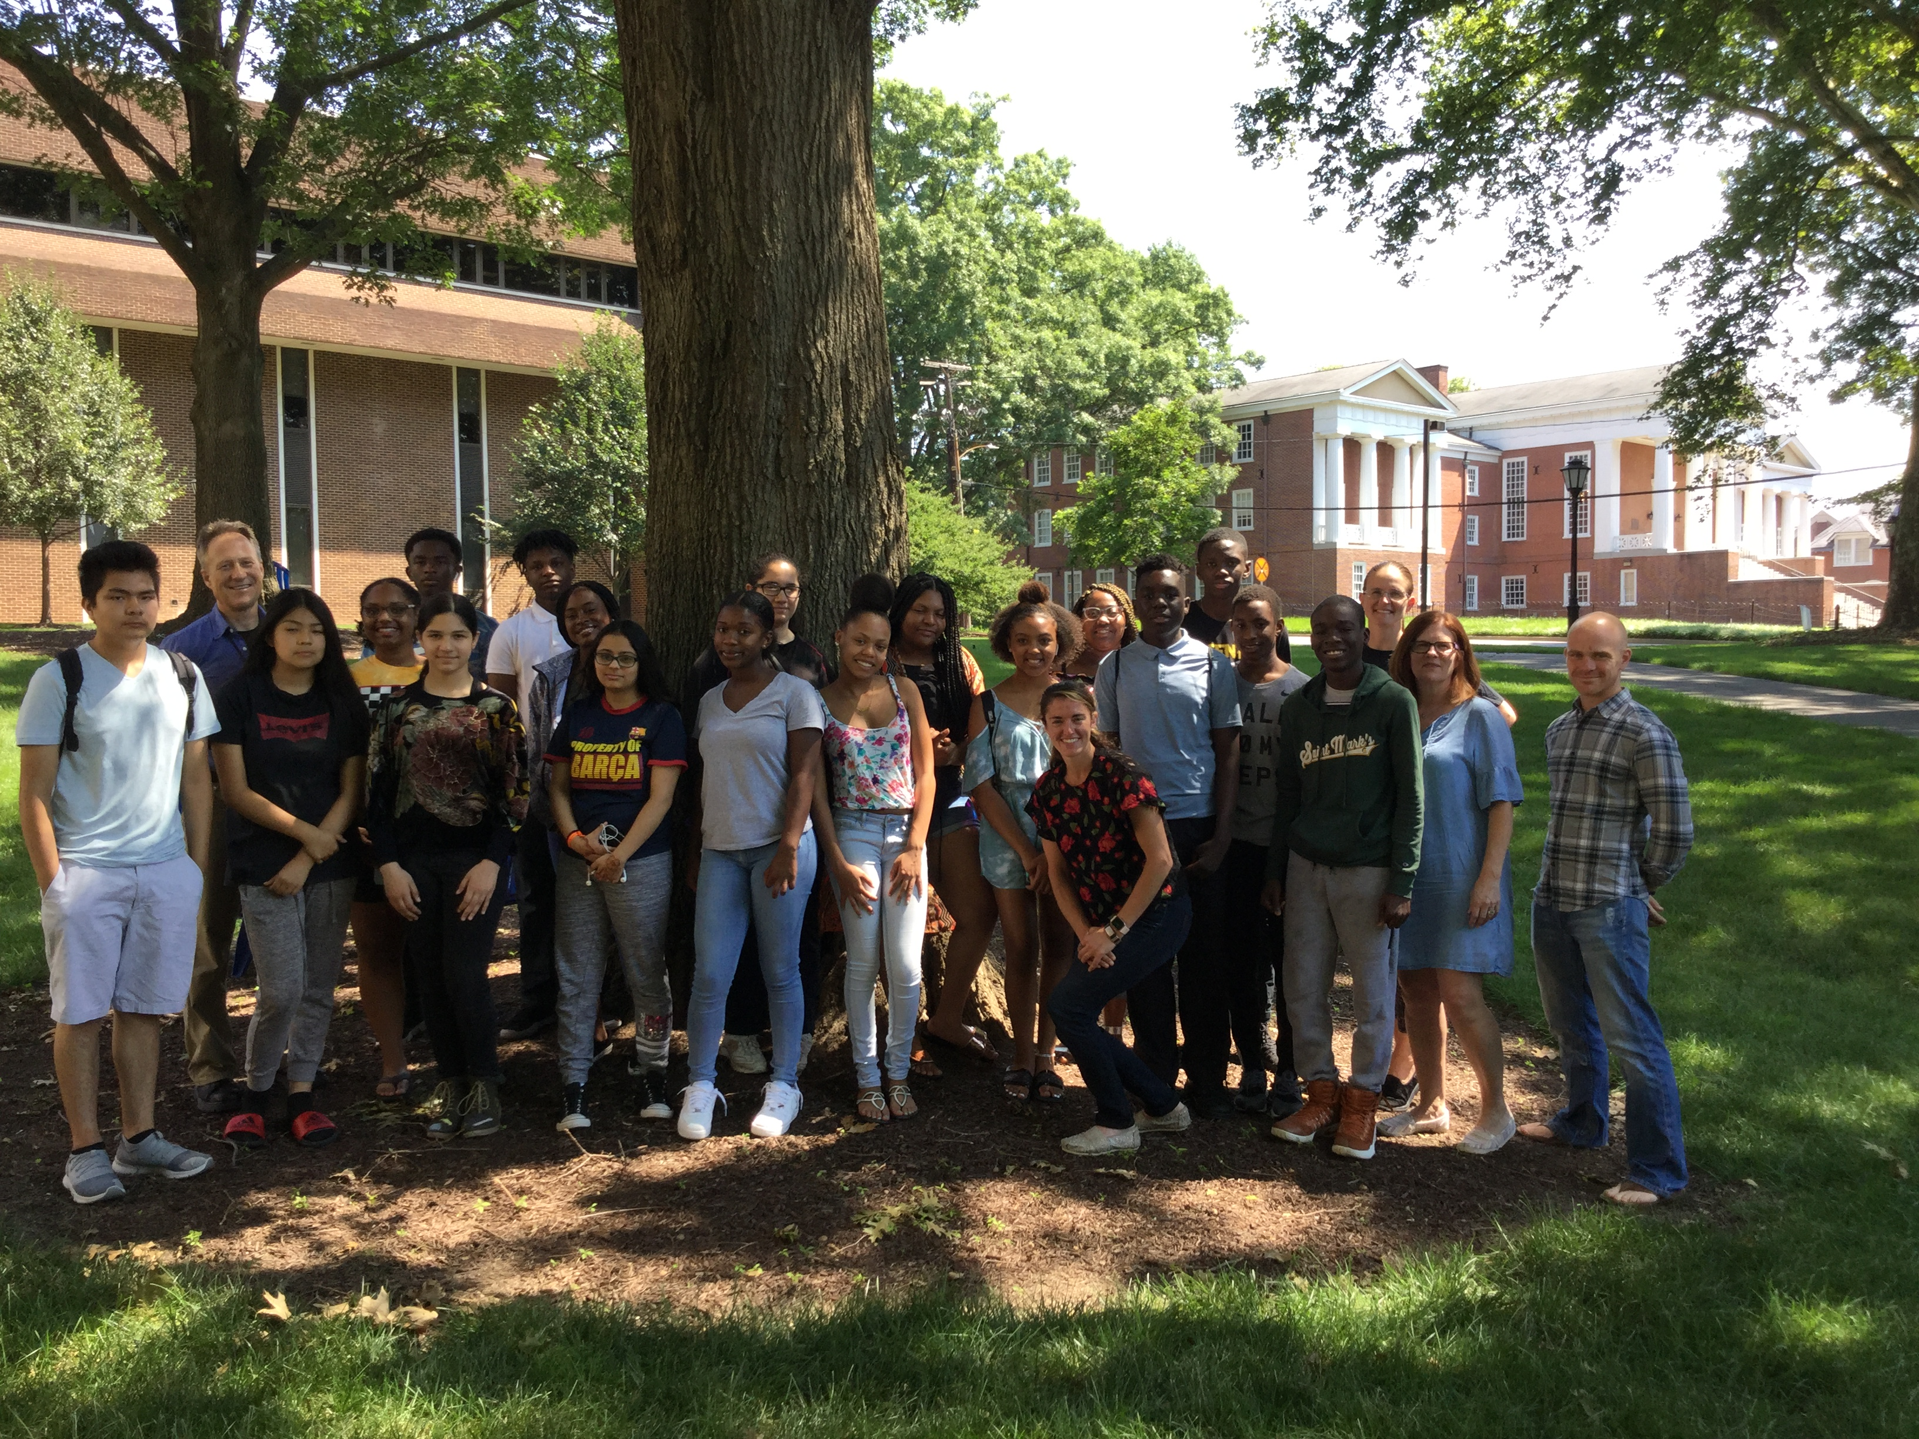
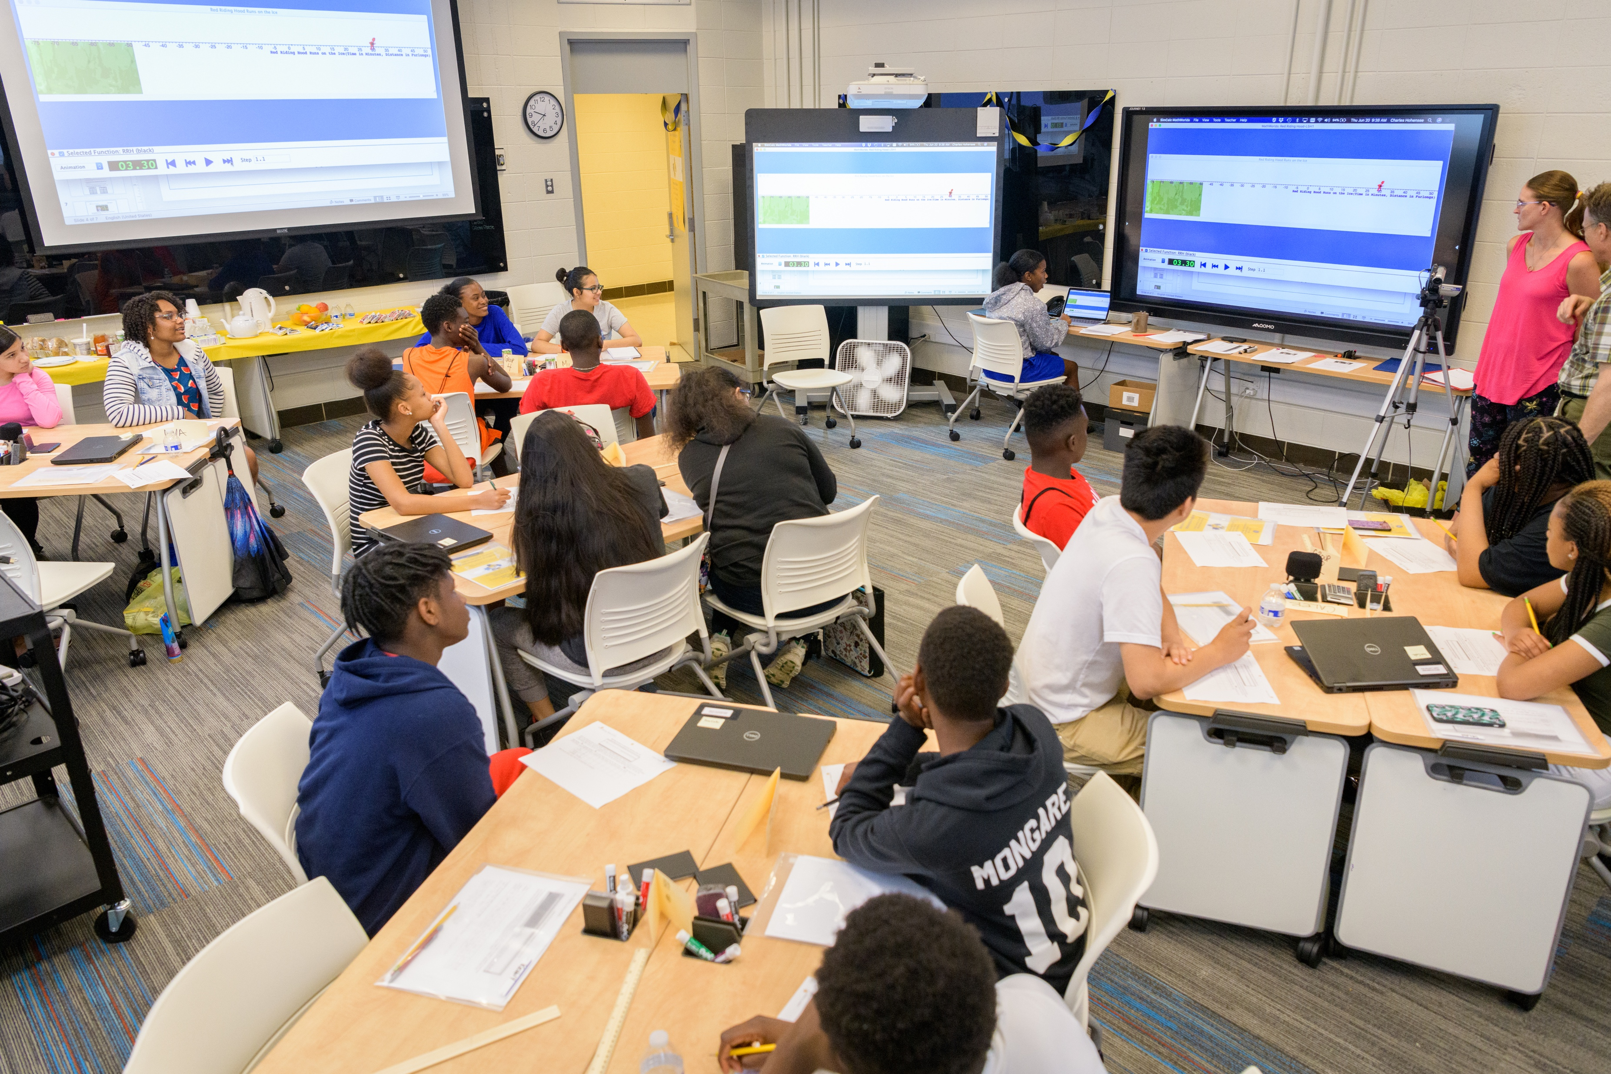
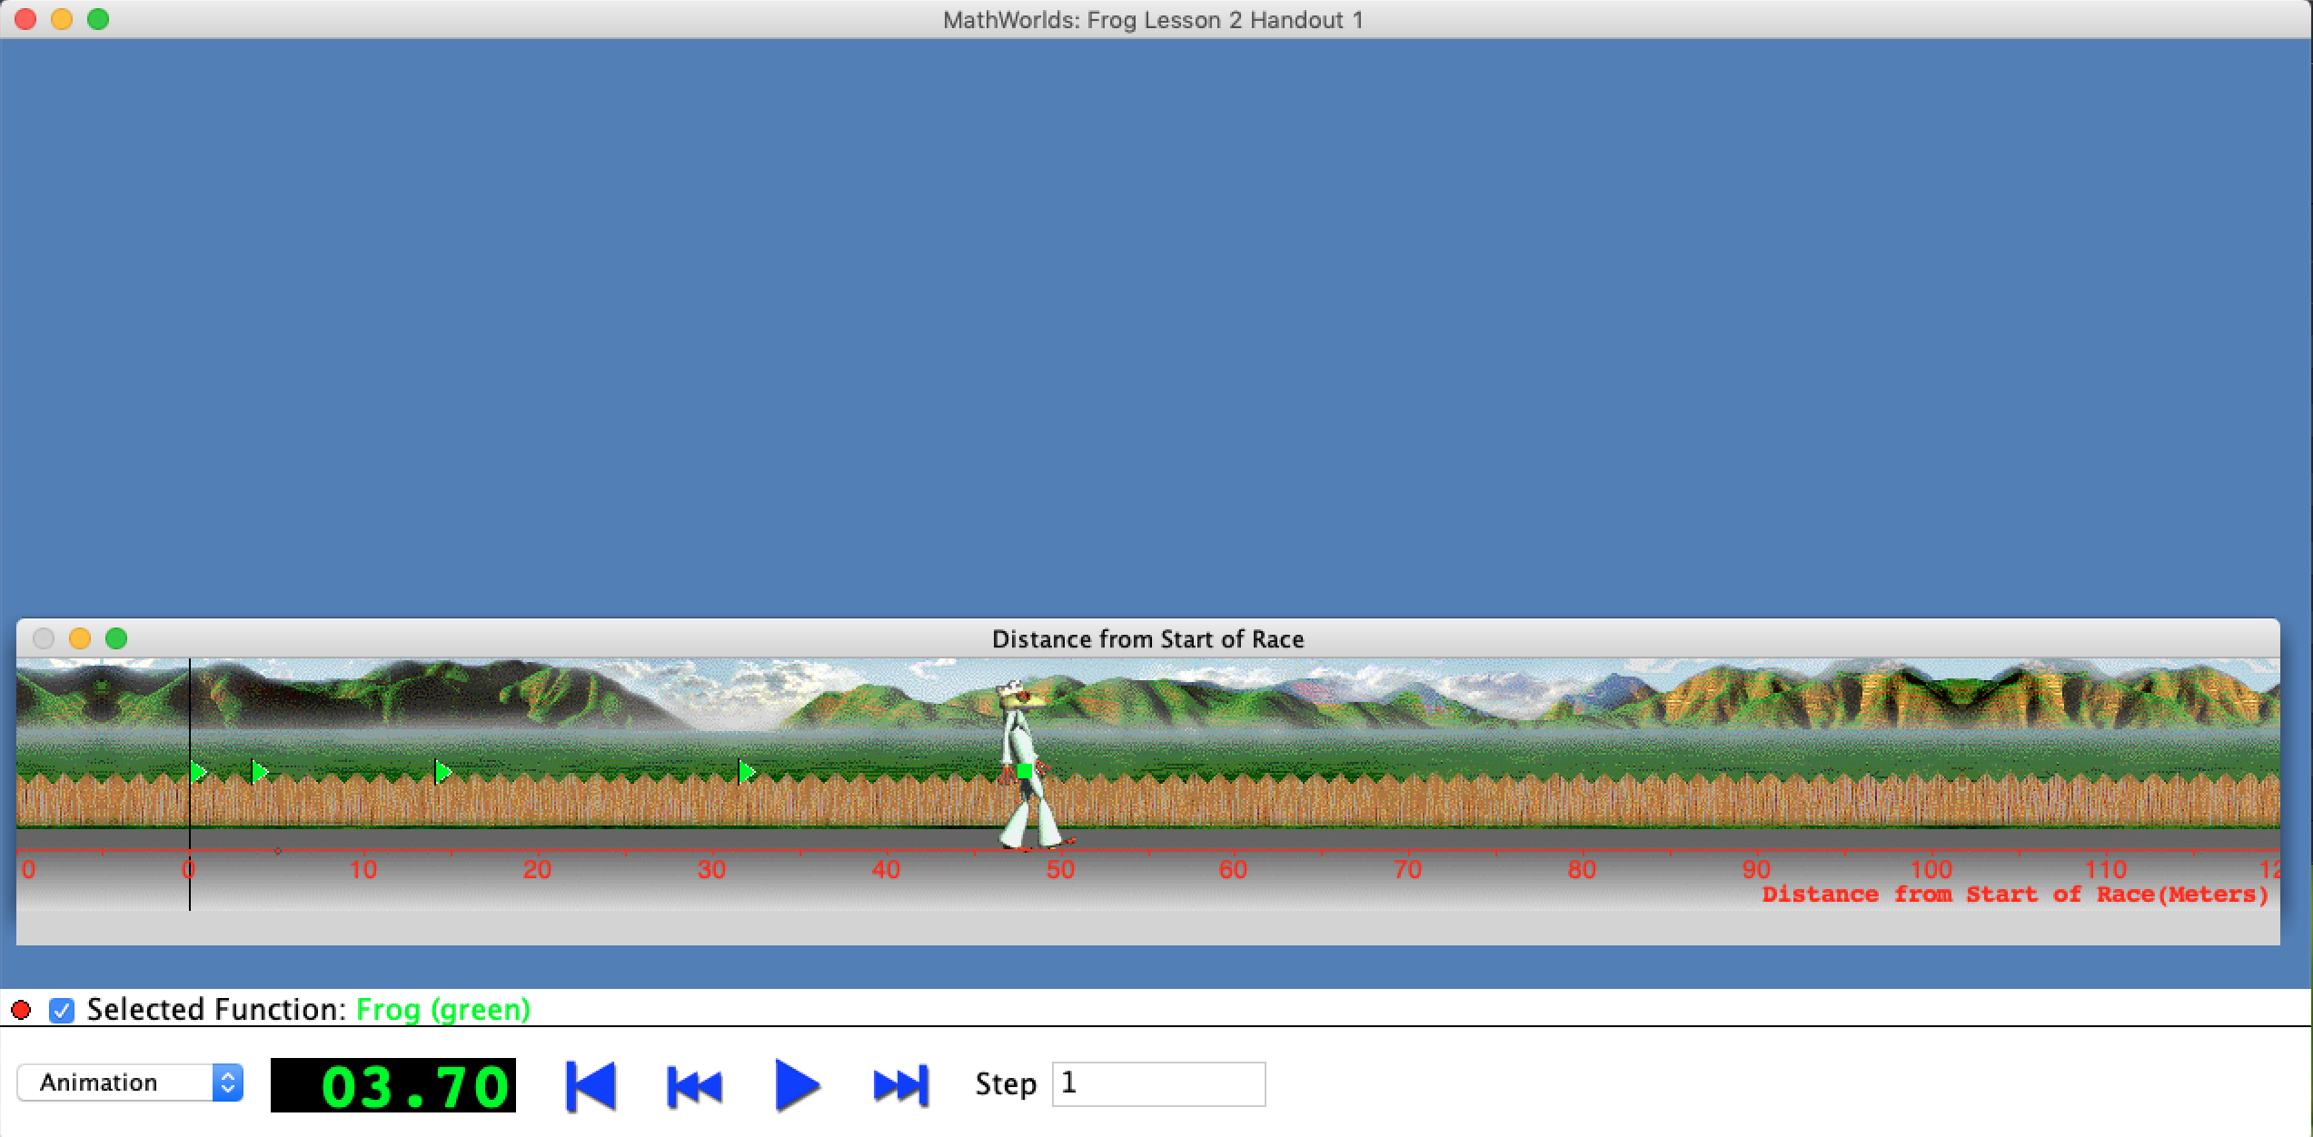
Contrasting Cases of Backward Transfer Involving
Linear and Quadratic Functions
Charles Hohensee & Matthew Melville
Example of Backward Transfer
The Type of Research We Do
Our Research Project
What We Found (cont.)
Students learn about Linear
Functions
Students are tested on Linear
Functions
Students learn about Quadratic
Functions
Students are tested on Linear
Functions
Our Mathematical Focus: We study how to teach quadratic functions so that the influences it has on students’ prior ways of reasoning about linear functions are productive.
Summer Math Program: Much of this project is situated around running 2-3 week summer math programs, in which students learn about quadratic functions.
Experimental Group: We gave a pre- and post-tests on linear functions to students in our summer math program (n₂=18), before and after we taught them about quadratic functions, using an approach that emphasized covariational reasoning and used SimCalc MathWorlds. The students came from low-income ethnically-diverse populations.
Control Group: We gave the same pre- and post-tests on linear functions to 2 regular algebra classes (n₁=57), before and after they learned about quadratic functions. The teachers taught the way they normally teach that topic. Both schools serve low-income, ethnically diverse populations.
Finding 1: We found far fewer changes in prior ways of reasoning in the experimental group than the control group.
Alex’s Reasoning Before Learning
About Quadratic Functions
 | Experimental Group | Control Group
Responses from pre- to post-test with changes in prior ways of reasoning | 28% | 50%
Finding 2: We found that the changes in prior ways of reasoning for the experimental group were more in one direction than for the control group.
 | Experimental Group | Control Group
Responses from pre- to post-test with changed from a general answer to a specific answer | 0% | 32%
Responses from pre- to post-test with changed from a specific answer to a general answer (this was the correct answer) | 44% | 35%
Alex’s Reasoning After Learning
About Quadratic Functions
The Test We Used
Possible Explanations
SimCalc MathWorlds
for Computers
The experimental group experienced a more consistent instructional focus on particular aspects of reasoning about quadratic functions (i.e., covariational reasoning) then the control group. That may have led to fewer backward transfer effects that were more consistently in a particular direction.
Defining Backward Transfer
We define Backward Transfer in the following way:
Backward transfer is the influence that learning something new has on a learner’s prior ways of reasoning about a different or related concept.
(Hohensee, Gartland, Willoughby, & Melville, 2020)
What We Found
Our Team
Why BT Research is Important
Our Research Question
Three types of Changes in Reasoning:
Changes in the strategies students used (build-up vs abbrev build-up).
Changes in whether they thought a solution was possible or not possible.
Changes in the kind of solutions they found (specific vs general).
Sometimes BT can be unproductive (i.e., the new learning makes students’ prior ways of reasoning less clear and/or less correct). We want to find ways to teach, that minimize or even eliminate unproductive BT.
Sometimes BT can be productive (i.e., the new learning makes students’ prior ways of reasoning more clear and/or more correct). We want to find ways to teach, that promote and maximize productive BT.
How will backward transfer effects (i.e., influences on prior ways of reasoning by new instruction) produced in an experimental setting (i.e., a summer math program) compare with backward transfer effects produced in a control setting (i.e., two business-as-usual classrooms)?
This work was supported by
Link to video: https://youtu.be/gJi2Nu5-HTU

