Slide 1

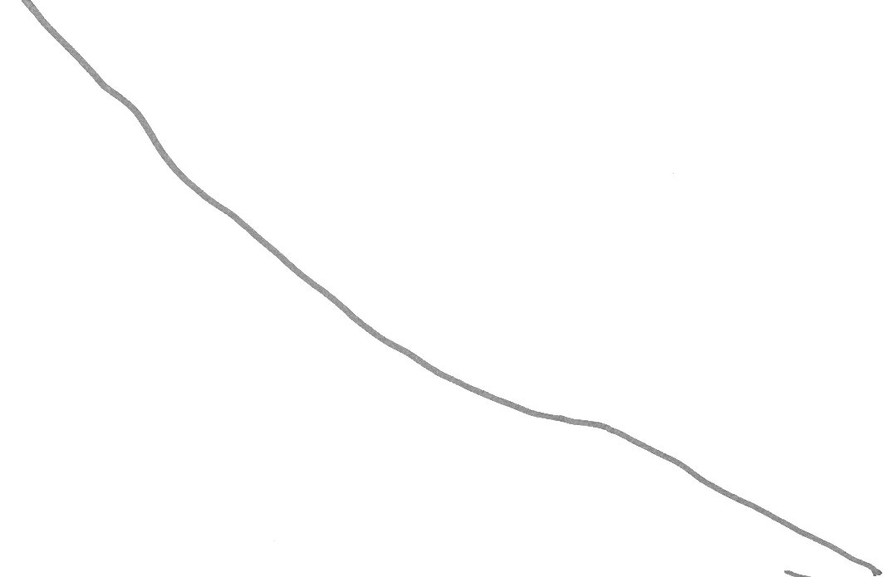
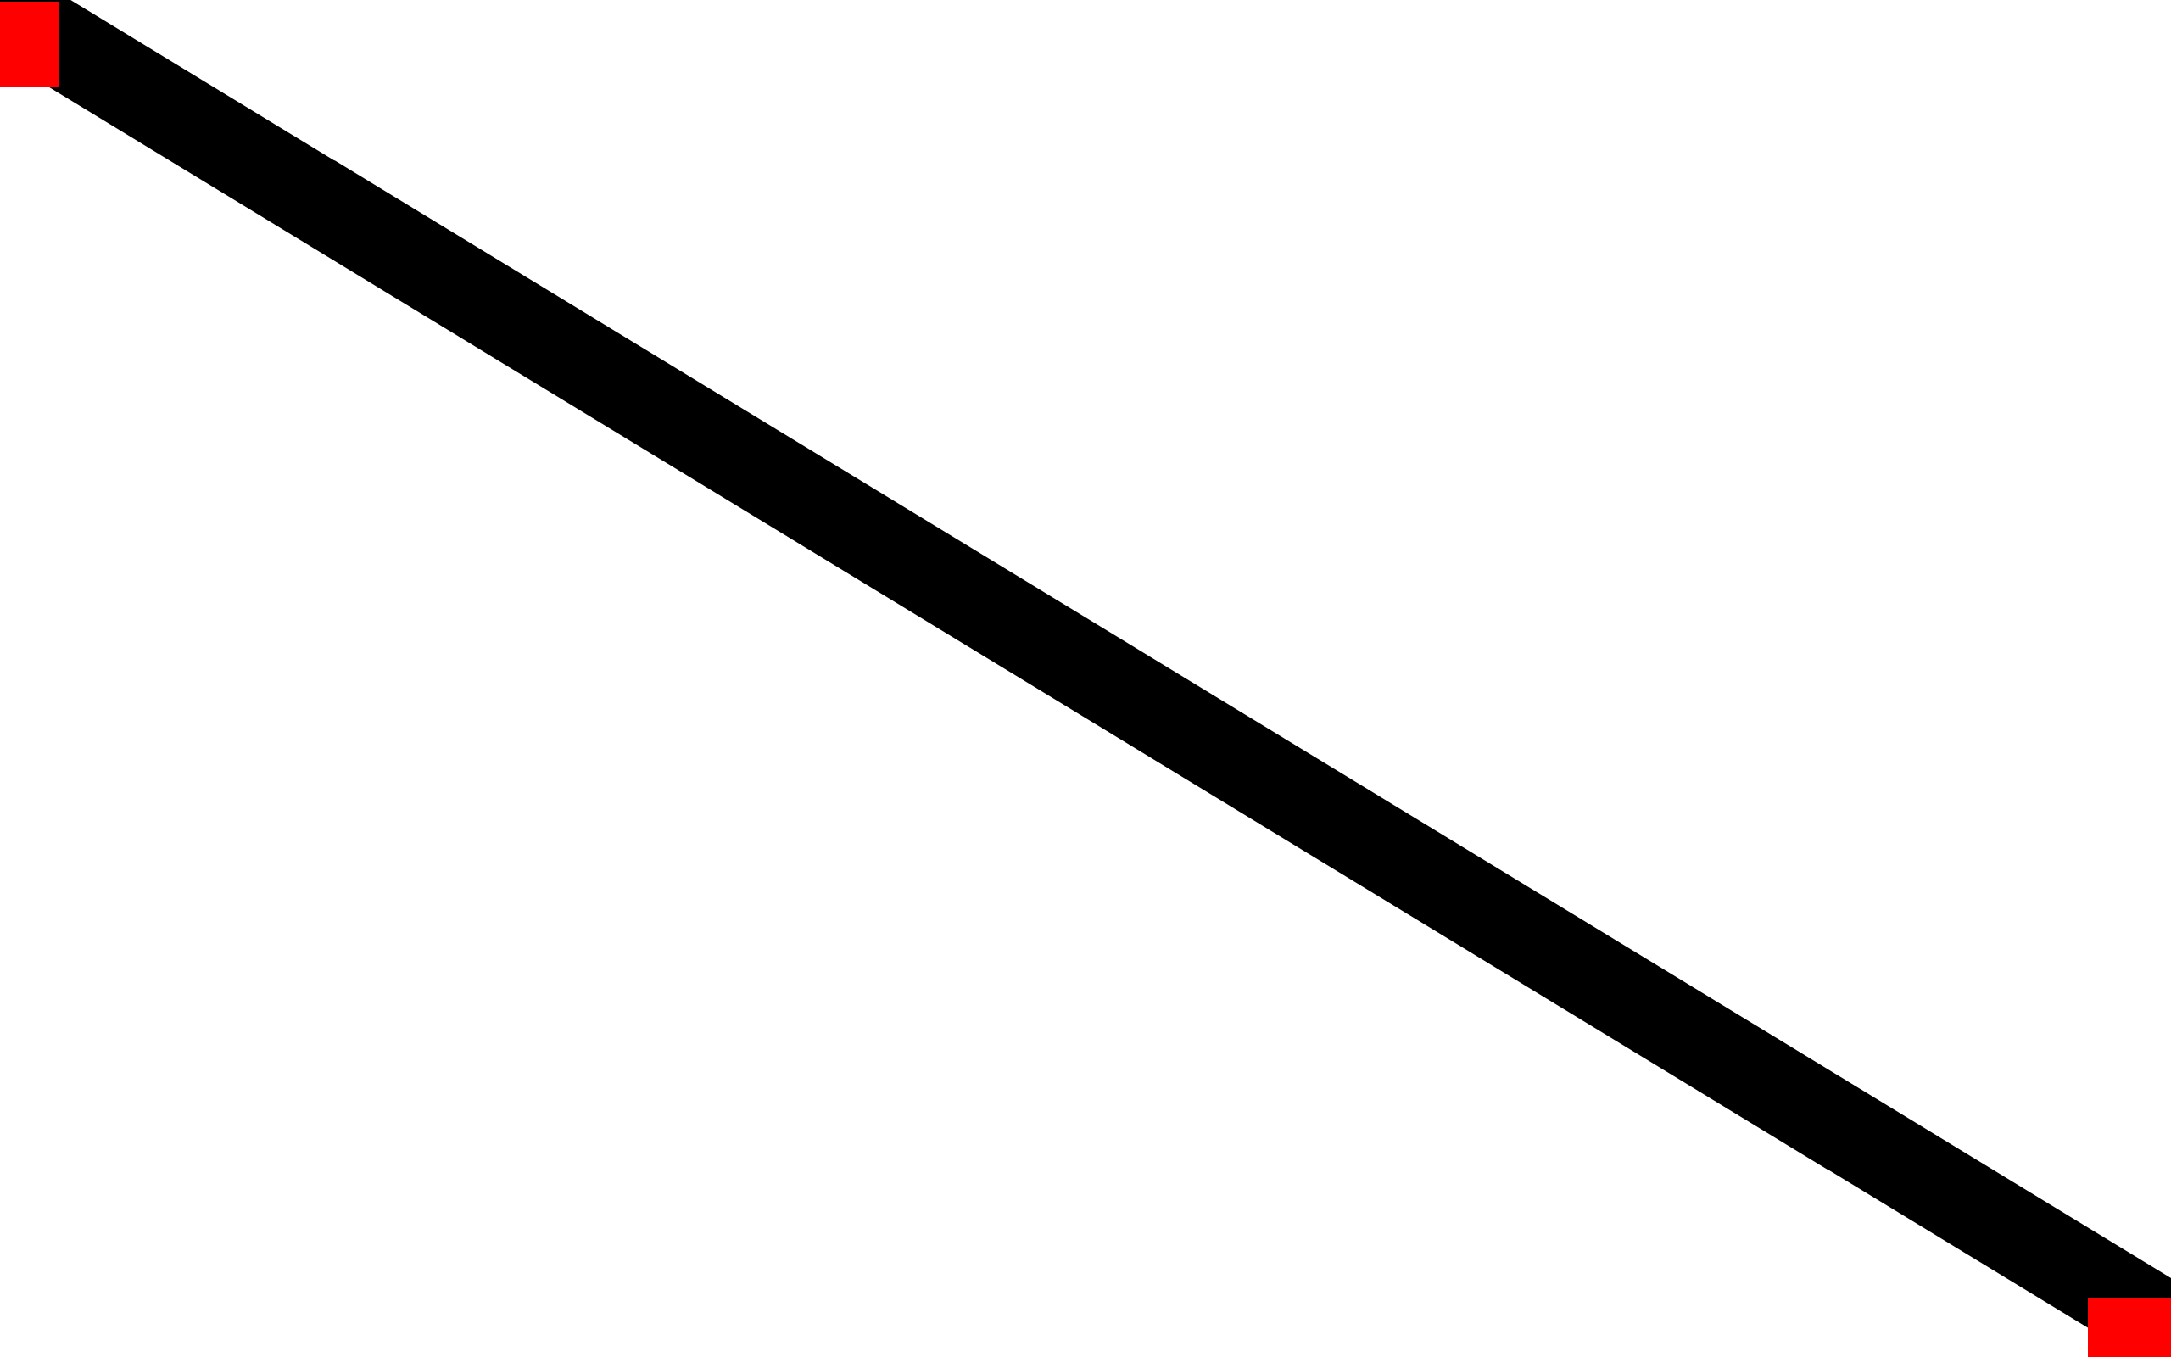
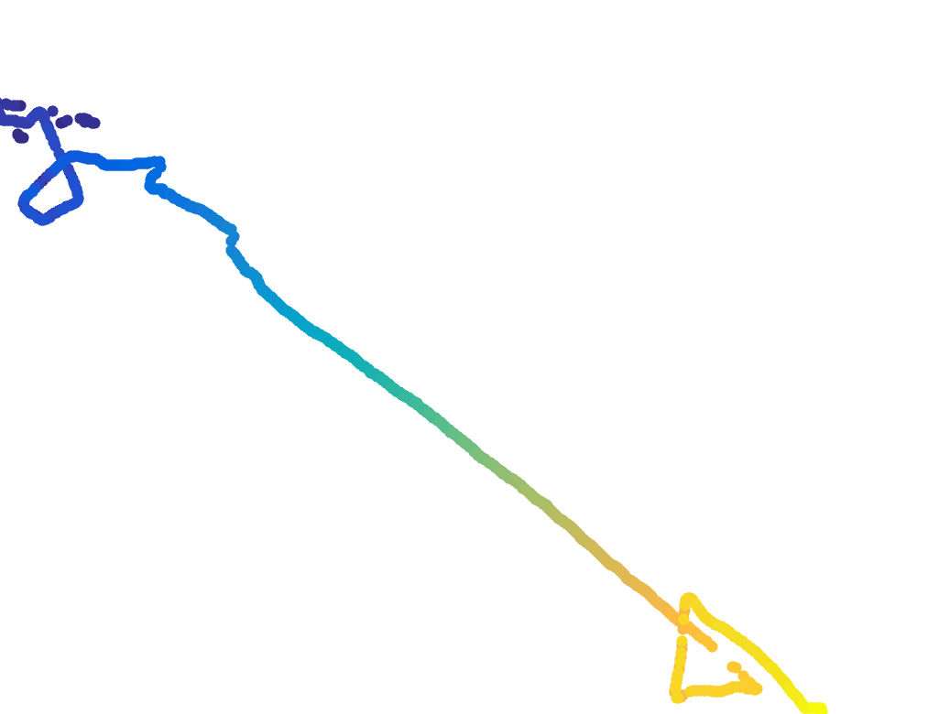
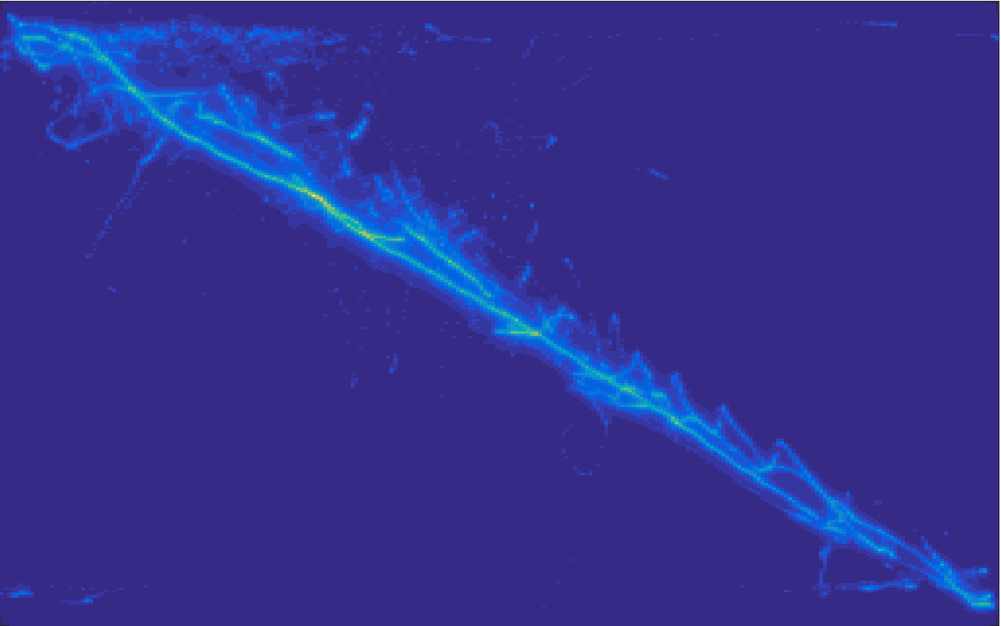
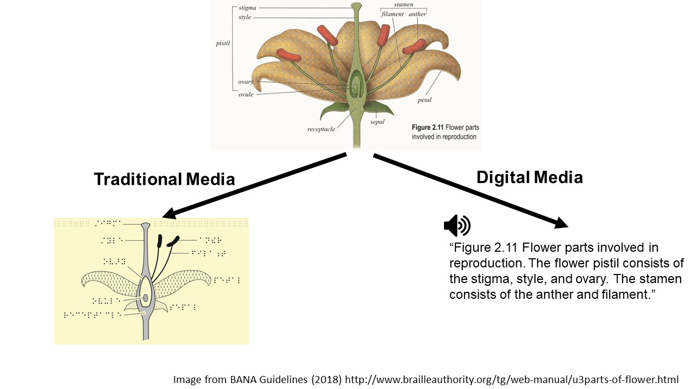
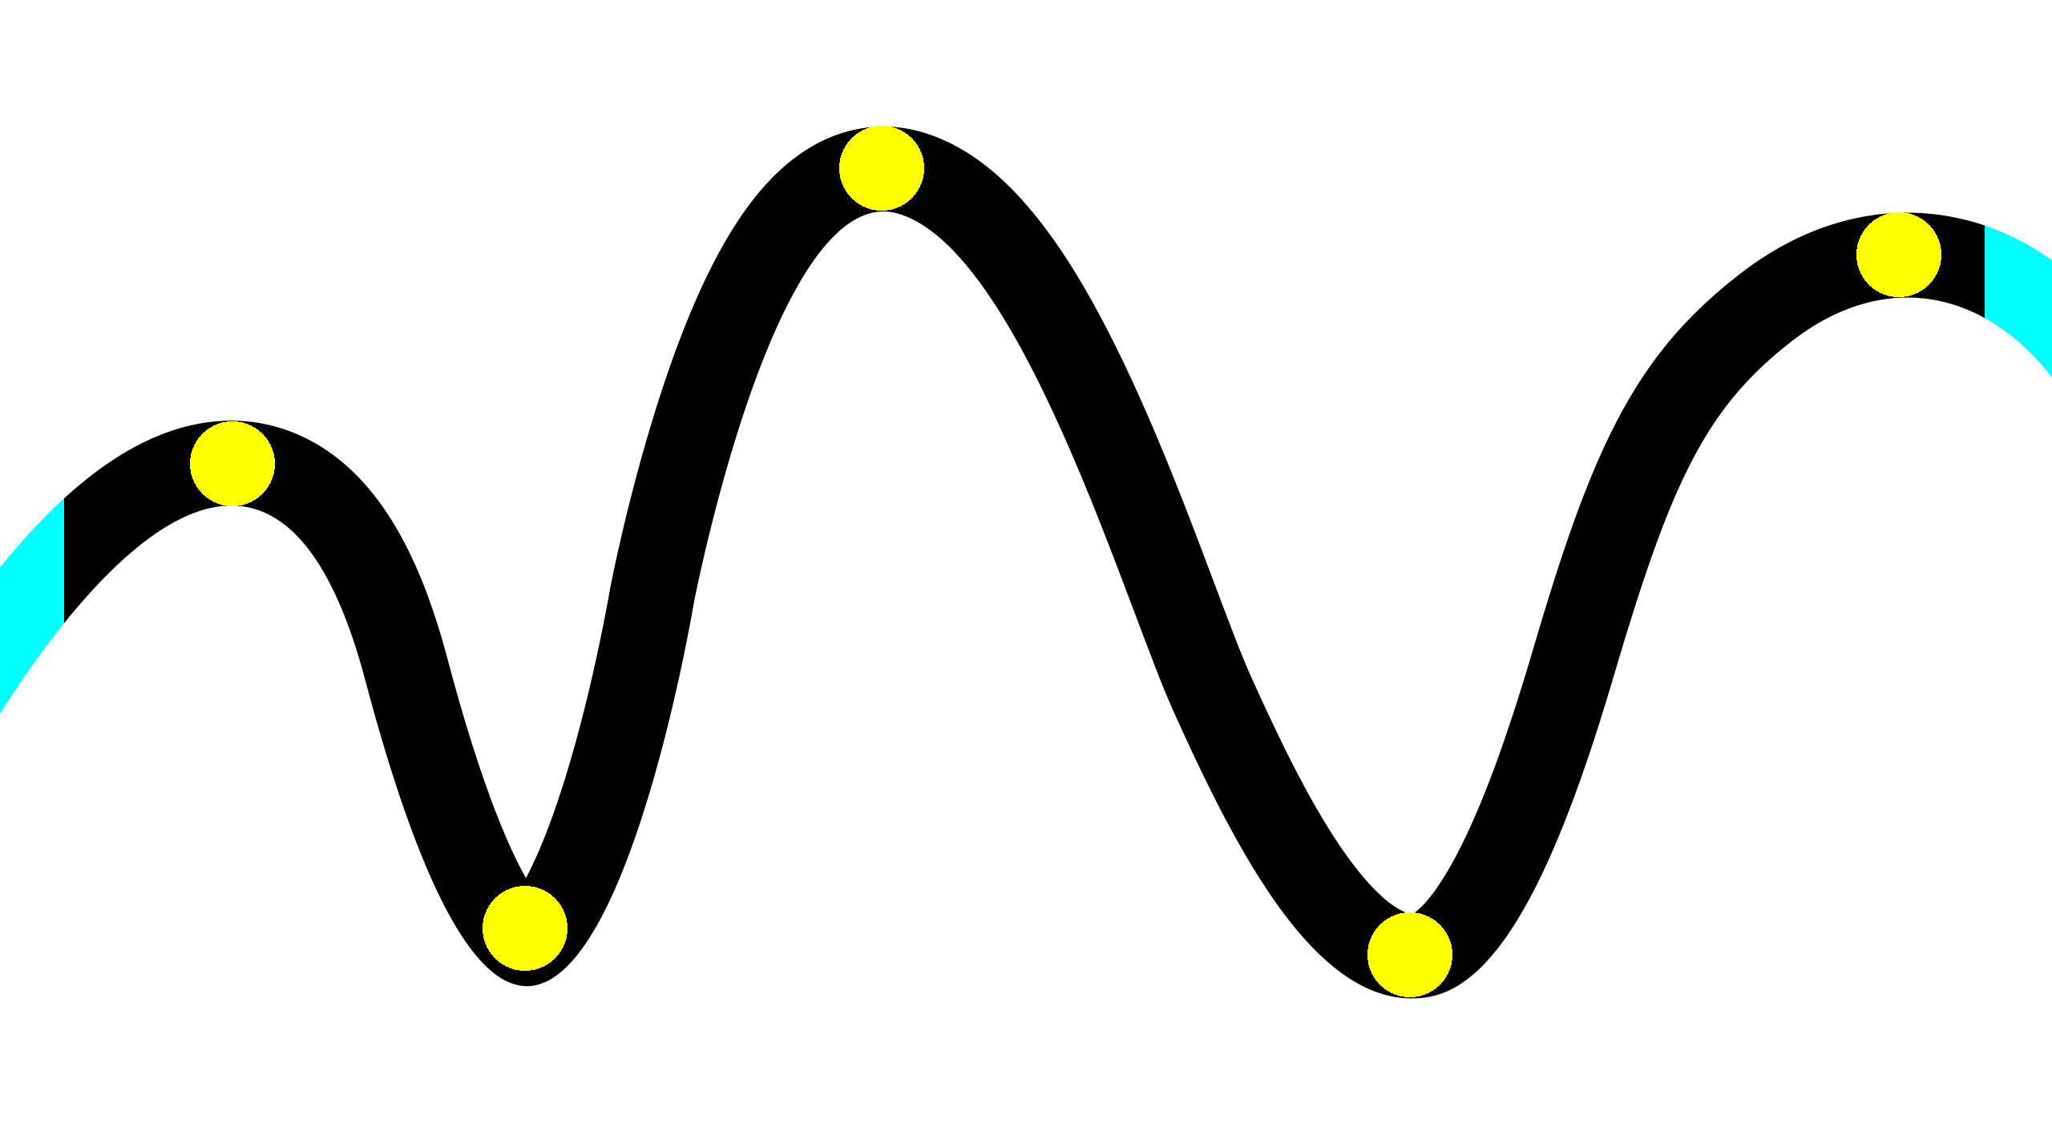
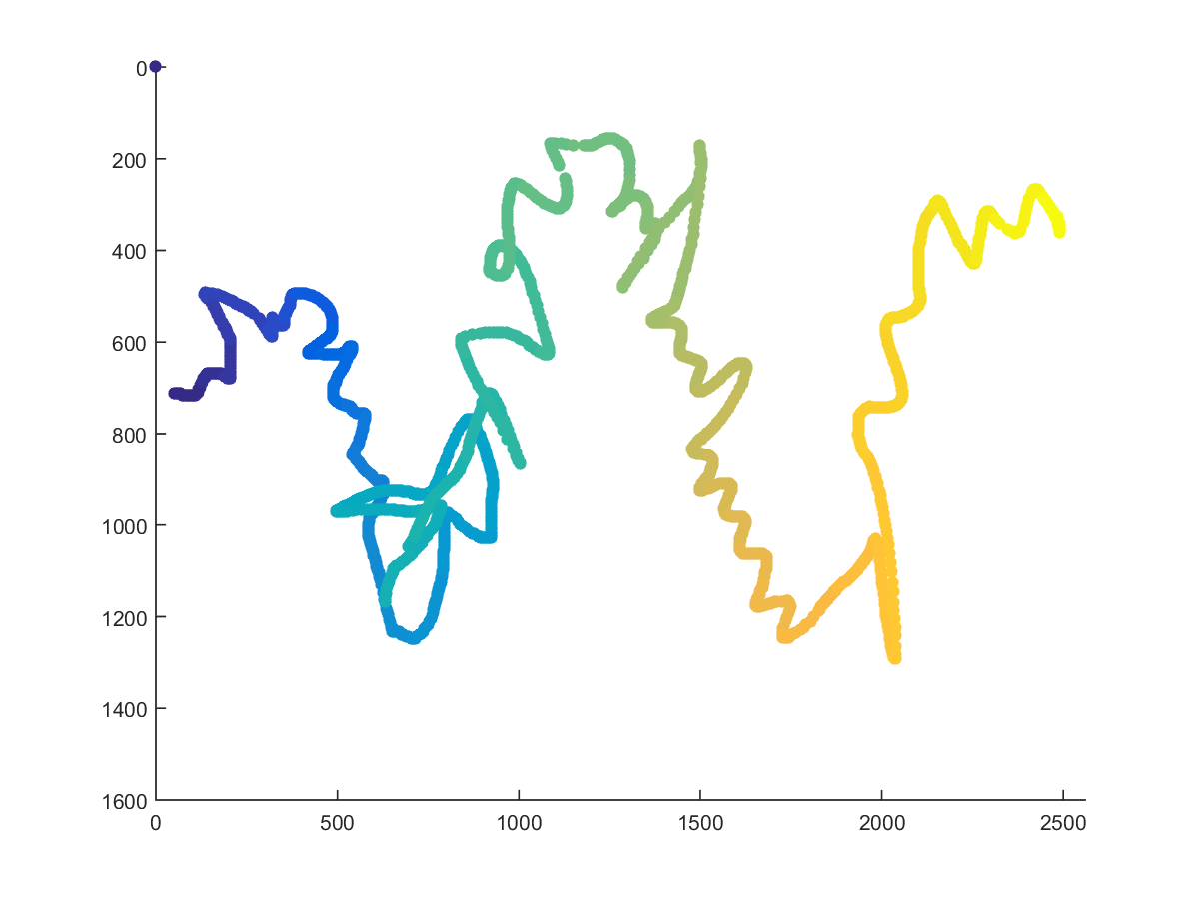
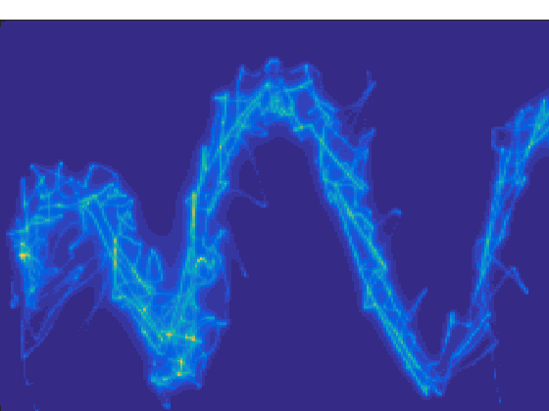
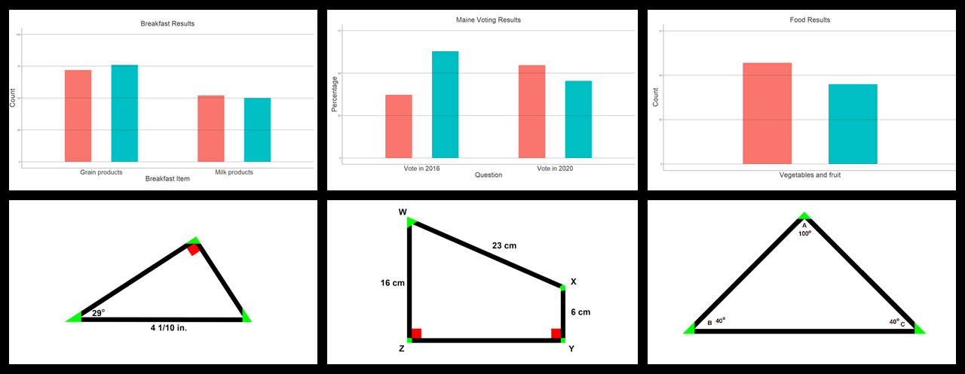
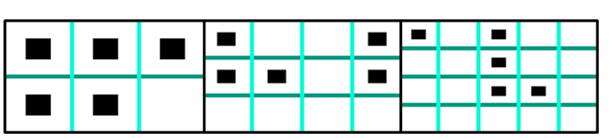
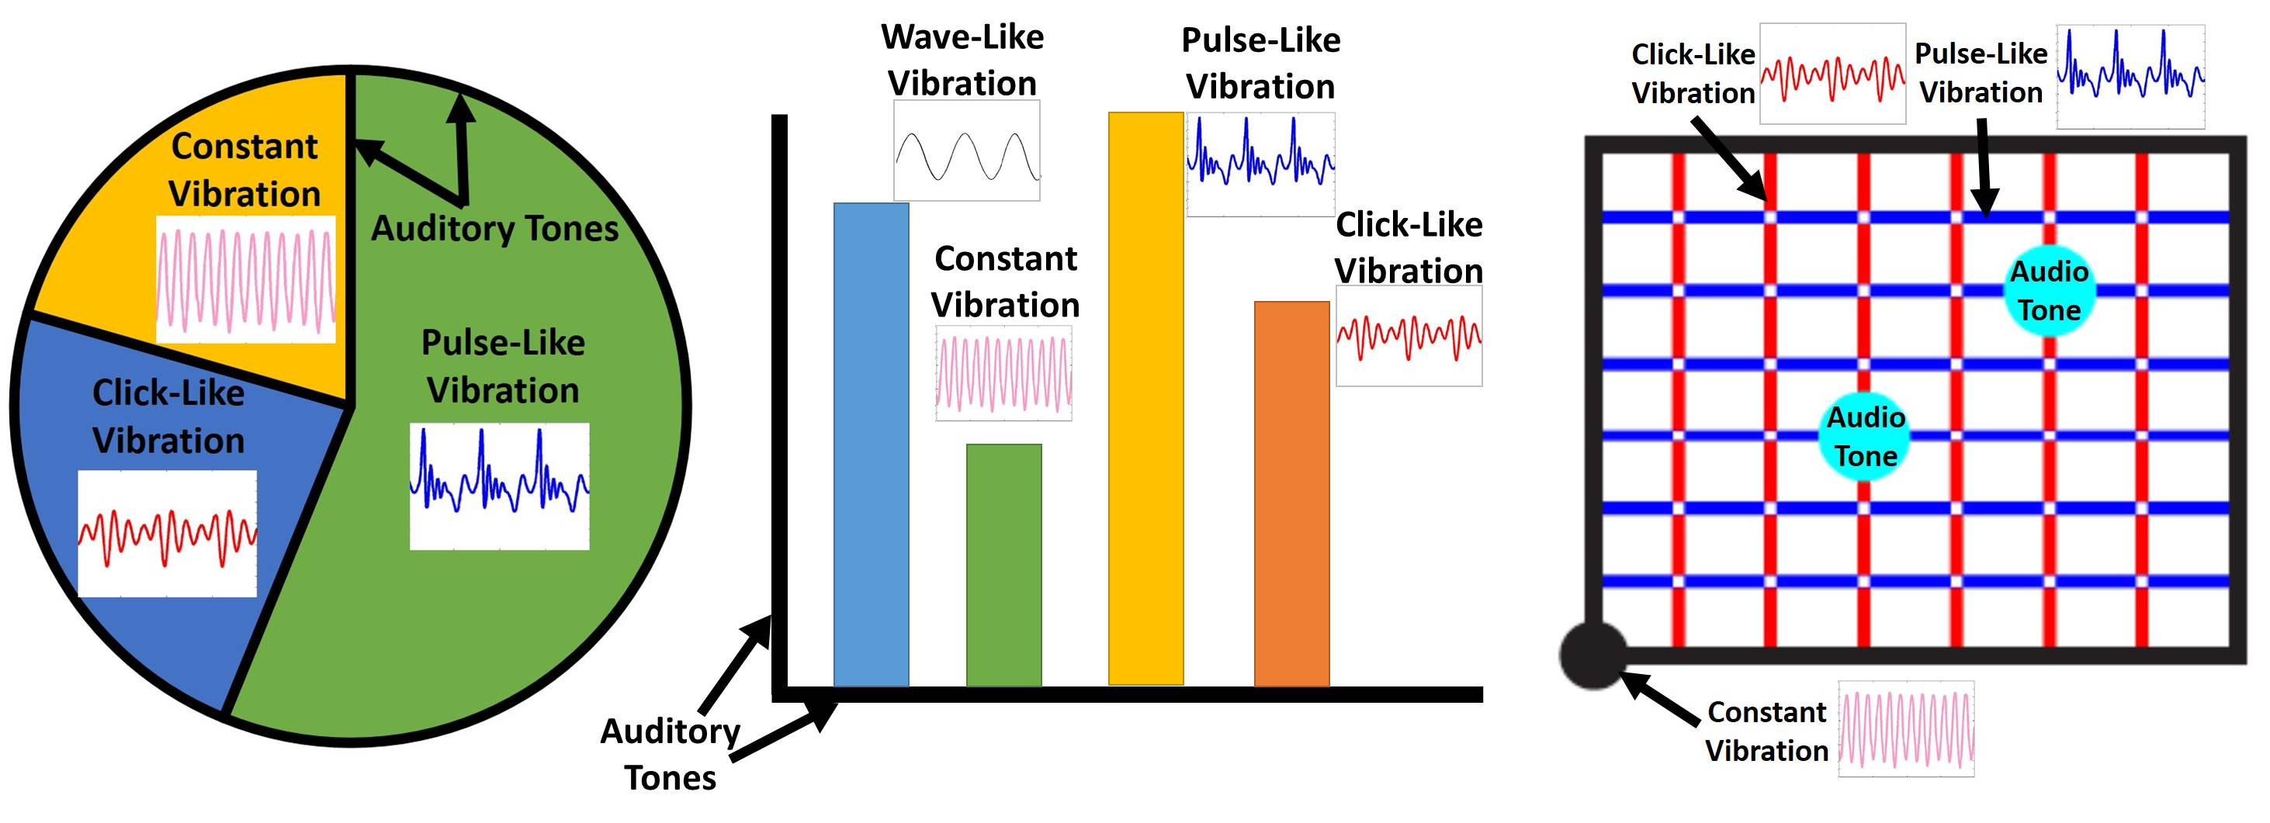
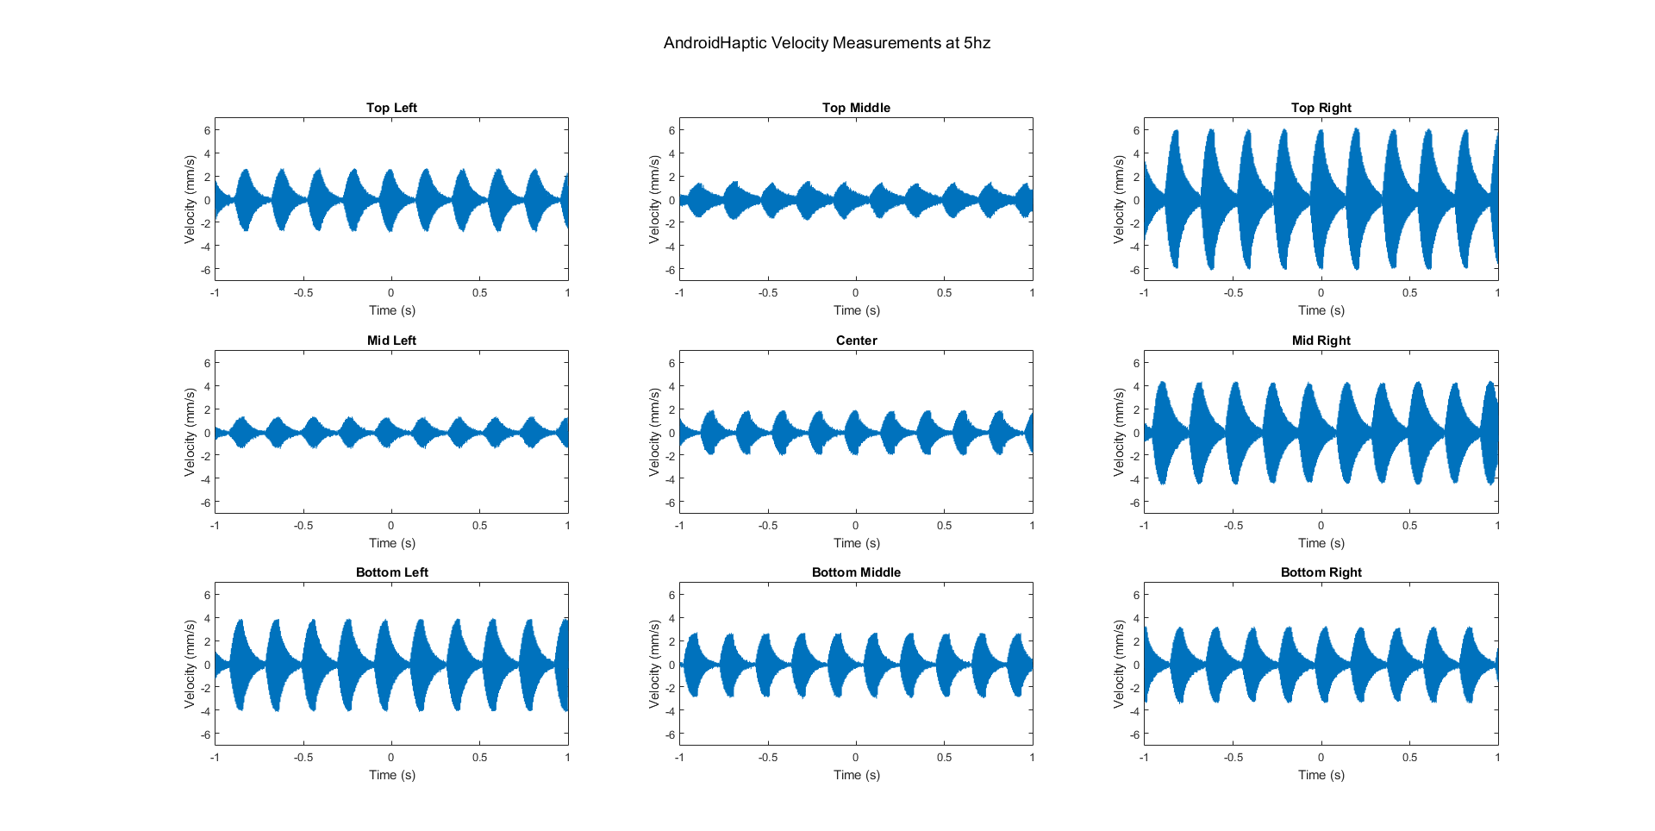
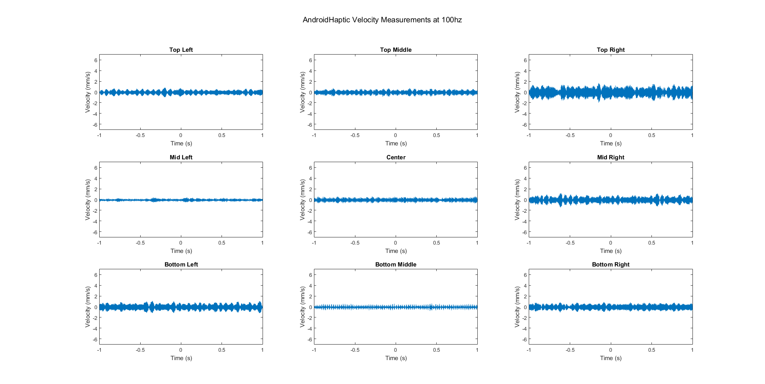
CAREER: Bridging the Digital Accessibility Gap in STEM Using Multisensory Haptic Platforms
Also Presenting on Collaborative Project: Perceptual and Implementation Strategies for Knowledge Acquisition of Digital Tactile Graphics for Visually Impaired Students
Jenna Gorlewicz¹, Nicholas Giudice², Andreas Stefik³, Derrick Smith⁴, Jennifer Tennison¹
Motivation
Linear Line Following
Guidelines
Make digital graphics accessible using multimodal feedback on touchscreens.
How best to convey straight lines on a flat, smooth, touchscreen surface?
Lines with borders had highest recreation accuracies (90%) and smallest average deviation (11-12 mm).
Vibration-only (81%; 14.5 mm) and audio-only (81%; 13.5 mm) were comparable.
How best to indicate curves and deviations in lines?
Auditory points improved average deviations (1 point: 7-8 mm; 3 point: 7-9 mm
No difference was found between the 2 point orientations, indicating the importance of user preference.
Are there differences between large and small screens when understanding graphics?
Tablet-sized devices are more accurate.
Phone-sized screens afford comparable accuracy, but are quicker to explore.
Dashed lines: <10 Hz
Dotted lines: 10-25 Hz
Solid lines: 25-100 Hz
> 100 Hz difficult to perceive
Optimal vibrotactile line width for information extraction is 4 mm.
Gap between vibrotactile lines should be 4 mm at minimum.
Borders around lines encourages finer tracing.
Indicate significant points with a different vibration or with audio.
Design to allow multitouch on screen, even if just used for reference.
Minimize signal distractions and clutter during tasks.
Full guidelines: Gorlewicz et al (2020. ACM TACCESS 13(3), 1-30.
Current Challenges
Access to graphical information is one of the most pervasive challenges faced by individuals who are blind or visually impaired.
Captions on figures, alt tags on web images, etc. tend to be short and imprecise.
Traditional approaches to tactile graphics, are expensive, inconvenient, and not immediately accessible.
Non-Linear Line Following
Validation of Guidelines
No statistically significant difference between embossed and touchscreen bar charts or geometry figures
Participants performed better on geometric figures overall, but touchscreen bar charts better liked.
We would like to thank the NSF for supporting this work (Grant #1845490 and #1644538) Any opinions, findings, and conclusions or recommendations expressed in this material are those of the author(s) and do not necessarily reflect the views of the National Science Foundation..
References
[1] Klatzky, Giudice, Bennett, & Loomis, 2014
[2] Poppinga, Magnusson, Pielot, & Rassmus-Gröhn, 2011
[3] Palani & Giudice, 2017
[4] Palani, Giudice, & Giudice, 2016
¹ Jenna.Gorlewicz@slu.edu, Jen.Tennison@slu.edu (Saint Louis University)
² Nicholas.Giudice@maine.edu (University of Maine)
³ Andreas.Stefik@unlv.edu (University of Nevada Las Vegas)
⁴ Derrick.Smith@uah.edu (University of Alabama Huntsville)
Screen Size and Graphical Density
Multimodal Feedback on Touchscreens
Acknowledgements
Using haptics (touch) and audio. Useful in interpreting graphs [1], maps [2], and for panning and zooming on touchscreens [3][4].
Vibration Discrimination and Categorization
Notes:
Side panels: 12”
Middle panel: 24”

