Slide 1
Teacher Preparation Programs
Engineering and Technology Education: “Putting the T&E in STEM”
Kurt Becker
Professor, Department Head
Engineering and Technology Education
Utah State University

Slide 2




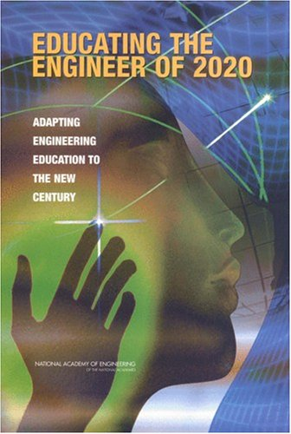




Engineering - Global Calls to Action
“Education as usual” will not get us there
“Business as usual” will not get us there

Slide 3
Why Change?
The call for a transformation in how engineers are educated is well documented. The need for change: American students’ declining interest in engineering and/or STEM as a major, low engineering retention rates, the need for a diverse engineering workforce, the effects of rapid technological change and globalization.
ASEE’s Engineering Dean’s Council and the Corporate Roundtable (1994); the National Research Council (1995); the National Academy of Engineering (2002 and later); and the National Science Foundation.
Notes:
3

Slide 4
Benefits of K-12 Engineering Education
Improve learning and achievement in science and mathematics;
Increase awareness of engineering and the work of engineers;
Understanding of and the ability to engage in engineering design
(Engineering in K-12 Education, NAE, 2009)

Slide 5
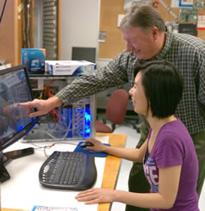
Who Will Teach Engineering at the Secondary Level?
Currently engineering education at the secondary level is taught by math, science, physics, and technology education teachers.
Technology education teachers are the predominant group teaching engineering.

Slide 6
Engineering and Technology Education
Why?
Infrastructure is in place
  Buildings, classrooms & laboratories
  Programs in high schools and junior high schools
Technology Education – has a great overlap with engineering (design component)
Ill-structured creative problem solving
Standards for Technological Literacy are in place (STL, 2000)
Secondary Licensure (6 – 12)

Slide 7


Engineering and Technology Education
The Engineering and Technology Education degree consists of courses in the following areas:
communication
construction
engineering
manufacturing
power, energy & transportation
These courses consists of hands-on experiences in laboratory settings. Laboratory activities have a design emphasis that requires creative problem solving.

Slide 8
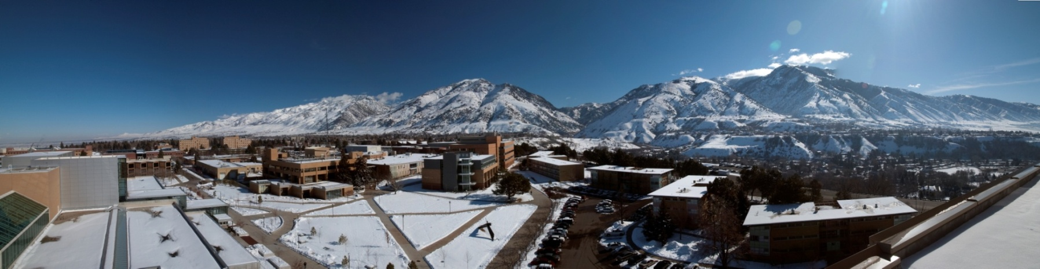
COLLEGE OF ENGINEERING
Utah State University
5 Departments
  Biological Engineering
  Civil & Environmental Engineering
  Electrical & Computer Engineering
  Engineering & Technology Education
  Mechanical & Aerospace Engineering

Slide 9
Department of Engineering & Technology Education
Offers a PhD in Engineering Education
Offers the first two years of the engineering program – foundational courses
Offers a two year Assoc. of Pre-Engineering (APE) at Regional Campuses
Offers a 6-12 Engineering and Technology Education – Teacher Preparation Program

Slide 10


National Center for Engineering and Technology Education (NCETE)
NCETE a collaborative network of scholars with backgrounds in technology education, engineering, and related fields. The mission is to build capacity in technology education and to improve the understanding of the learning and teaching of high school students and teachers as they apply engineering design processes to technological problems.
www.ncete.org

Slide 11
Comparison of Design Process
(Hailey, Becker, Erickson, Thomas, 2005)
Engineering Design Process
(Eide, Jenison, Mashaw, Northup, 2001)
Identify the Need
Define Problem
Search for Solutions
Identify Constraints
Specify Evaluation Criteria
Generate Alternative Solutions
Analysis
Mathematical Predictions
Optimization
Decision
Create a Working Model
Design Specifications
Communication
Technology Education
Design Process
(Standards for Technological Literacy, 2000)
Defining a Problem
Brainstorming
Researching & Generating Ideas
Identifying Criteria
Specifying Constraints
Exploring Possibilities
Selecting an Approach and Develop a Design Proposal
Building a Model or Prototype
Testing & Evaluating the Design
Refining the Design
Communicating Results

Slide 12
Comparison of Design Process
(Hailey, Becker, Erickson, Thomas, 2005)
Engineering Design Process
(Eide, Jenison, Mashaw, Northup, 2001)
Identify the Need
Define Problem
Search for Solutions
Identify Constraints
Specify Evaluation Criteria
Generate Alternative Solutions
Analysis
Mathematical Predictions
Optimization
Decision
Create a Working Model
Design Specifications
Communication
Technology Education
Design Process
(Standards for Technological Literacy, 2000)
Defining a Problem
Brainstorming
Researching & Generating Ideas
Identifying Criteria
Specifying Constraints
Exploring Possibilities
Selecting an Approach and Develop a Design Proposal
Building a Model or Prototype
Testing & Evaluating the Design
Refining the Design
Communicating Results

Slide 13
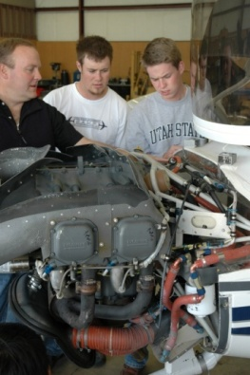
Problems with Existing Programs
Technology Education - Use trial & error
Mathematics & Science – Teachers struggled with teaching open ended engineering problems
Teachers struggle with teaching engineering concepts

Slide 14
Utah State University
Pre-Service Model
Curricular Changes
  changed course requirements
Course Modifications
  Added engineering design component to each technical course

Slide 15
Typical
Engineering and Technology Education Program
Math Requirements
Trigonometry
College Algebra
Other Requirements
Physics for Technology

Slide 16
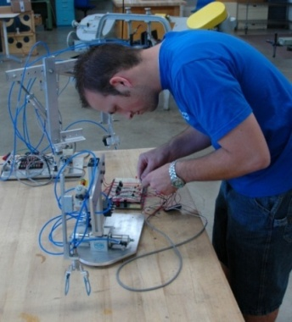
USU’s Technology Education Pre-Service Program
Math Requirements
Calculus I
Calculus II
Other Requirements
Physics
Chemistry
Statics
Dynamics

Slide 17
Reasons for Change
Prepare the next generation of teacher who can truly teach engineering.
Increase Rigor – Students from engineering and other majors would take a look at our course curriculum and move on.
STEM Integration – Teachers with a skill set to do a better job with integrating science and math into engineering and technology.

Slide 18
Issues & Challenges
Recruitment - We are working on the premise that: “If we build It, they will come”
  math, science, engineering,
Student Support for foundational courses (Calculus, Statics, Dynamics)
Will this new breed of student be successful?

Slide 19
Thank You
Department of Engineering and Technology Education
www.ete.usu.edu

