Slide 1
Clarifying the Role for the Evaluator: Working with Projects Focusing on Research Products
Jeff Barrett

Slide 2
Being a critical friend but not just another researcher (with PI and Co-PI)
How does the evaluator serve the project as “critical friend” in a situation where the project is primarily designed to produce research outcomes such as frameworks or trajectories (progressions for curriculum or assessment development)? What contribution is possible for a researcher/evaluator that is distinct from the work and ongoing contributions of the project researchers themselves?
Context: a DRK12 project, “A Study of the Struggling Learner’s knowledge and Development for Number and Operation”. Data collection and data analysis . I am eval, and member of a 4 person adv board.

Slide 3
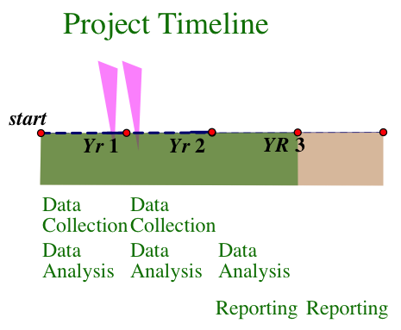

Slide 4
Checkpoint 1 (monthly or semester):
While the design was intact, and the fidelity of data collection was carefully monitored, it became clear that the interpretation of these data was unusually demanding and ambitious for time from the limited project staff.
There were provisions for extensive observation, but less opportunity for predictive model construction and testing, since researcher/interviewers were often engaged in daily lessons/ tutoring with students, as often as 4 times a week.

Slide 5
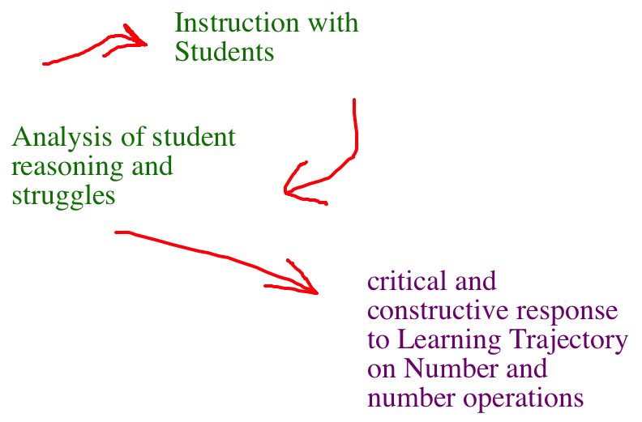
Theory of Action

Slide 6
Modify existing theory of action
This was a tradeoff, balanced against substantive review and model construction based in analysis of these sessions. Although summative review would be worthwhile as the researchers would be able to review the videotaped data during the subsequent summer, the ongoing and concurrent analysis was going on during the school year without extensive documentation of the analyst’s reasoning and decision making to prepare for subsequent lessons.
A need for modified ways of finding and examining shift points: where are students changing? What is happening to promote changes in their thinking? Can we build adequate predictions of change, based on current LT? I recommended that the researchers take the opportunity to reflect on their ways of working with an existing LT and adapting it in use with a different population. While the outcome would be useful as a product, the process would be useful as a second-order outcome too.

Slide 7
Negotiation of changes
I advised the project team to adapt a funneled process of data analysis, altering the design of the teaching sessions during the second year of the project.
We examined alternatives to the present methodology and schedule and decided to present these alternatives to the advisory board.
Thus, as evaluator, I took responsibility to recommend a specific way of adapting the project with varying schedules of engagement with different members of the cohort of students as children participants entered Grade 2. I submitted revision options to the PI team as a record of the adaptation and improvement of the methodology from year1 to year2.
Then we checked this decision with the advisory board, presenting options and asking their counsel.

Slide 8
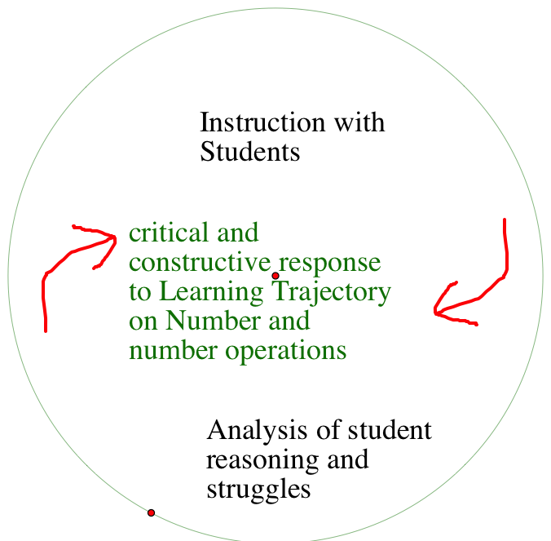
Modified theory of action

