Slide 1
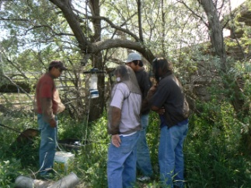
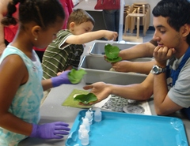
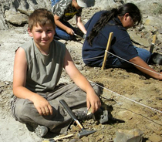
Brief thoughts and encouragements
Sue Allen
Division Director (Acting)
Division of Research on Learning in Formal and Informal Settings

Slide 2
Two surprises
Programs like DRK-12 are not everlasting.
NSF doesn’t give money for noble activities, it invests.

Slide 3
Two main threads of DR K-12
Small scale
R&D
Developing resources, models, and technologies, ultimately toward national adoption
What works, for whom, and under what circumstances?

Slide 4
DR K-12 Findings
From each project
Knowledge
Knowledge
Knowledge
Knowledge
Knowledge
Knowledge
National scale
Congress
State legislators
Public
Pre-service faculty
In-service faculty

Slide 5
DR K-12 Findings
From each project
Knowledge
Knowledge
Knowledge
Knowledge
Knowledge
Knowledge
National scale
Congress
State legislators
Public
Pre-service faculty
In-service faculty
Synthesis Studies

Slide 6
DR K-12 Findings
From each project
Knowledge
Knowledge
Knowledge
Knowledge
Knowledge
Knowledge
National scale
Congress
State legislators
Public
Pre-service faculty
In-service faculty
Synthesis Studies

Slide 7
How will you feel this pressure?
Project Outcomes Report (POR)
Data Management Plan (Friday)
Metrics for DRK-12

Slide 8
Two main threads of DR K-12
Small scale
R&D
Developing resources, models, and technologies, ultimately toward national adoption
What works, for whom, and under what circumstances?

Slide 9
DR K-12 Products
From each project
Products
Products
Products
Products
Products
Products
National scale
Teacher ed institutions
Teachers
Districts
Administrators
Policy-makers

Slide 10
DR K-12 Products
From each project
Products
Products
Products
Products scale-up
Products
Products scale-up
National scale
Teacher ed institutions
Teachers
Districts
Administrators
Policy-makers

Slide 11
DR K-12 Products
From each project
Products
Products
Products
Products scale-up
Products
Products scale-up
National scale
Teacher ed institutions
Teachers
Districts
Administrators
Policy-makers

Slide 12
What mechanisms are there?
DRK-12 synthesis and scale-up
PRIME
TSL
Cyberlearning: Transforming Education
EAGERs
RAPIDs

Slide 13
Comments on Scaling and
National Adoption
Joan Ferrini-Mundy
Acting Assistant Director
Directorate for Education and Human Resources

Slide 14
Two main threads of DR K-12
Small scale
R&D
Developing resources, models, and technologies, ultimately toward national adoption
What works, for whom, and under what circumstances?

Slide 15
Agree that there is a major need for “crossing the abysses”
Agreement on Need
Notes:
Taking the larger perspective, I agree that we face pressing needs for crossing the abysses toward national adoption of both products and findings.

Slide 16
Context is Important

Slide 17
EXECUTIVE OFFICE OF THE PRESIDENT
NATIONAL ECONOMIC COUNCIL
OFFICE OF SCIENCE AND TECHNOLOGY POLICY
A STRATEGY FOR AMERICAN INNOVATION: DRIVING TOWARDS SUSTAINABLE GROWTH AND QUALITY JOBS
September, 2009
“Fundamentally, innovation is the development of new products, services, and processes. “
Notes:
The President has defined innovation in terms of the translation from basic research to market.

Slide 18
National Standards
44 states have signed on to adopt common core standards in Mathematics and ELA
Framework for new science standards by National Research Council
Notes:
Standards movements are gaining momentum so there is a huge push away from fragmentation and toward alignment on very large scales.
By the way, this is an opportunity for our researchers to have their evidence-based materials and findings brought to scale.
Math researchers should know the math standards.
Science researchers should know that within ELA standards there are sections that discuss literacy in science.
Science standards are coming soon.
Advertise tomorrow’s session

Slide 19
President’s Council of Advisors on Science and Technology Prepare and Inspire: K-12 Education in STEM for America’s Future September 2010
“We believe that the NSF’s current funding portfolio is not optimally balanced to support the Nation’s need. The emphasis on supporting development and implementation of scalable solutions should be substantially increased. This should ideally involve appropriation of additional resources for this work, but, if necessary, could appropriately involve some shifting of resources.”
III. Federal Role in K-12 STEM Education (pg.32)
Notes:
Another high profile call for national adoption comes from the PCAST report.

Slide 20
Notes:
But here is a caveat: we are only a limited part of this.

Slide 21
Notes:
But here is a caveat: we are only a limited part of this.

Slide 22
Possible Strategies
Require national adoption for renewal
Require partnerships with VCs, private sector, etc.
“Hand-off”
Teacher testers
Confer with end-users in new ways
Synthesis of efficacy studies
????
Notes:
At the same time, we need to do more. So here are some ideas to talk about at your tables.

