Slide 1
From Access to Sustainability:
Investigating Ways to Foster Sustainable Use of Computational Modeling in K-12 Science Classrooms
Paulo Blikstein (PI)
Tamar Fuhrmann (Co-PI)
Adelmo Eloy
TC, Columbia University
Michelle Wilkerson (Co-PI)
University of California, Berkeley
Aditi Wagh (Co-PI)
Massachusetts Institute of Technology
Engin Bumbacher
HEPL Switzerland
This material is based upon work supported by the National Science Foundation under Grant No. 2010413. Any opinions, findings, and conclusions or recommendations expressed in this material are those of the author(s) and do not necessarily reflect the views of the National Science Foundation.

Slide 2
Motivation
Vision
Programming models support engagement in disciplinary learning and computational practices (VanLehn, 2013; Wilensky, Brady, & Horn, 2014).
Widespread use of computational modeling in classrooms deterred by:
Need to better integrate modeling with other scientific practices (Hmelo-Silver et al., 2012)
Time required for students to become adept modelers (Xiang & Passmore, 2012)
Need for teachers to experience agency in using these modeling tools (Wilkerson, Wagh, & Wilensky, 2015)
Investigate how computational modeling can be made a sustainable practice across middle school classrooms through design and research.
By “sustained”, we mean long-term and integrated practice in science classrooms.

Slide 3
Design
Research goals
Develop a computational modeling tool for:
How can we support students’ trajectories as modelers as they progressively move towards modeling with greater computational expressivity?
How do student models become objects for classroom reflection and how students integrate modeling into other practices such as explanation and argumentation?
How can teachers be supported in attending and responding to students’ modeling work?
How do the designed units foster disciplinary and computational learning?
Thematically linked units
Enables moving through layers of computational complexity
Integrate computational modeling with data practices

Slide 4
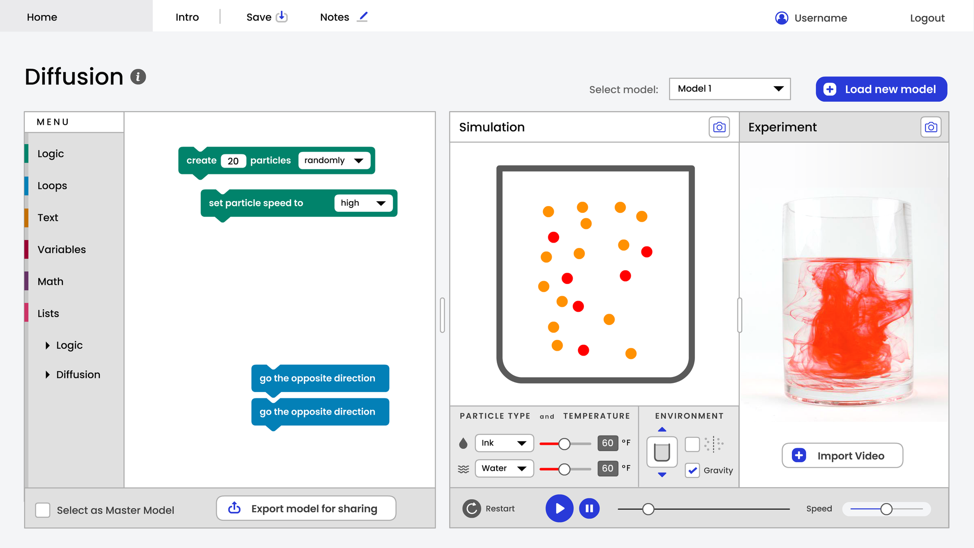
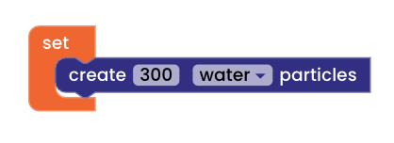
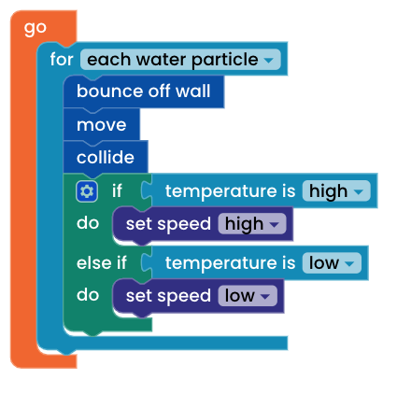
Design
Develop an environment for block-based computational modeling
Low threshold | High ceiling | Integrated with data | web based | block-based
Thematically linked curricular units
Enables moving through layers of computational complexity
Integrates computational modeling with data practices
View this at: https://a2s.fablevision-dev.com/#/

Slide 5
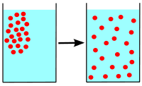
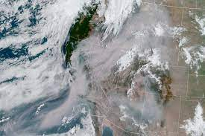
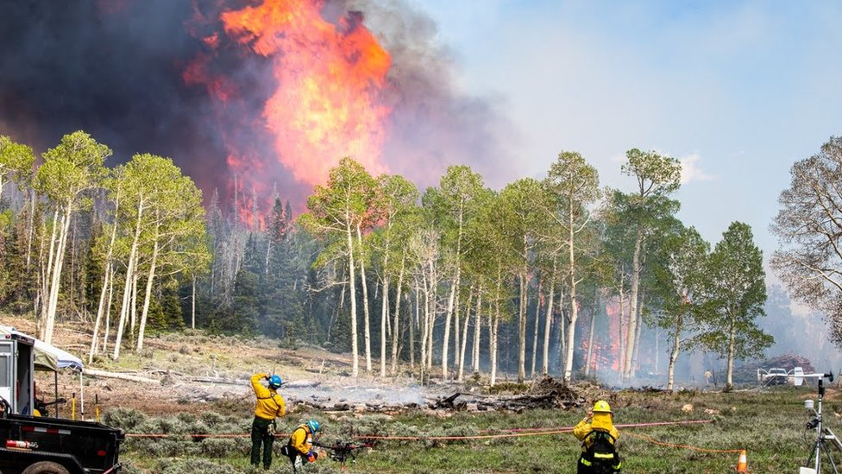
Design
Develop four curricular units linked by a conceptual theme or cross-cutting concept.
Thematically linked curricular units
Unit 1: How ink disperses in hot and cold water?
Enables moving through layers of computational complexity
Movement from high to low concentration
Unit 2: How wildfires and smoke spread?
Integrates computational modeling with data practices

Slide 6
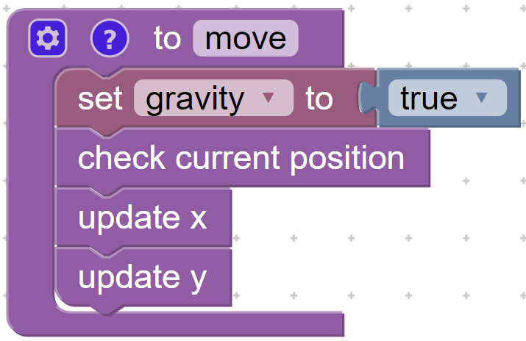
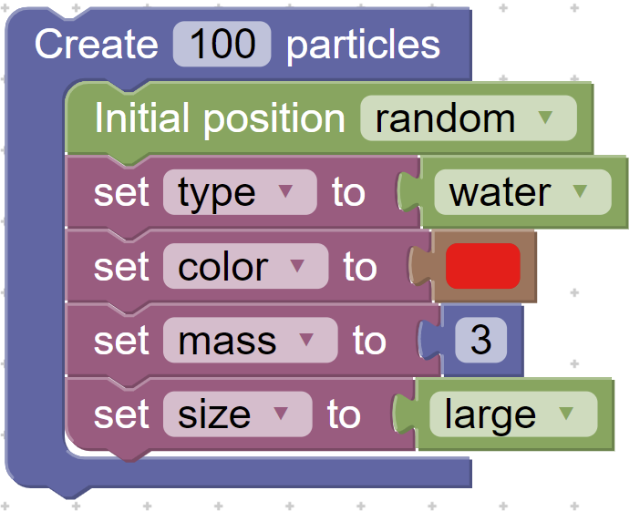
Design
Library contains: Unpackable blocks: Predefined domain-specific procedures
Thematically linked curricular units
Unpackable blocks can be:
Expanded to see definition & redefined
Enables moving through layers of computational complexity
Unpacked blocks: Smaller grain size that make up the unpackable blocks
Integrates computational modeling with data practices
Unpacked blocks can be:
Reused in other procedures & contexts

Slide 7
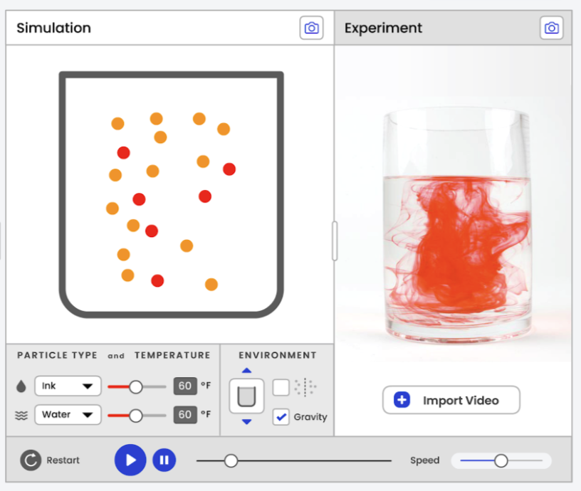
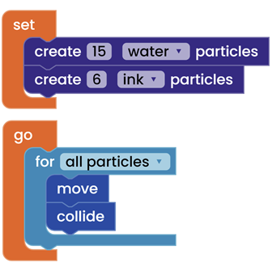
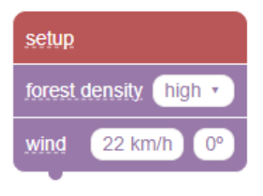
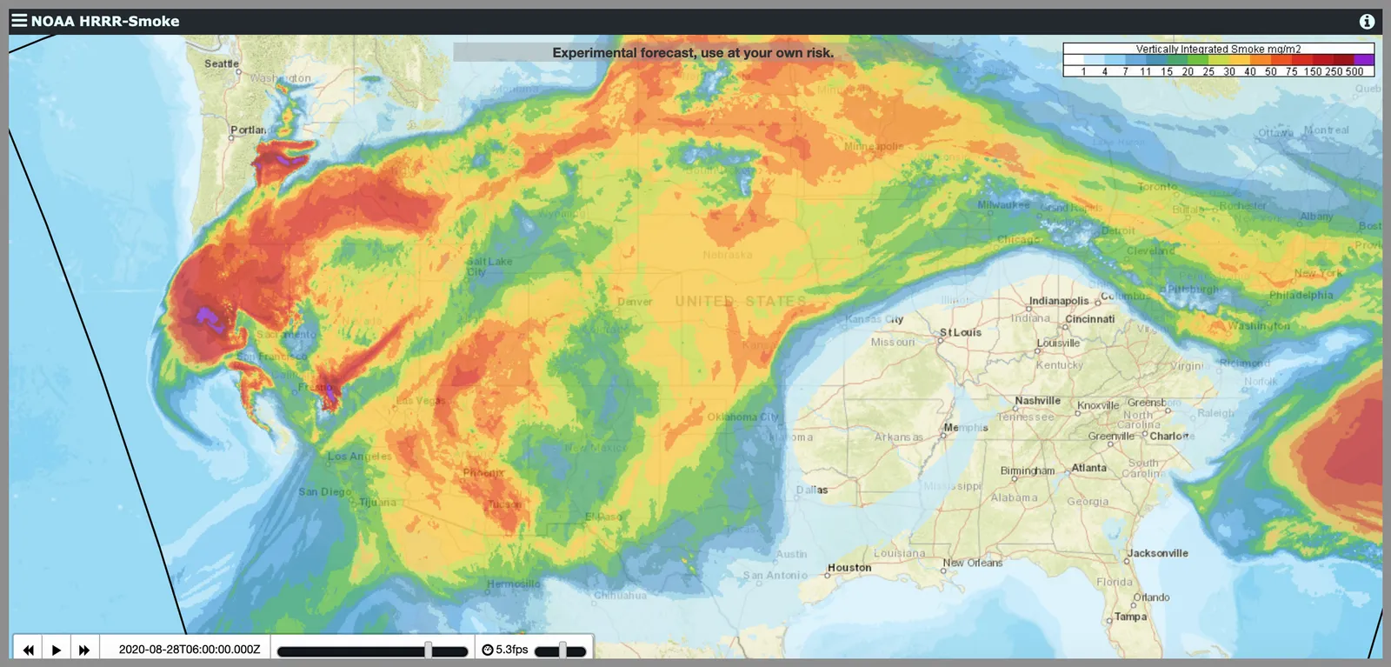
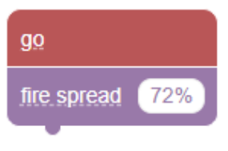
Design
Linking computational modeling with science experiments
Thematically linked curricular units
Students can compare and contrast video data from their experiment with the model
Enables moving through layers of computational complexity
Students can program a simulation to replicate an experiment
Linking computational modeling and complex data
Integrates computational modeling with data practices

Slide 8
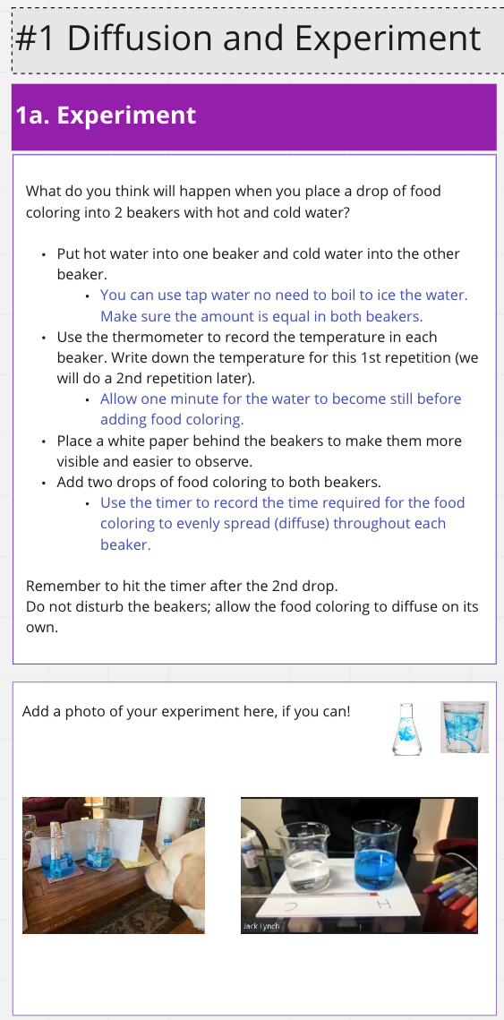
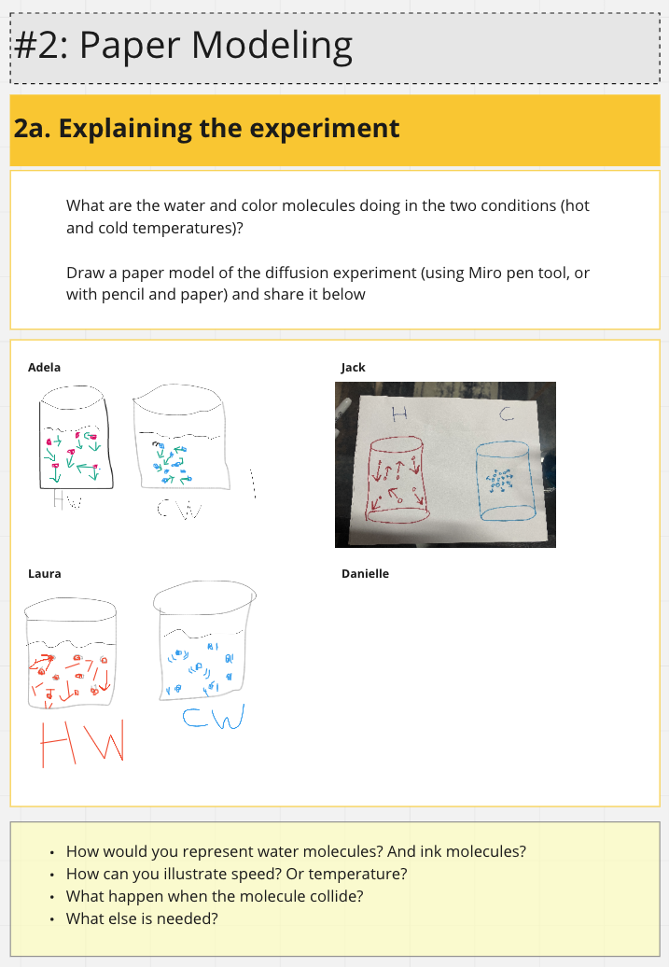
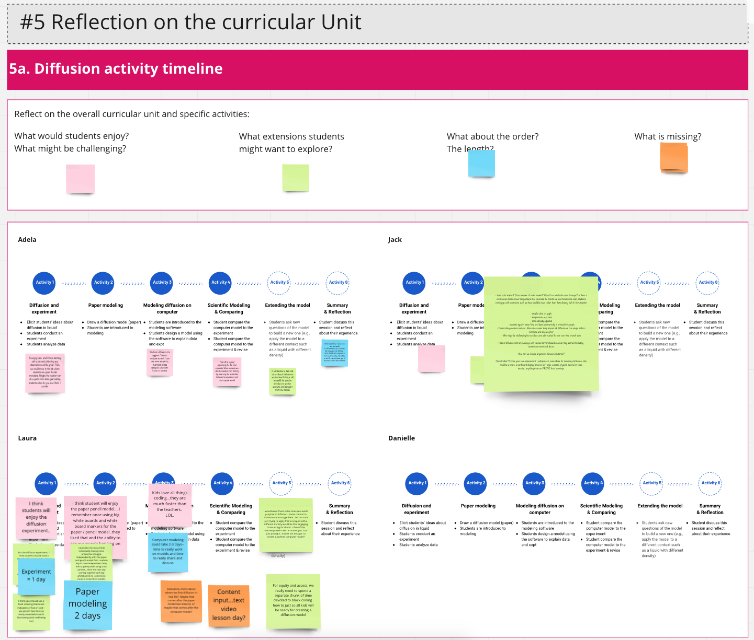
Co-design with four middle school science teachers
Teachers as students:
Enacting designed activities
Teachers as designers:
Revising designed activities

Slide 9
Next steps
Student testing: Pilot studies with students to test the environment and activities (Summer ‘21)
Teacher PD: 3-day long workshop with 6th & 7th four grade science teachers (Summer ‘21)
Monthly meetings through academic year
Questions? Comments? Please leave your thoughts or ask us anything here
Continued teacher co-design: To design units 3 & 4
Class implementations: Curricular implementations in 6th & 7th grade classrooms (Fall ‘21-Spring ‘22)

