Slide 1
Early Algebra: What is critical?
David Carraher (TERC)
Analúcia Schliemann (Tufts)
The Poincaré Institute for Mathematics Education
TERC-Tufts Early Algebra, Early Mathematics Project (earlyalgebra.org)
NSF Grants DUE-0962863, REC-0310171, REESE-0633915
Notes:
This is the mere outline of the presentation.
This powerpoint file contains the clips we will be discussing during the symposium.

Slide 2
Exclusive focus on Arithmetic leads to:
Equals sign as unidirectional operator.
Focus on particular answers (unknowns, not variables).
Inability to represent verbal statements as equations.
Manipulation of equations as procedural rules.

Slide 3
A Functions-Approach to Early Algebra:
Arithmetic as part of a broader field of studies – arithmetic operations as functions
Emphasis on variables and relations between sets of possible cases instead of isolated computation results.
Multiple representations: function tables, graphs, algebraic notation, verbal statements.
Gradual shift from semantics to syntax.

Slide 4
But, can young students truly (be expected to) understand
functions and variables
covariation
equations
graphs
algebraic notation?

Slide 5
In a nutshell
Not on their own, but yes, with certain varieties of instruction
Not unless we distinguish
minor topics and issues
major, overarching concepts such as functions.

Slide 6
“Not on their own”
Striking a balance between discovery and direct instruction, students’ representations and conventional representations
Students have intuitions, their own representations, and prior understanding that are critical
But students will not re-invent conventional representational systems (number systems, algebraic notation, number lines, graphs...)

Slide 7
The Cart and the Horse
In Mathematics, Axioms, definitions, precise formulations, and proofs often lead; insight and understanding follow.
In early and middle school Mathematics Education, axioms, definitions, and so forth always follow students’ own intuitions, interpretations, and representations

Slide 8
An Example from Research
Mathematical representations:
f(x) := x +8 g(x) := 3x
x + 8 = 3x

Slide 9
The Study
Longitudinal classroom intervention (grades 3 to 5) with follow up data collection (grades 7 and 8).
Two cohorts of 26 and 24 children in two classrooms. Comparison to control peers.
Boston Public School serving minority groups and immigrant families.
Regular curriculum plus early algebra activities for three hours per week.
Analysis of videotaped discussions and written assessment data.
Notes:
We’ll give some background about the students here.

Slide 10
The Wallet Problem Three lessons - beginning of 2nd semester in grade 4
Mike has $8 in his hand. The rest of his money is in his wallet.
Robin has exactly three times as much money as Mike has in his wallet.
What can you say about the amounts of money that Mike and Robin have?
Notes:
This is the task around which the session is structured.

Slide 11
Day 1
Students’ initial discussion and ‘spontaneous’ representations of the problem.
Notes:
Three
We’ll mention what was done on Day 1 of the lesson.

Slide 12
1-Mike
Notes:
Students try to express what they know about the amounts even though specific amounts are not given.

Slide 13
Day 3
Predicting graphs from tabular data
y-intercept
Rate of change, slope
Intersection of two graphs
Using the geometric information to draw inferences about the ‘stories’.
Notes:
“Robin’s line is steeper”.
The student uses:
For Robin: “times 3” (operation in the formula)
For Mike: the increments, “he just pluses one”.

Slide 14
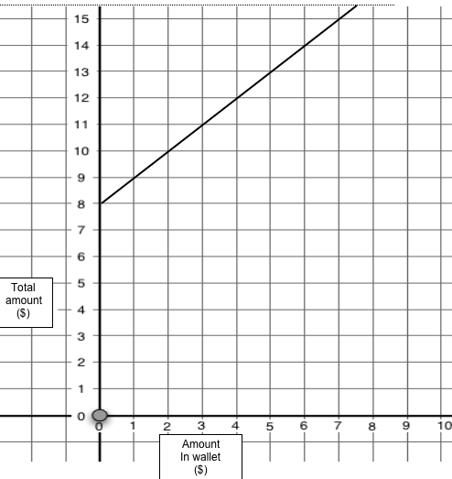
W + 8
3W

Slide 15
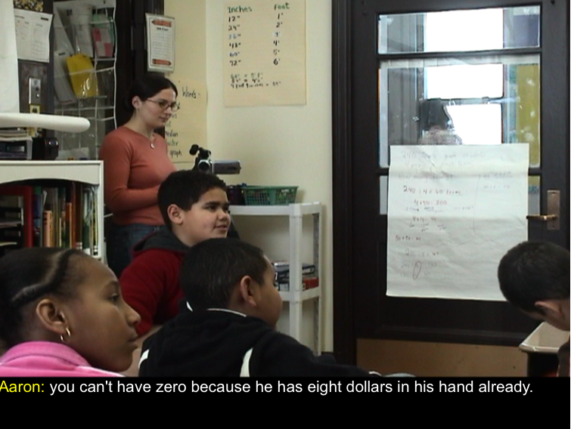

Slide 16
Evidence students worked with variables, relations and functions:
Amount in Mike’s wallet construed as a variable (not merely as isolated particular values).
They flexibly moved between graphical, tabular, and narrative accounts.
They organized the outcomes according to intervals of the independent variable. (‘up to $3.99, at $4.00, from $4.01 upward).
Explicitly referred to rates of change.

Slide 17
Three years later: Written Assessment Results in grades 7 and 8

Slide 18
Average percent of correct answers on items related to the 3rd to 5th grade intervention lessons (old items).

Slide 19
Average percent of correct answers on items related to the summer camp lessons (new items).

Slide 20
Results by the control and experimental groups on items related to summer camp lessons (new items), before and after participation in Summer Camp 2009.

Slide 21
What is critical?
Create situations in classrooms in which values are allowed to vary
Equations have variables, but we usually do not allow them to vary. I.e. we treat them as single-valued unknowns.
If we treat equations as the comparison of functions, letters stand for variables, not single-valued unknowns.

